Slide 1
A new Probabilistic Earthquake Hazard Model for Central Asian Countries
SFRARR Central Asia disaster risk assessment
16, September 2021
1

Slide 2
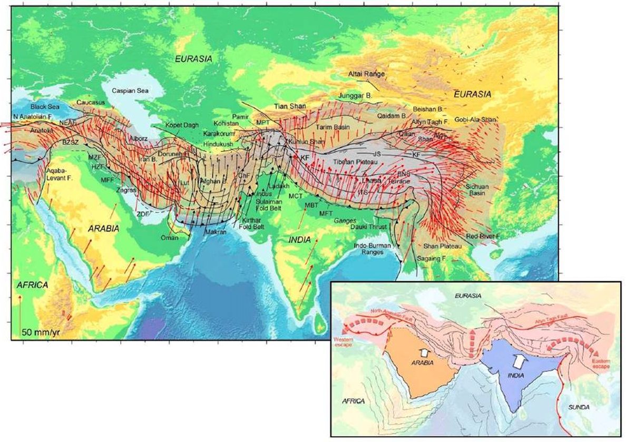
Seismotectonic Overview
Central Asia is an area characterized by complex tectonic and active deformation.
Large historical earthquake events (M>7) have occurred, mostly caused by thrust and reverse-faults generated by the collision of the Eurasian and Indian plates.
GPS-derived velocity maps from Hatzfeld and Molnar (2010)
This regime was responsible for the development of the Cenozoic belts of Tien Shan and Pamir, which are accommodating a great part of the regional deformation.

Slide 3
Motivation
For the purpose of developing a comprehensive risk model for Central Asia, a probabilistic seismic hazard assessment (PSHA) has been performed for the Central Asia countries (Kazakhstan, Kyrgyz Republic, Tajikistan, Turkmenistan, Uzbekistan).
The analysis was conducted using state-of-art methodologies and analysis tools, using the most complete and up to date information available for the territory, such as:
  Previous geological and seismological studies
  Global and local earthquake catalogues
  Active fault databases
  Ground motion recordings
The study took advantage from the collaboration and continuous interaction with the local experts of the consortium, that provided the necessary support in term of datasets, local knowledge and expertise.

Slide 4
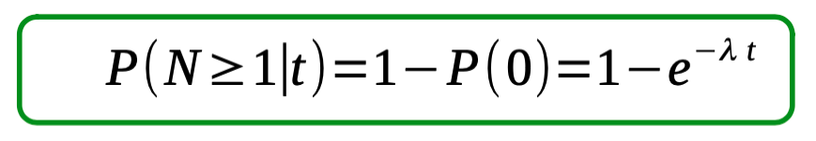
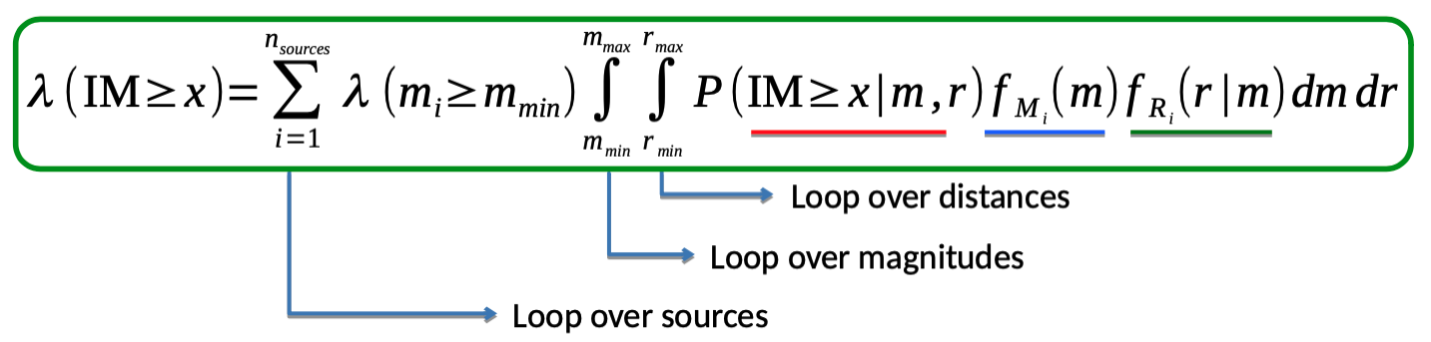
Probabilistic Seismic Hazard Assessment (PSHA)
In a nutshell
Where:
Seismic Sources
When (how often):
Recurrence Models
How (how strong):
Ground Motion Models
Poisson assumption
Hazard integral
Hazard curve

Slide 5
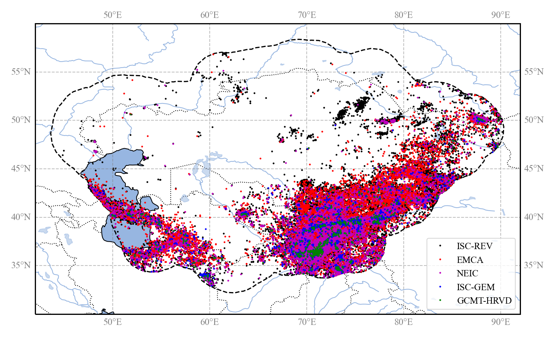
Harmonized Earthquake Catalogue
The creation of a state-of-art earthquake catalogue with homogenous magnitude (Mw) provides base information for the evaluation of the location, size, and occurrence of potentially damaging future earthquake events.
The Harmonized Earthquake Catalogue for Central Asia (HECCA) is obtained by combination of:
publicly available global earthquake information (e.g., ISC-Reviewed, ISC-GEM, GCMT, NEIC compilations)
information from past regional projects (e.g., EMCA)
data from agencies and scientific institutions of the project state members

Slide 6
Assembling Workflow
Merge Sources
Global / Regional Datasets
Source | N. of Events | Mag. Range | Mag. Type | Year Range | Depth Range
ISC-GEM | 1525 | 4.96 - 8.02 | Mw | 1906 - 2016 | 5.0 - 274.1
ISV-Rev | 51093 | 2.0 - 8.4 | Various types | 1906 - 2018 | 0.0 - 441.4
GCMT | 814 | 4.64 - 7.61 | Mw | 1976 - 2017 | 2.7 - 400.6
USGS-NEIC | 15804 | 2.9 - 7.8 | Mw, Ms, mb | 1902 - 2020 | 0.0 - 400.57
GEM-GEHC | 24 | 7.0 - 8.3 | Mw, Ms | 1052 - 1902 | 20.0 - 200.0
EMCA – Hist. | 173 | 3.5 - 8.3 | Mlh | -2000 - 1898 | 3.0 - 180.0
EMCA – Inst. | 30700 | 2.0 - 8.2 | Mlh | 1901 - 2009 | 0.0 - 404.0
Duplicate Finding
Priority Rules
Solution Selection
Conversion Relations
Local Datasets
Source | N. of Events | Mag. Range | Mag. Type | Year Range | Depth Range
Kazakhstan | 30930 | 2.1 - 8.3 (Ms) | Kp, Mlh, Ms | -250 - 2020 | 0 - 210
Kyrgyzstan | 34434 | 2.2 - 7.7 (Ms) | Kr, Mlh, Ms | -250 - 2020 | 0 - 99
Tajikistan | 66602 | 4.0 – 16.5 (Kr) | Kr | 1962-1991 | 0 - 350
Uzbekistan | 1837 | 3.5 – 9.2 (Mlh) | Kr, Mlh | 1955-2020 | 0 - 35
Turkmenistan | 4928 | 8.6 – 14 (Kp) | Kp, Mpv | 1997-2008 | 0 - 63
Magnitude Homogenisation
Harmonized Catalogue

Slide 7
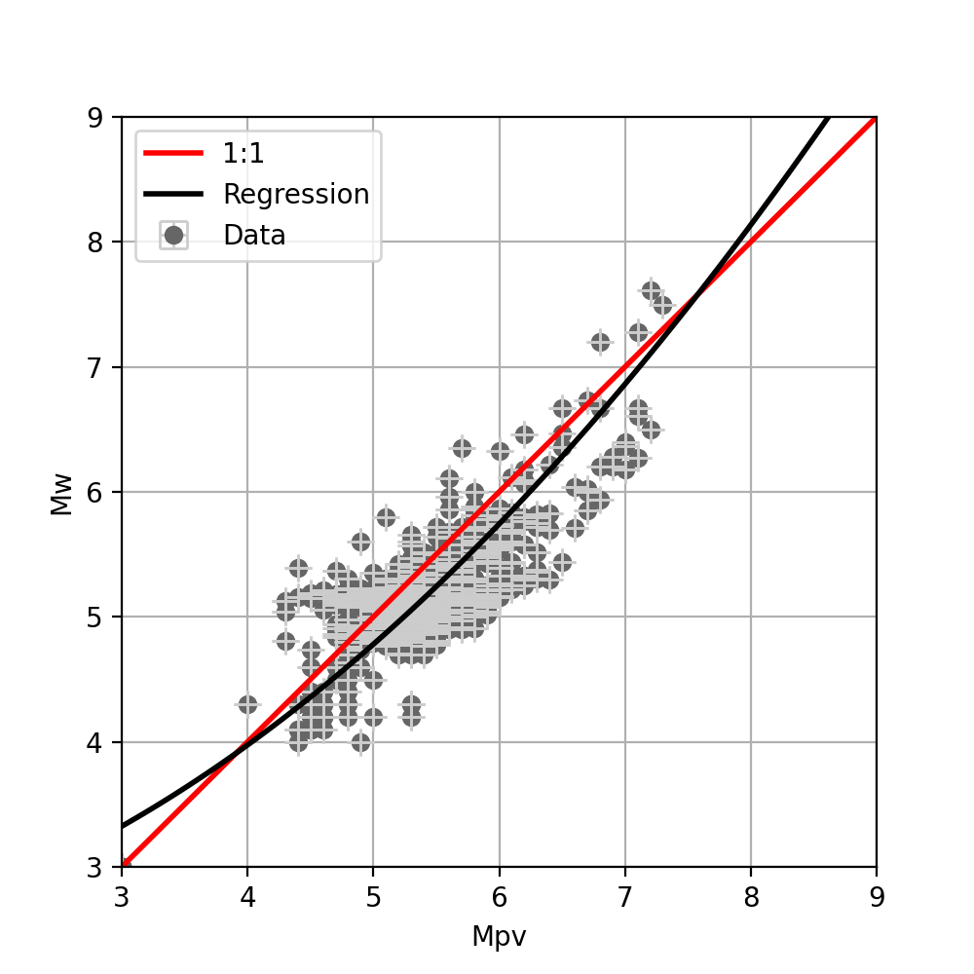
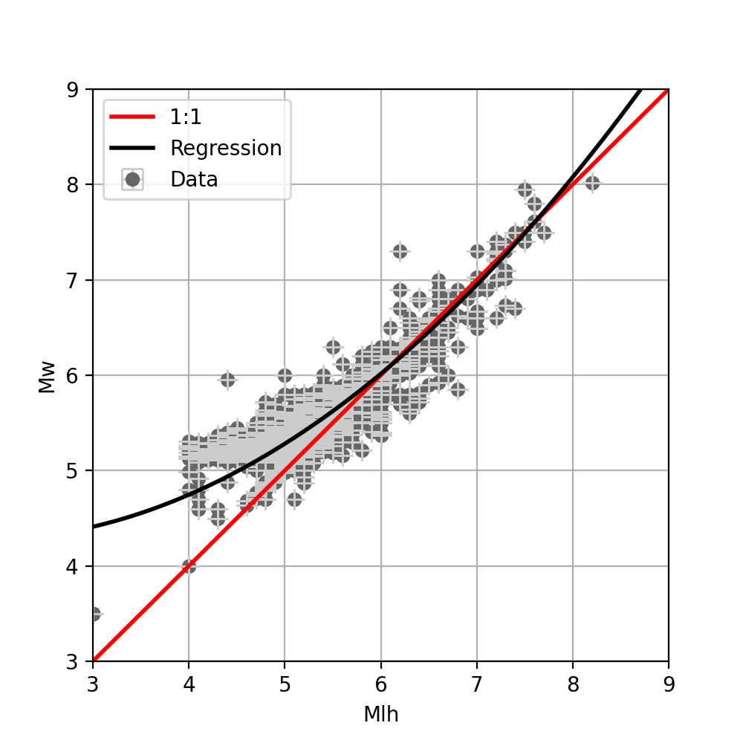
Magnitude Conversion
All events with different magnitude types must be converted to a reference scale (Mw), using:
globally calibrated magnitude conversion relations for the most common magnitude scales (Ms, mb, Ml)
ad-hoc relations have been developed using an orthogonal regression approach to convert specific scales (Mpv and Mlh) to Mw
Type | Conversion Rule
Mw | 1:1
Mlh | 4.594 - 0.359M + 0.099M² (this study)
Ms | Di Giacomo et al. (2015) – Exponential
Mpv | 2.311 + 0.104M + 0.078 M² (this study)
mb | Weatherill et al. (2016) – Linear (NEIC calibration)
ml | Edwards et al. (2010) - Polynomial
Md and other types | 1:1
Kr (energy magnitude) | Bindi et al. (2011)

Slide 8
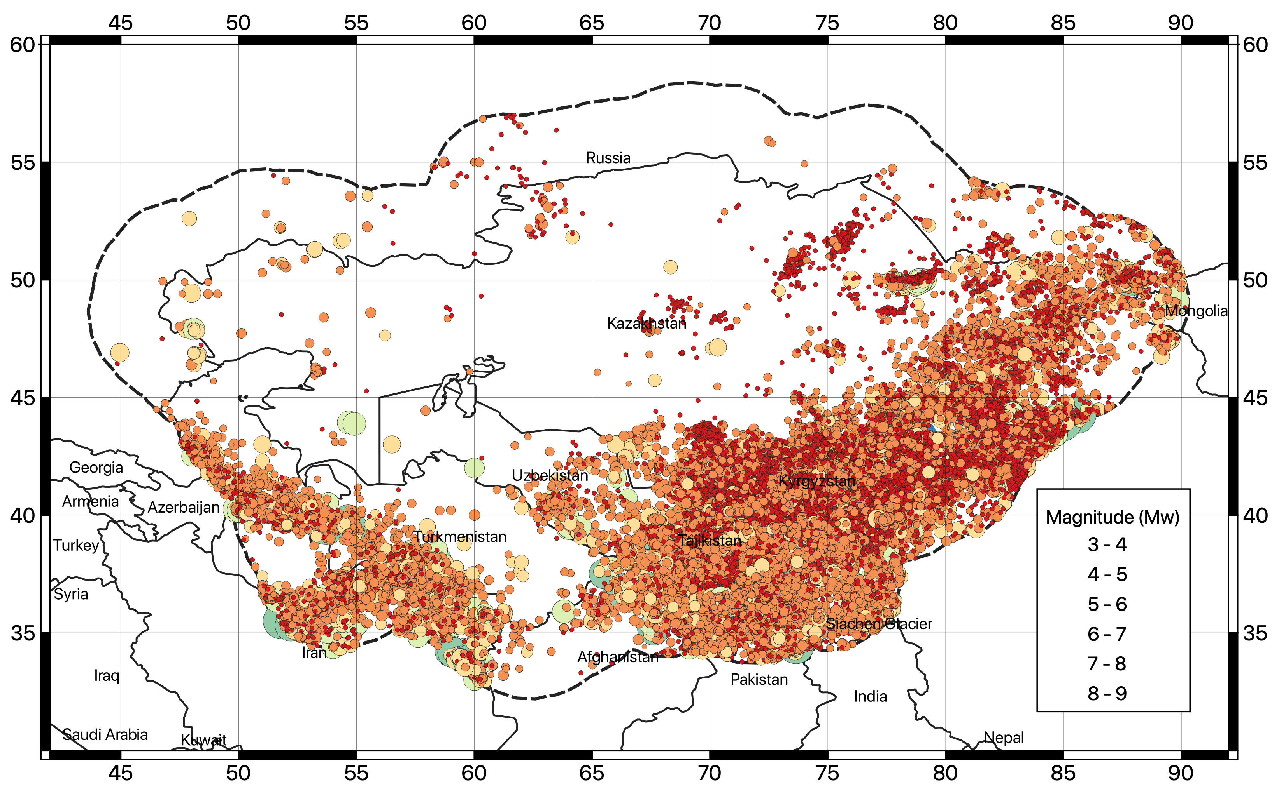
The Final Harmonized Catalogue for Central Asia
The harmonized backbone catalogue for Central Asia presently consists of 77376 events up to 2020 and in the range 3.0<Mw<8.5, although minimum regional completeness is found of about Mw 4 to 4.5.
Geographical distribution of earthquake hypocentres (Mw>3) of the newly developed Mw Harmonized Catalogue for Central Asia (HECCA)

Slide 9
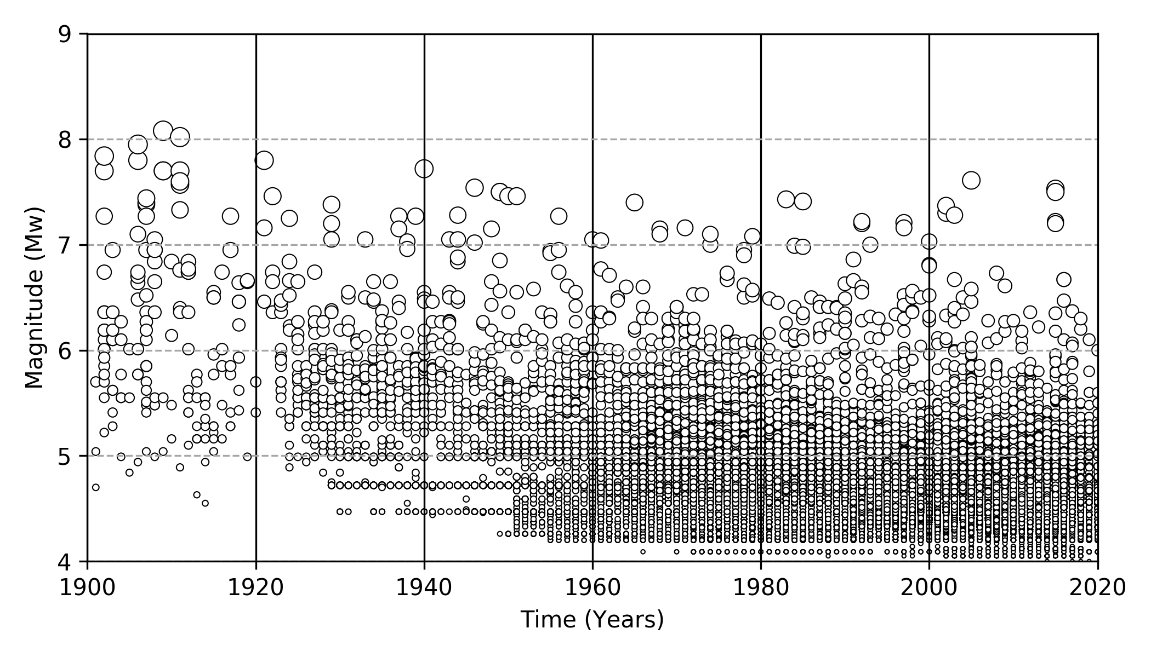
The Final Harmonized Catalogue for Central Asia
The historical period (before 1900) is covered mostly by the EMCA catalogue, while the instrumental period has been deeply revised in this study and extended by (i) the inclusion of new homogenous location solutions from global datasets, (ii) additional magnitude conversion relations and (iii) recent events (e.g., after 2009) from regional datasets.
Time-magnitude distribution of the earthquake events of the HECCA catalogue in the instrumental period (after 1900).

Slide 10
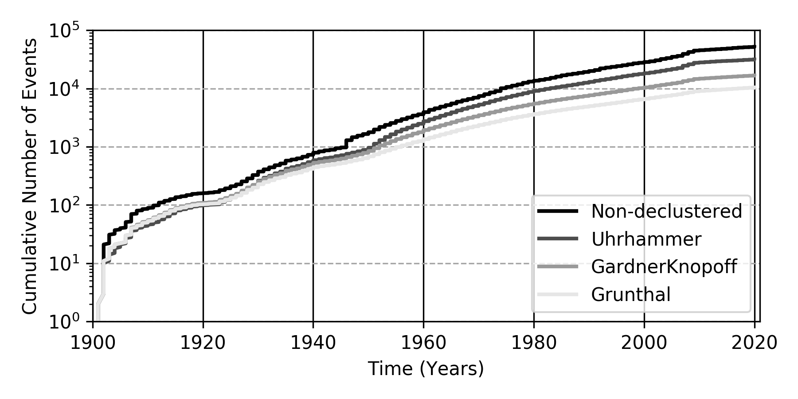
Removal of Dependent Events
Probabilistic seismic hazard analysis assumes that earthquake occurrences are independent and that their probability distribution is that of a Poisson process.
To fulfil the assumption, naturally correlated events (foreshocks, aftershocks) must be removed by applying a declustering procedure based on time-distance window matching.
 | All events | 3<Mw<4 | 4<Mw<5 | 5<Mw<6 | 6<Mw<7 | 7<Mw<8
Before declustering | 77376 | 25178 | 47599 | 4060 | 444 | 91
GardnerKnopoff | 24373 | 7398 | 14878 | 1774 | 248 | 71
Uhrhammer | 49018 | 17191 | 29146 | 2337 | 272 | 68
Grunthal | 14283 | 3654 | 8788 | 1539 | 228 | 70
Cumulative number of events over time using the three considered declustering algorithms.

Slide 11
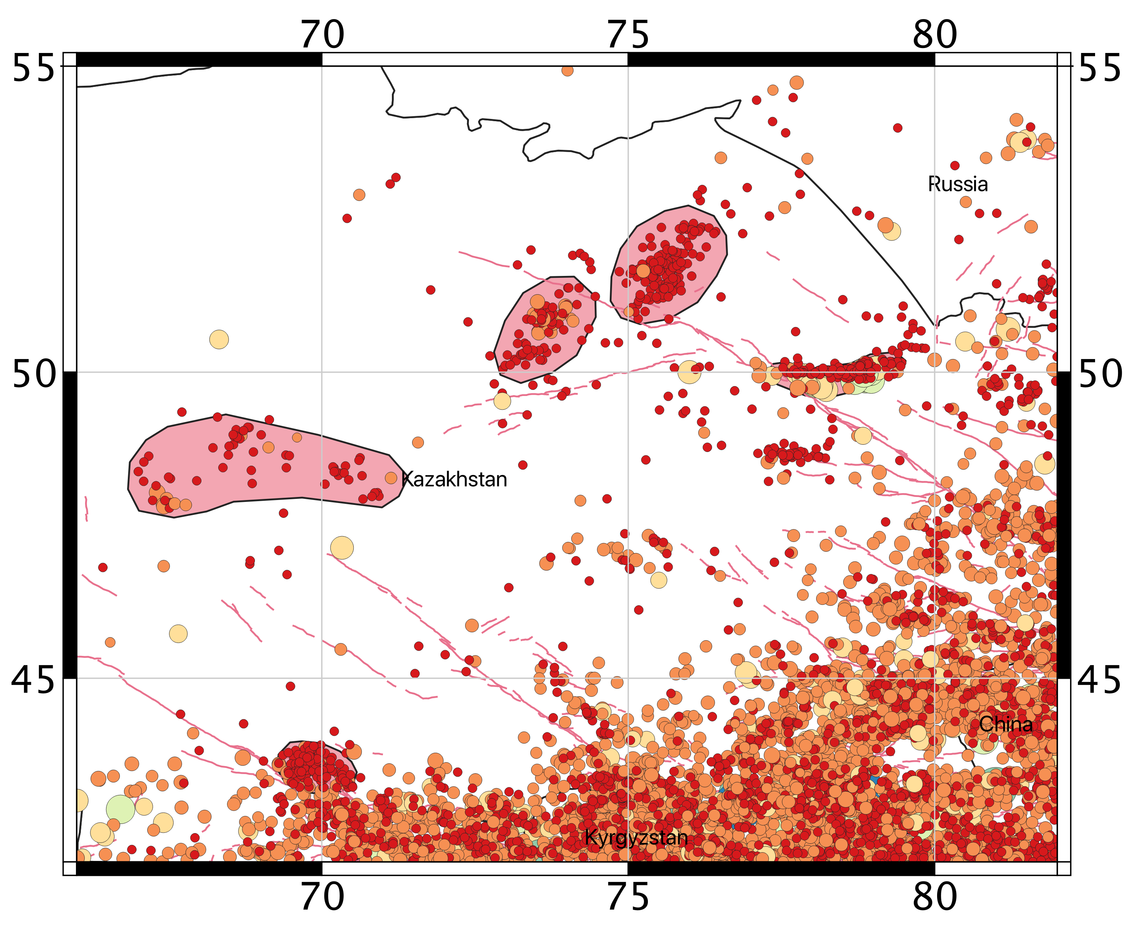
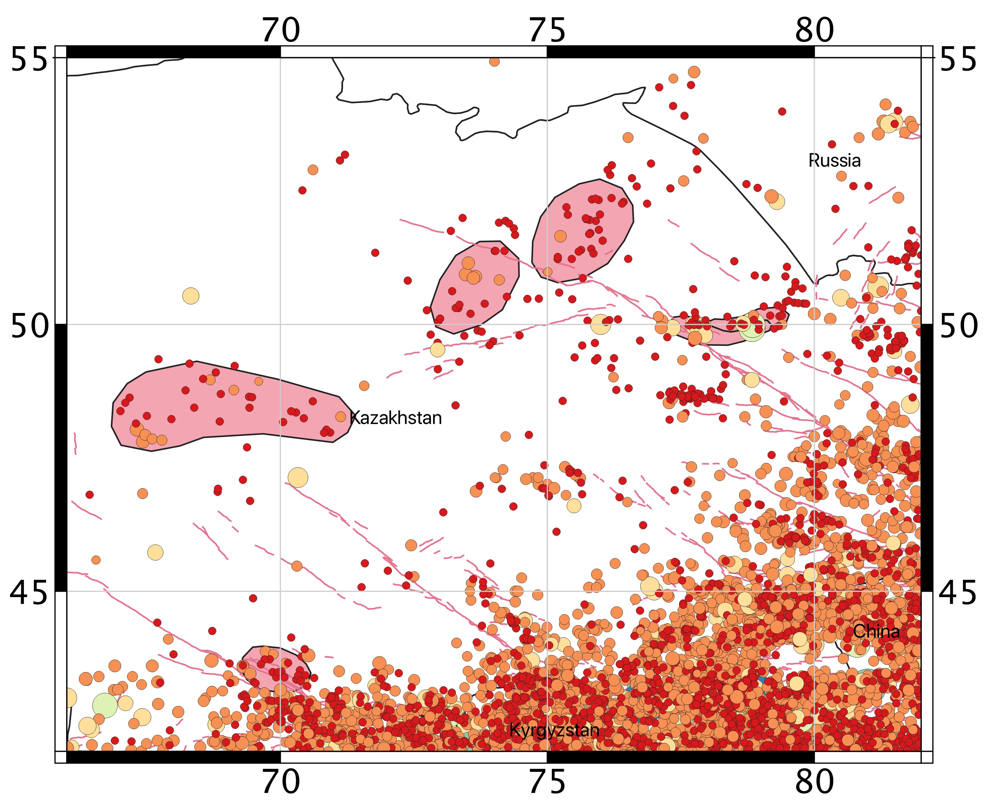
Removal of Anthropogenic Events
Man-made events (from geothermal exploitation, blasts, mining explosions) must also be purged from the earthquake record.
A modification of the declustering algorithm is used: starting from a Gardner and Knopoff (1974) window, a variable scaling factor is then applied till an optimal trade-off between purged event and residual seismicity (the regional background) is found.

Slide 12
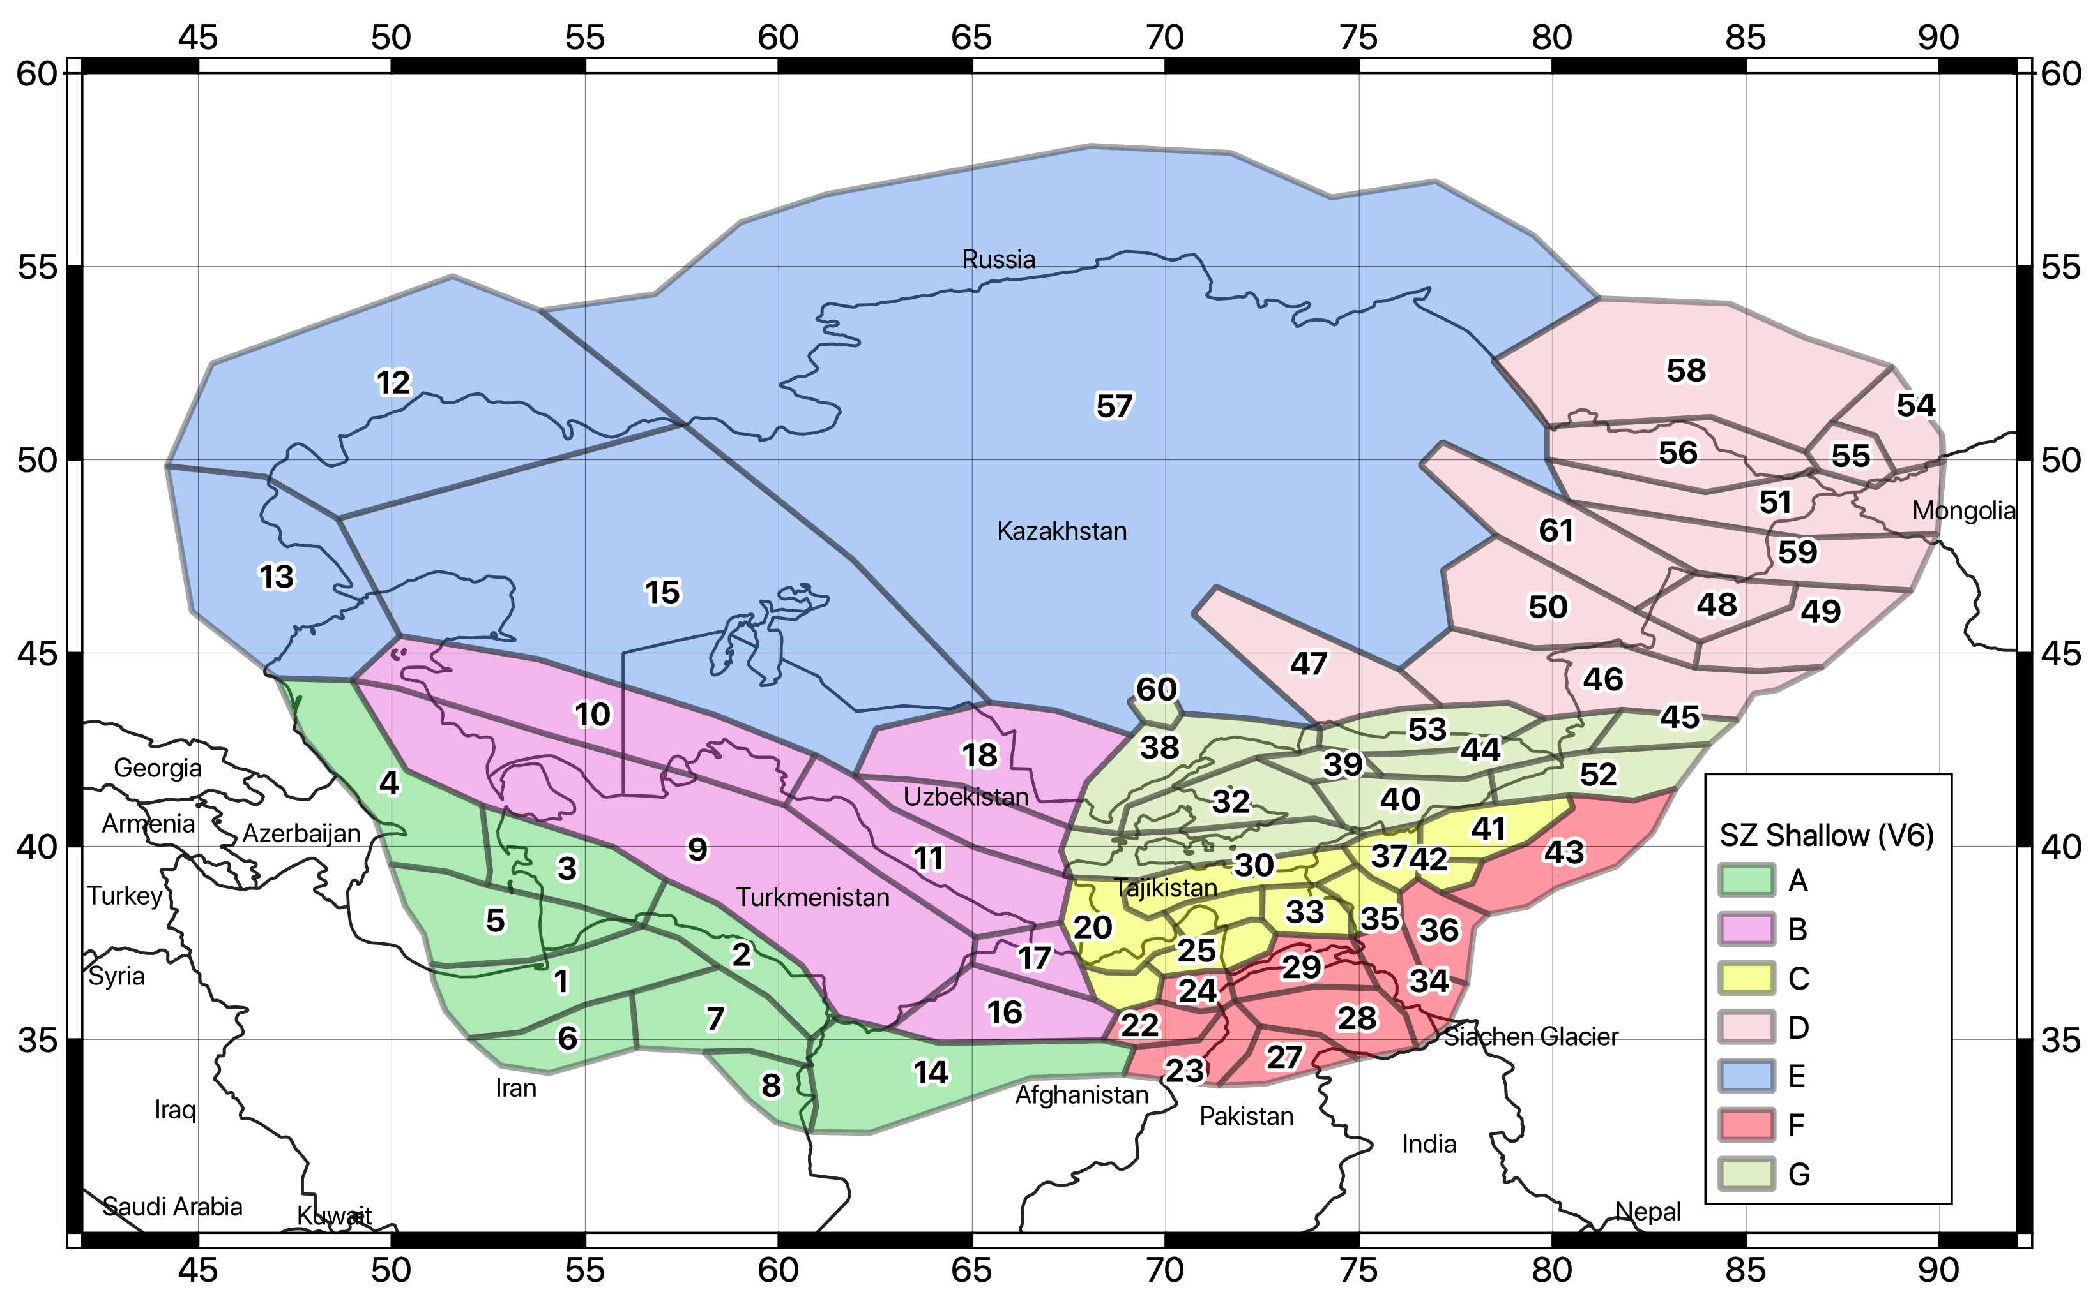
The Homogenous Area Source Model
In homogenous area source zonation, observed seismicity is assumed to have equal probability to occur anywhere within the area. Zones are defined on the base of the observed seismicity and the available geological and seismotectonic information for the area.
The shallow seismicity model was developed in collaboration with local partners and it represents earthquake sources within 50 km depth.
Its consists of 61 homogenous source zones, grouped into 7 main tectonic groups (A to G).

Slide 13
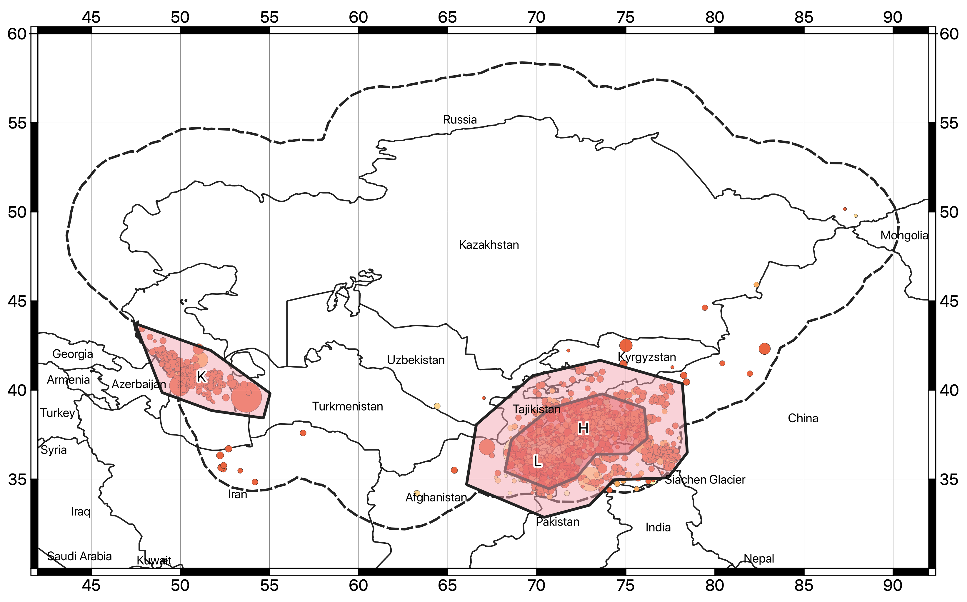
Deep Source Model
A significant fraction of earthquakes is located at depth below 40-50km, considered the lowermost thickness of the continental (brittle) crust for the area.
Two intermediate-depth (H and K) and one deep (L) source zones have been implemented separately, to represent the seismogenic range 50-150km and 150-400km.

Slide 14
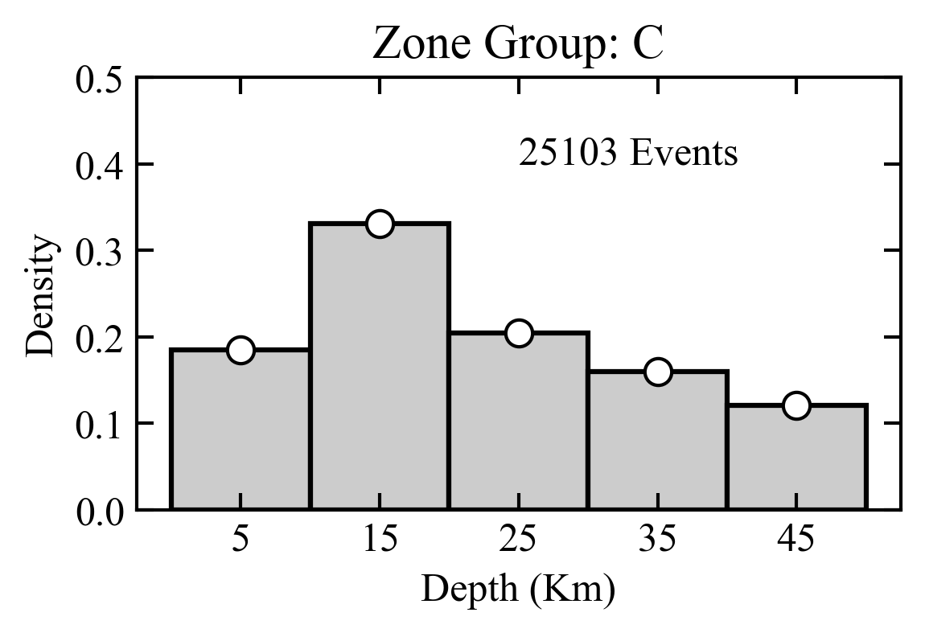
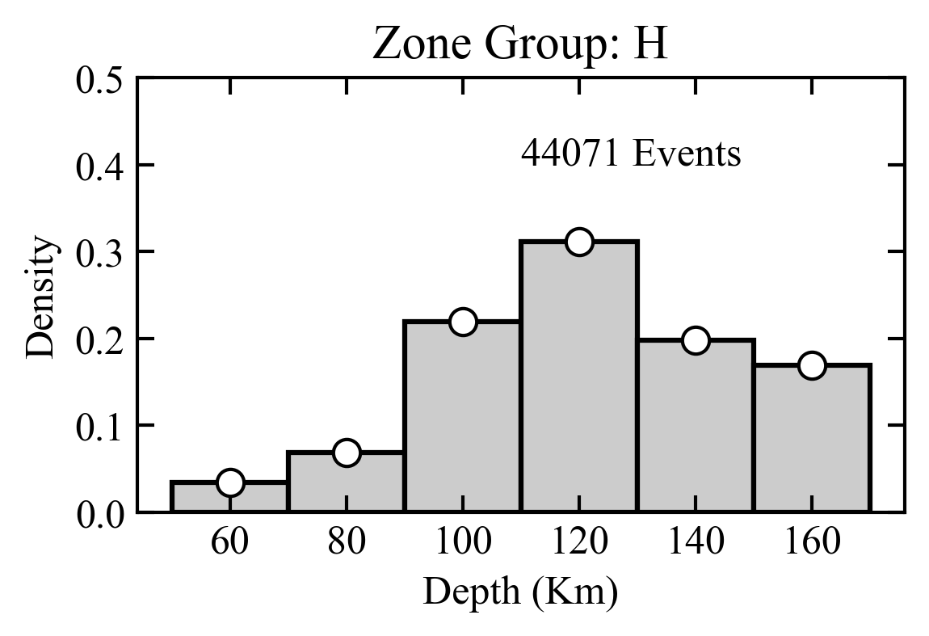
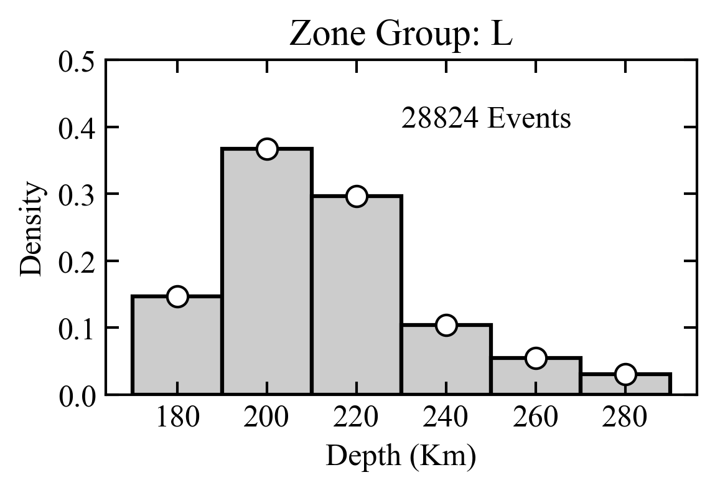
Hypocentral Depth Distribution
A depth probability density distribution was estimated for the different source groups from the analysis of the harmonized earthquake catalogue. Events with unknown depth were excluded from the analysis, as well as events with typical fixed depth solution (e.g., 0, 5, 10, 33 km etc.)
Shallow depth source
Intermediate depth sources
Deep sources
Increasing hypocentral depth

Slide 15
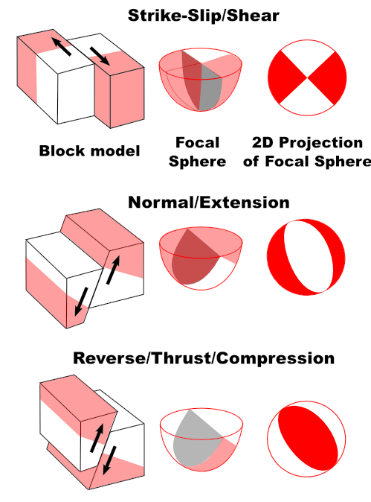
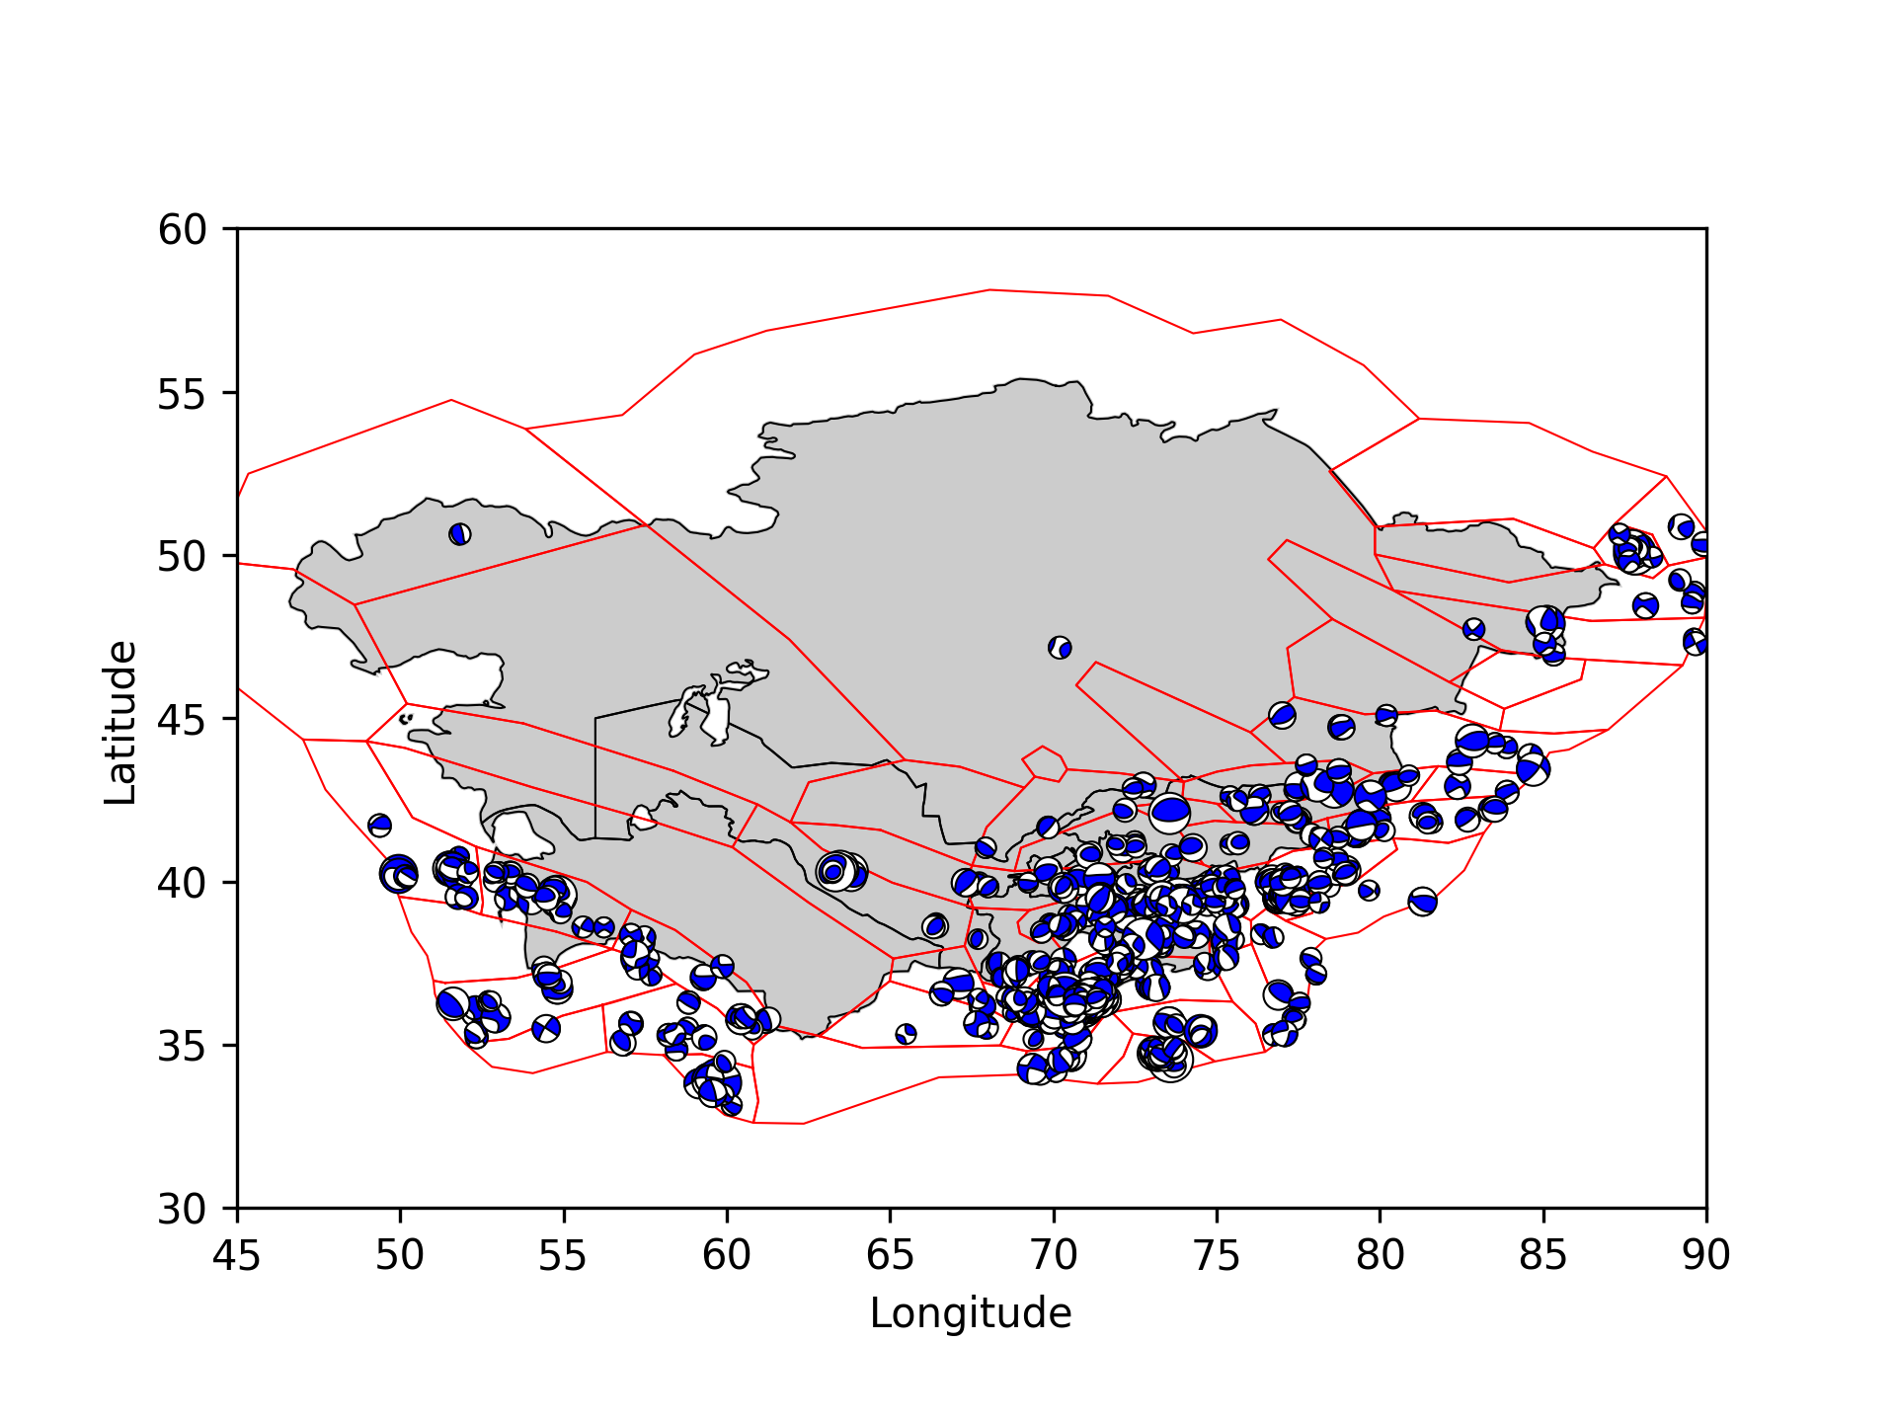
Rupture Mechanism Definition
The available information from mapped surface faults and moment tensor solutions from the GCMT bulletin were used to define the dominant rupture mechanism of each zone.
For the study region, 814 focal mechanisms are available for events in the range 4.64 < Mw < 7.61

Slide 16
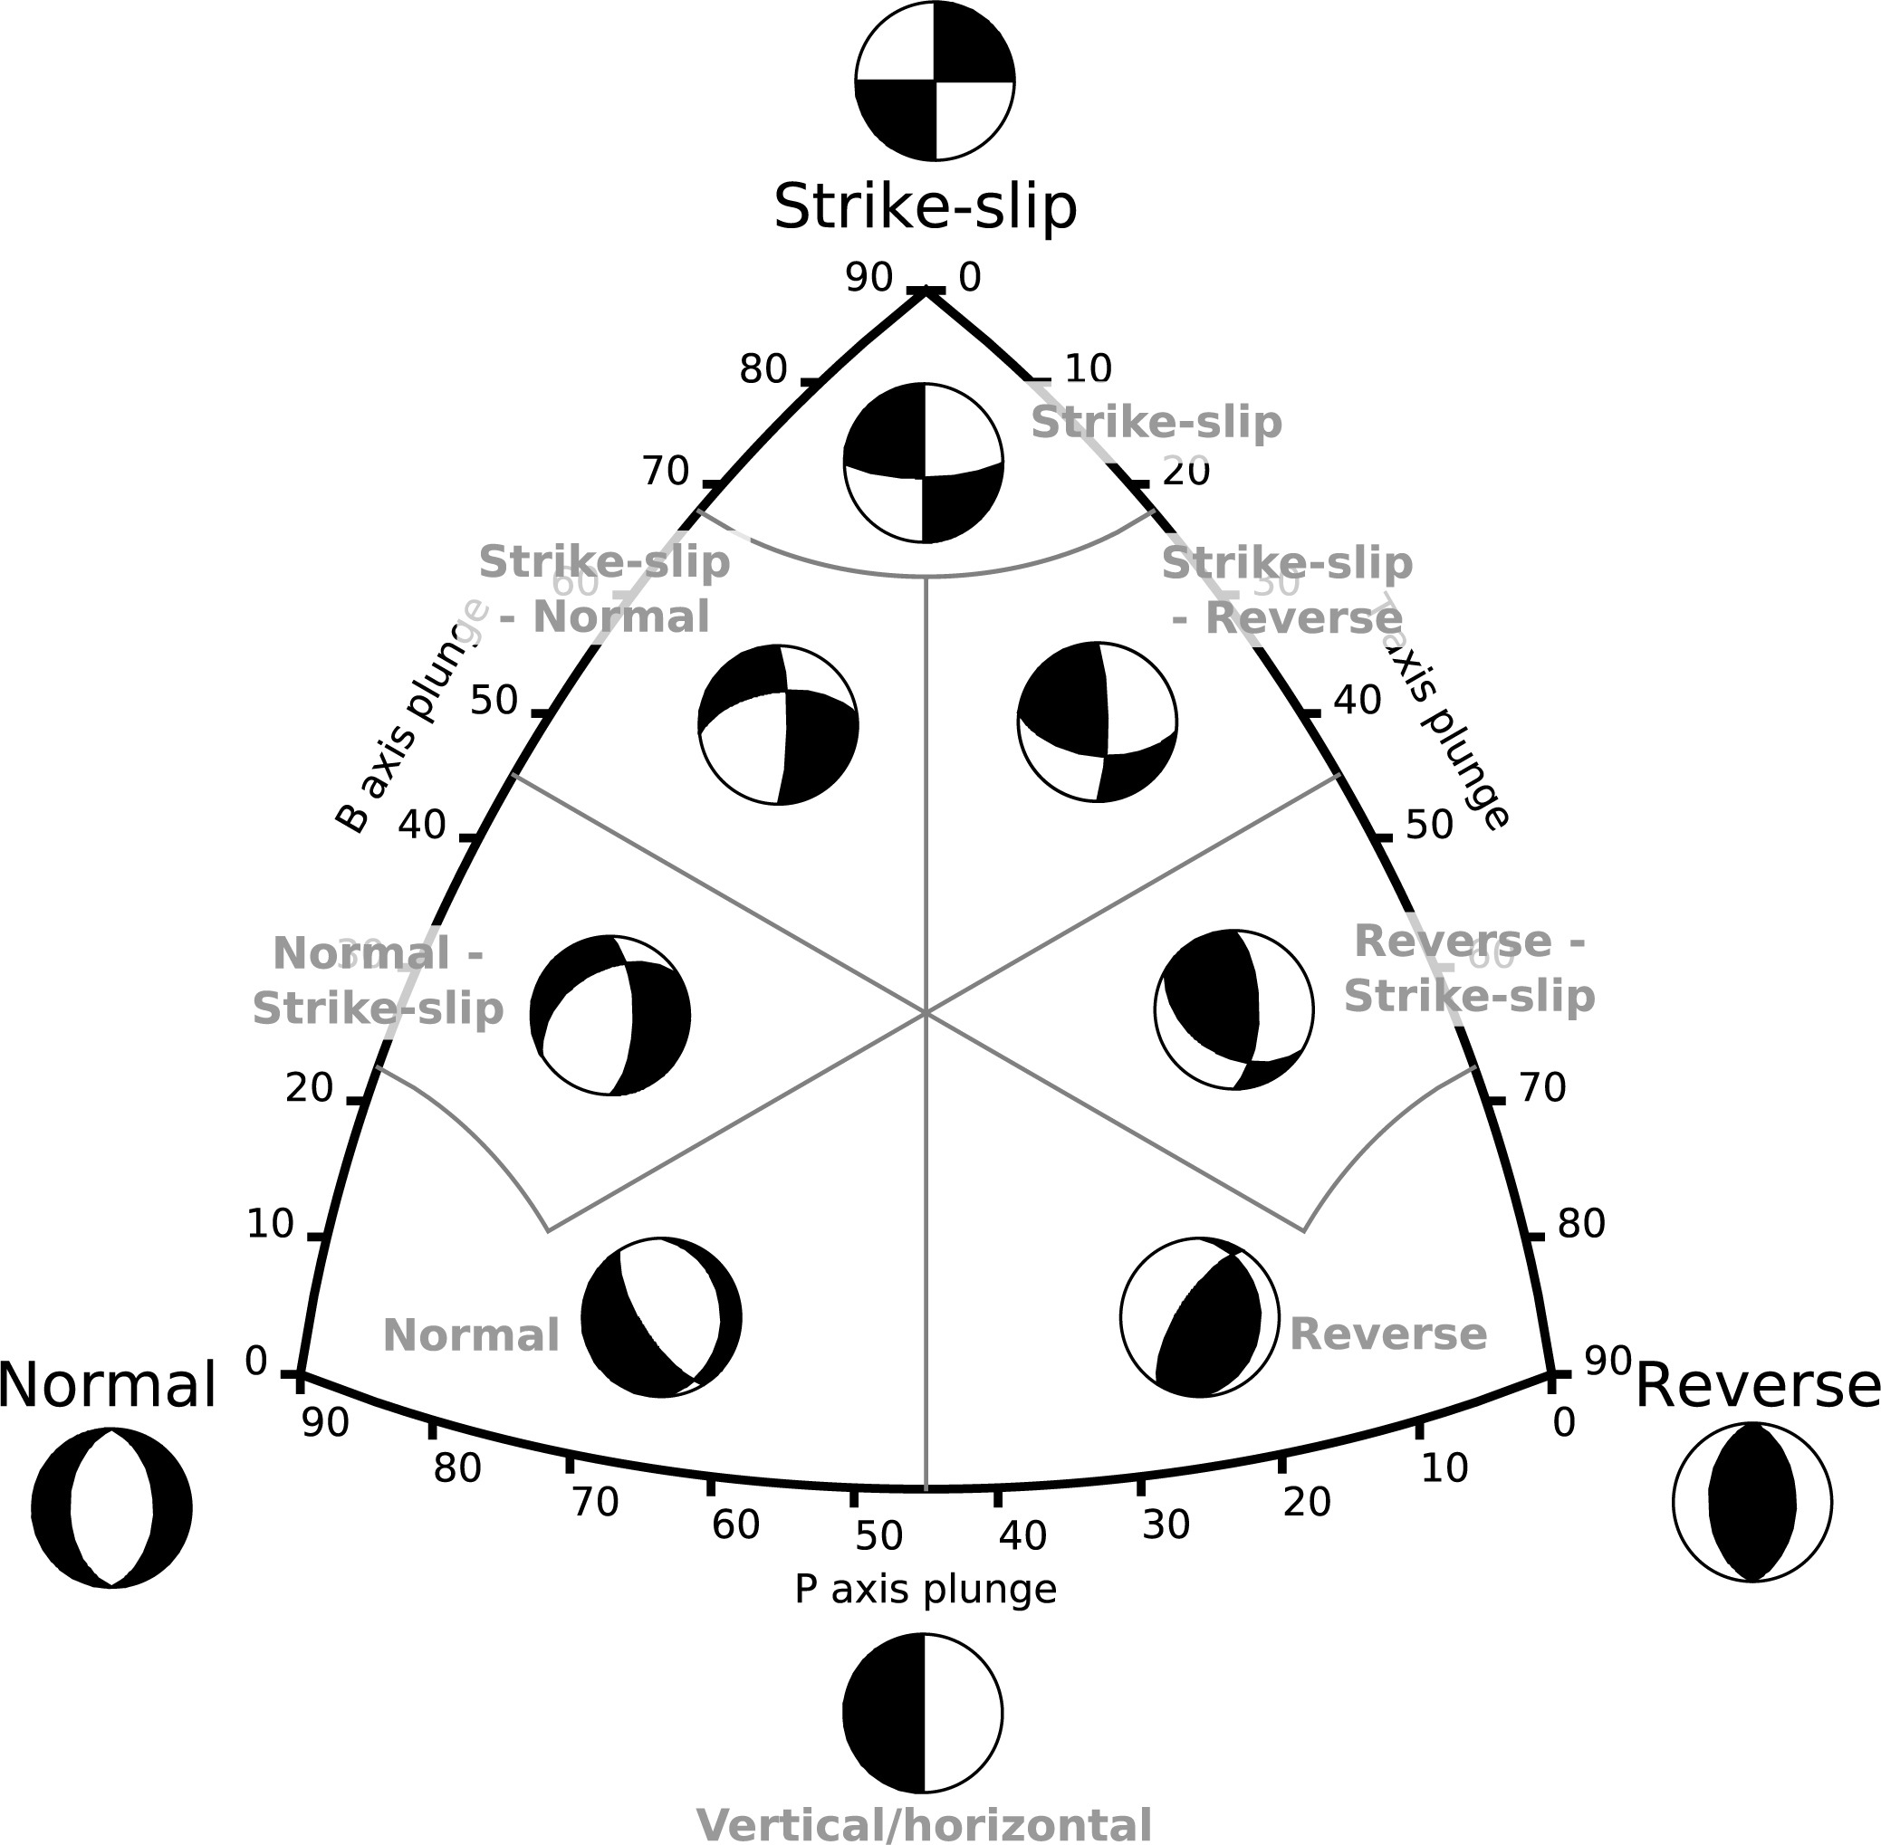
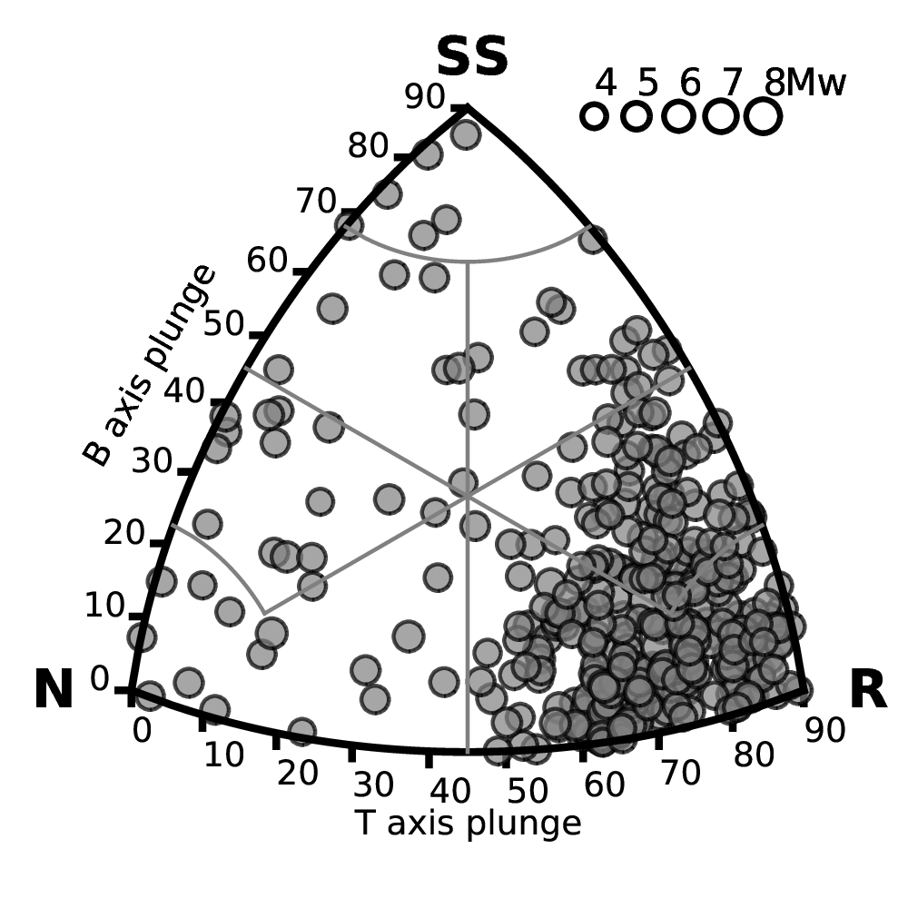
Rupture Mechanism Definition
Geometrical parameters (strike and dip orientation) of the different source zones were characterized by analysing the geometry of the focal mechanism using the “beachball” representation, while dominant faulting style was accessed by inspecting the distribution of the B-T axis orientations using Kaverina et al. (1996) classification diagrams.
FMC code of Álvarez-Gómez (2019)

Slide 17
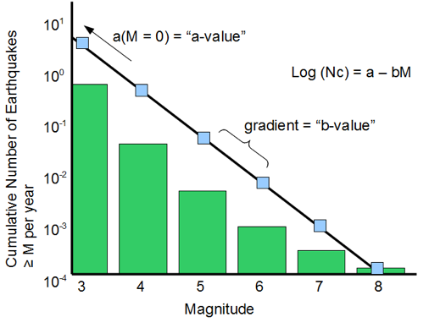
Magnitude Frequency Distribution
The temporal occurrence of the seismic events was assumed to follow a truncated Gutenberg-Richter (GR) model.
a- and b-value were estimated for each tectonic group and source zone by fitting observed annual rates from the declustered earthquake catalogue using a linear least-square approach on incremental (non-cumulative) magnitude bins
M_{max}

Slide 18
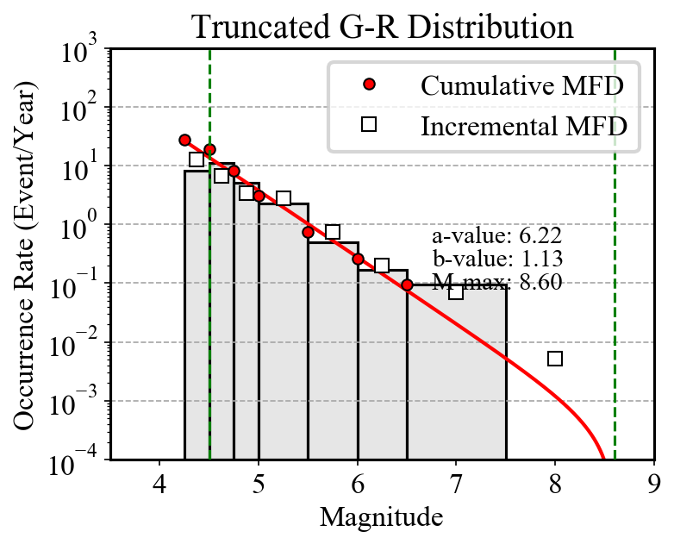
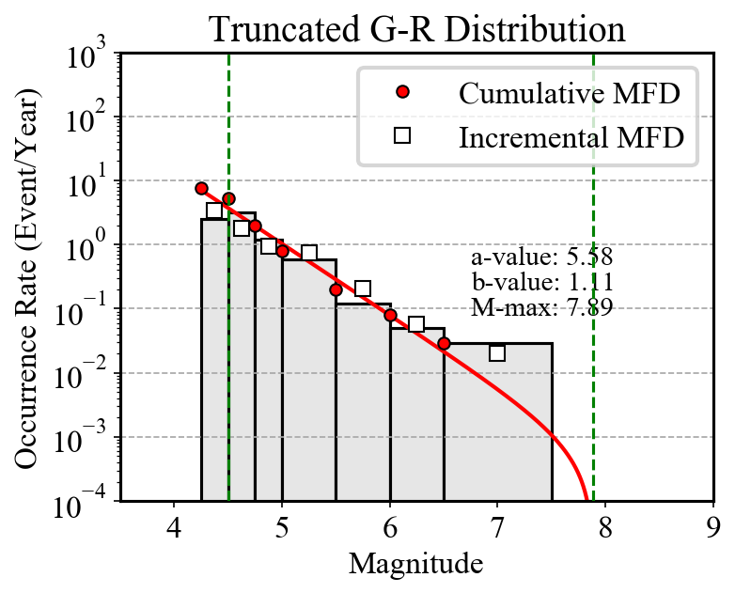
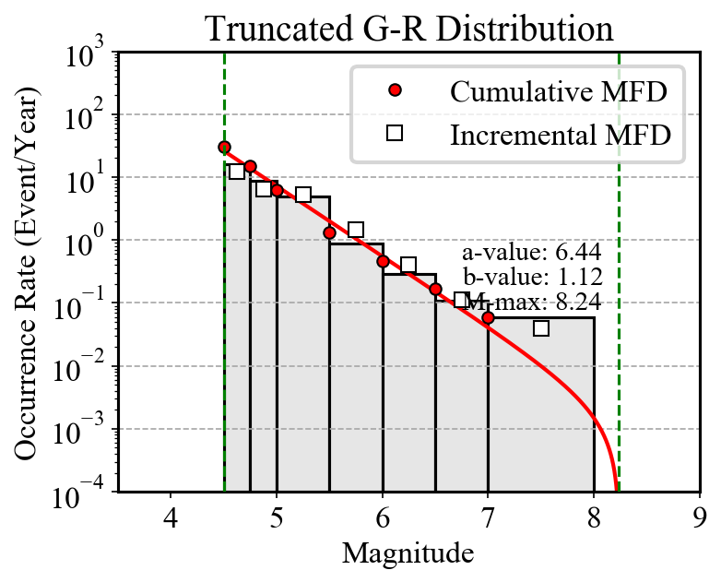
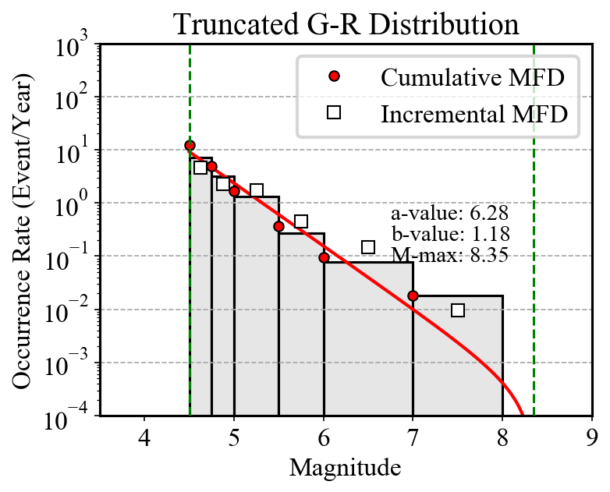
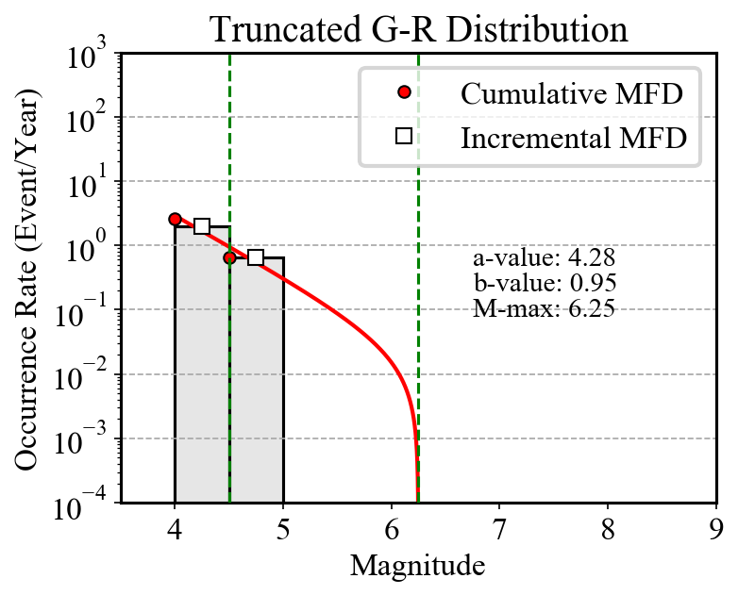
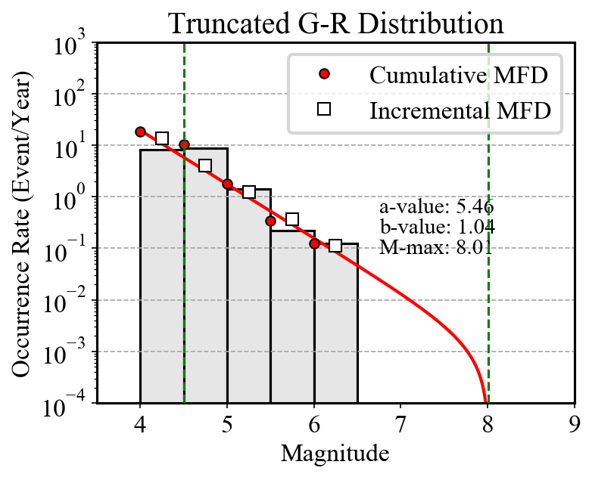
Magnitude Frequency Distribution
Group A
Group B
Group C
Group D
Group E
Group F

Slide 19
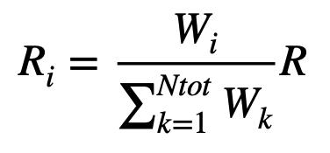
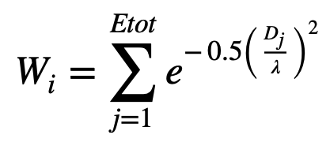
Smoothed Seismicity Model
The homogenous area source zonation approach may not be appropriate for regions where seismicity is known to be well localized along main tectonic structures and specific crustal domains.
To overcome this limitation, a variant of the smoothing procedure proposed by Poggi et al. (2020) is used, which has the significant advantage of preserving the overall rate balance of each discrete zone.
In this approach, total occurrence rates (R=10ª) are redistributed on a uniform grid (i) by weighting the relative distance (D) of the grid cell to the surrounding earthquake events (j).

Slide 20
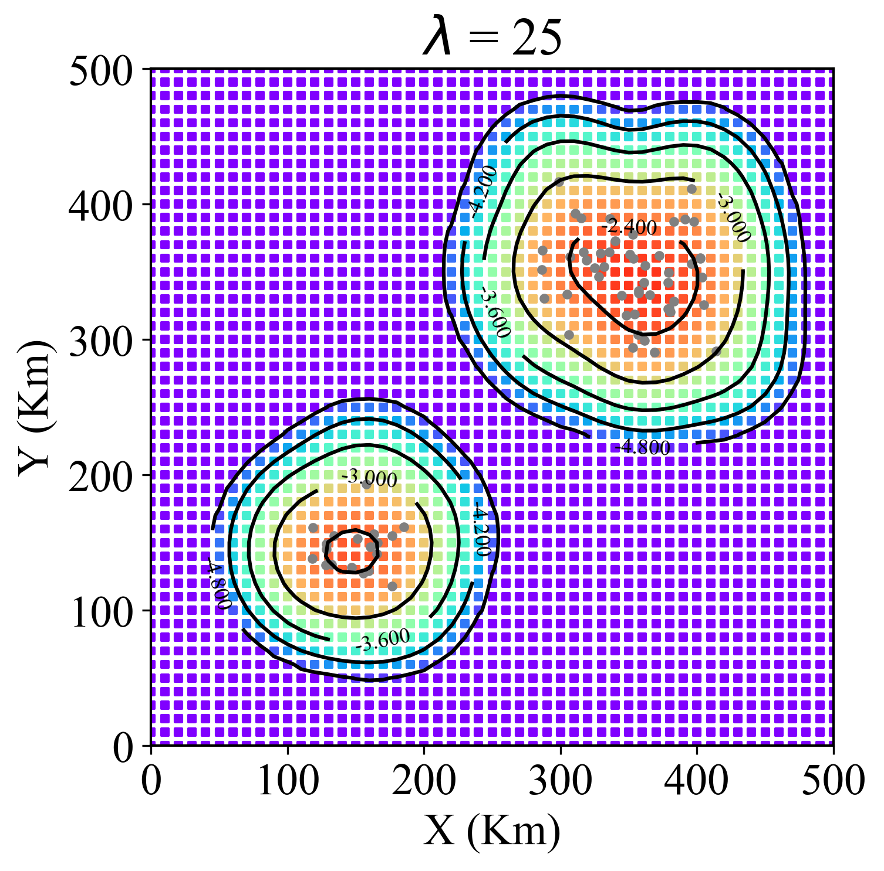
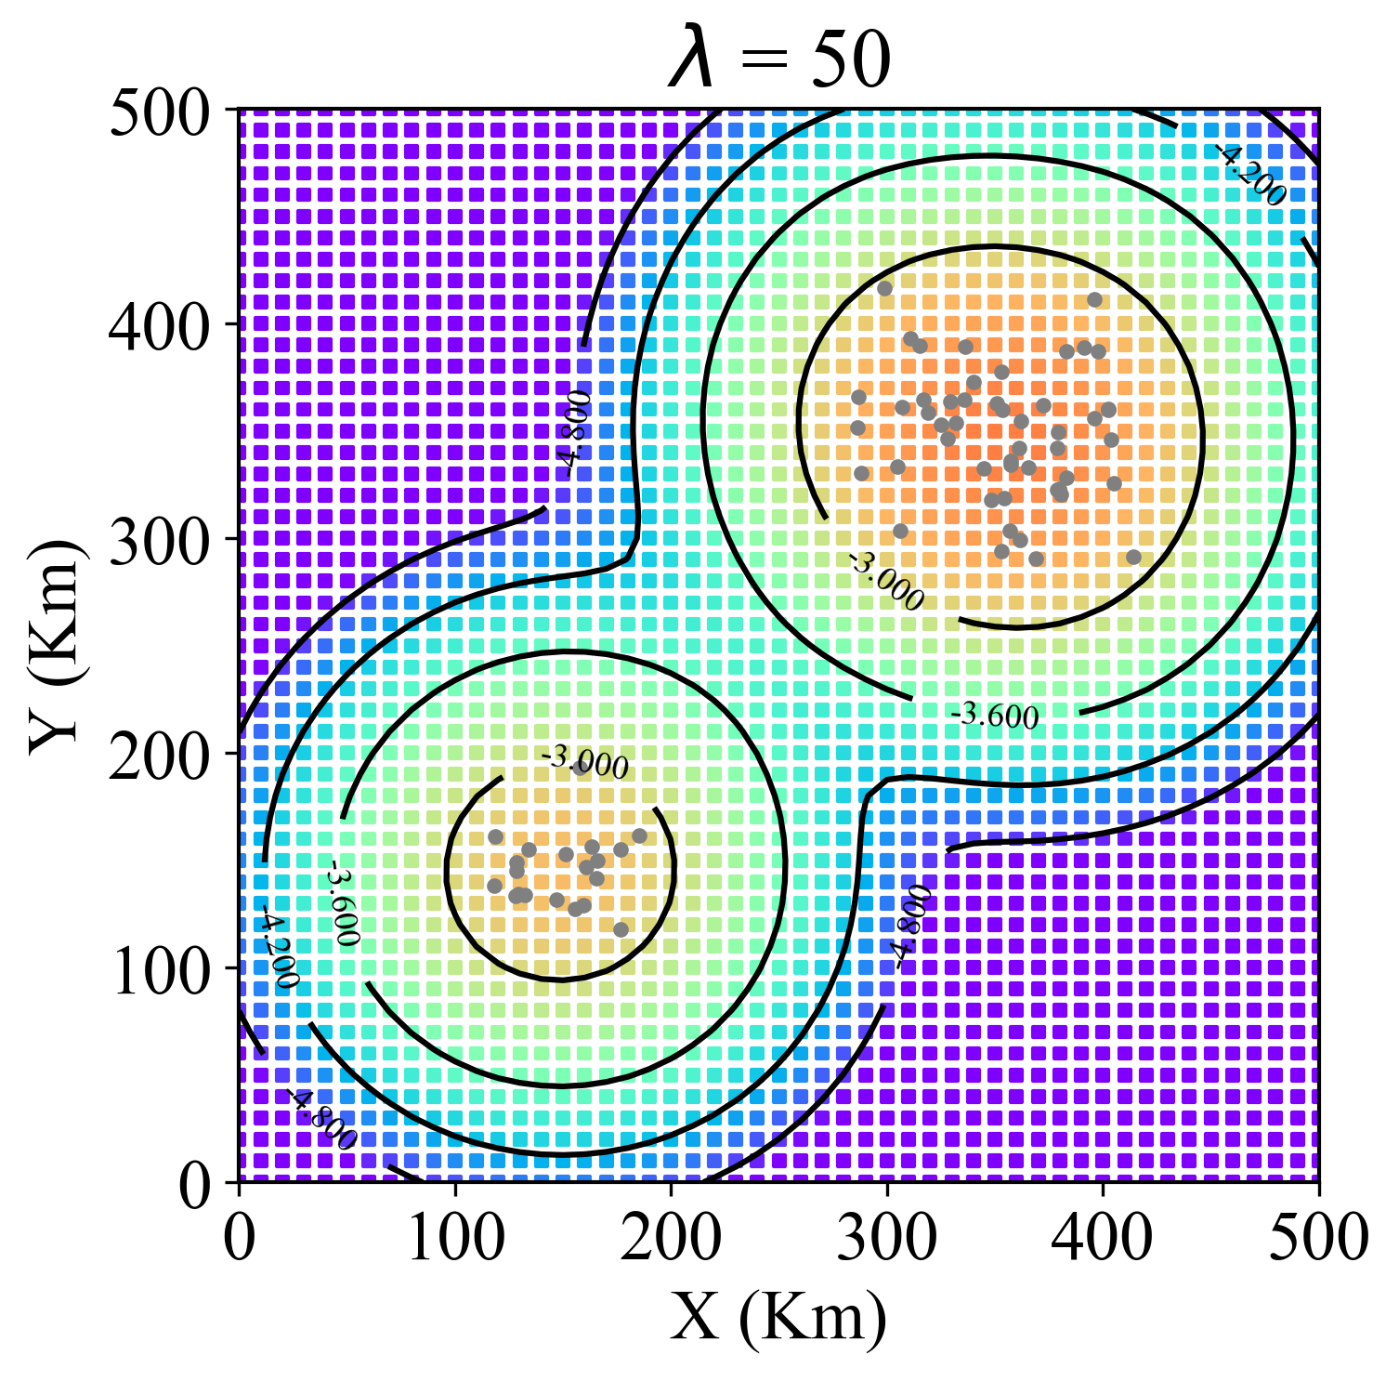
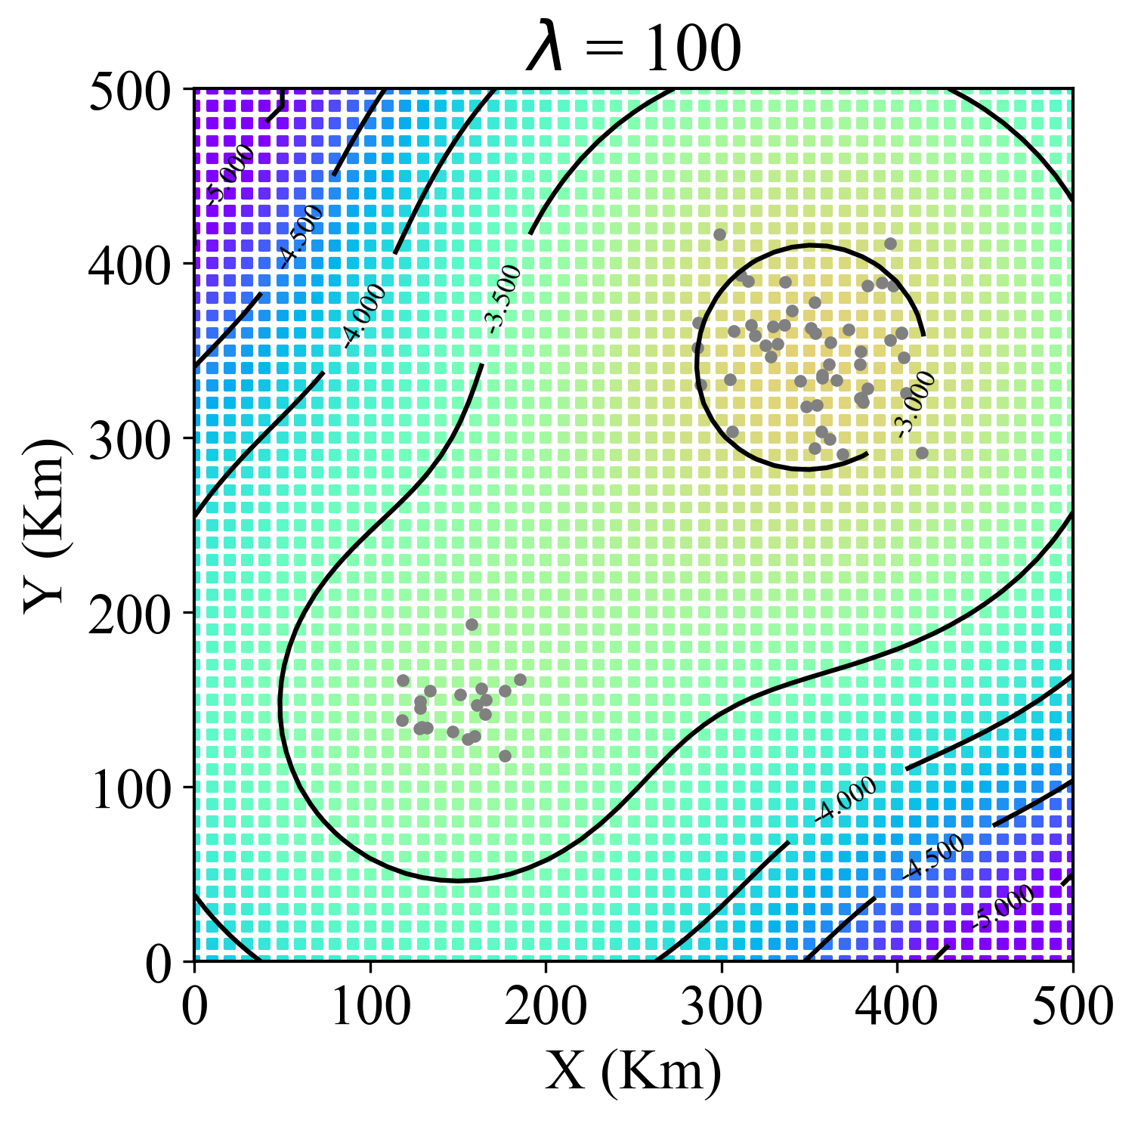
Smoothed Seismicity Model
The level of smearing of the rates is controlled by smoothing length parameter (λ), which reflects the belief in the actual observed seismicity pattern. To account for the variability of λ, three different values are used for each zone.
A different combination of smoothing length is also used for high and low activity zones, to avoid the development of “bull’s eye” effect.

Slide 21
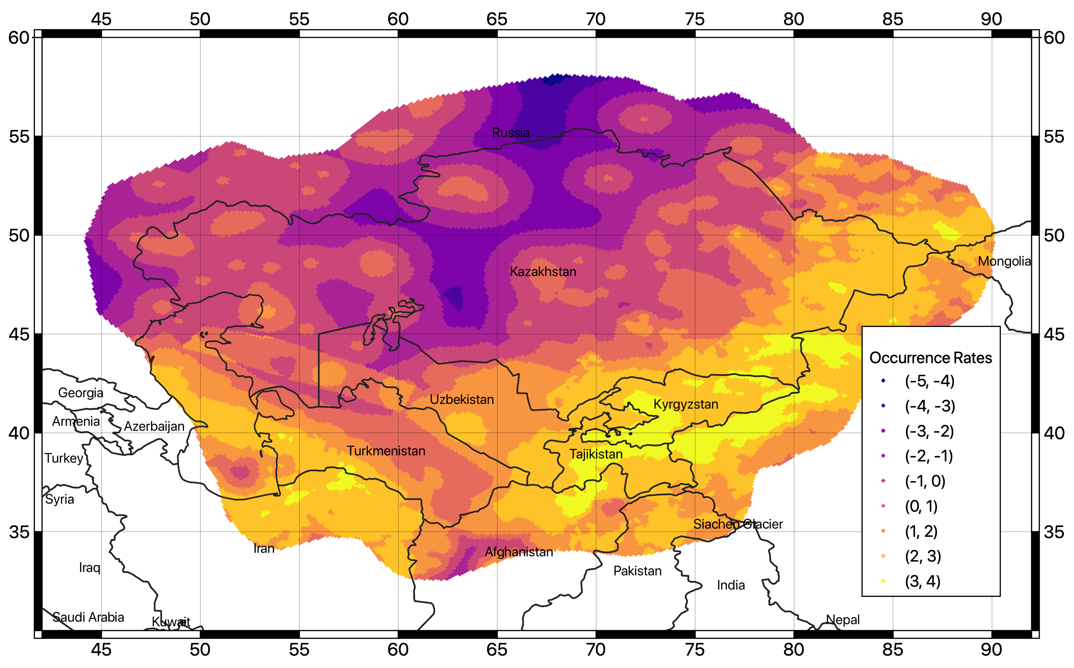
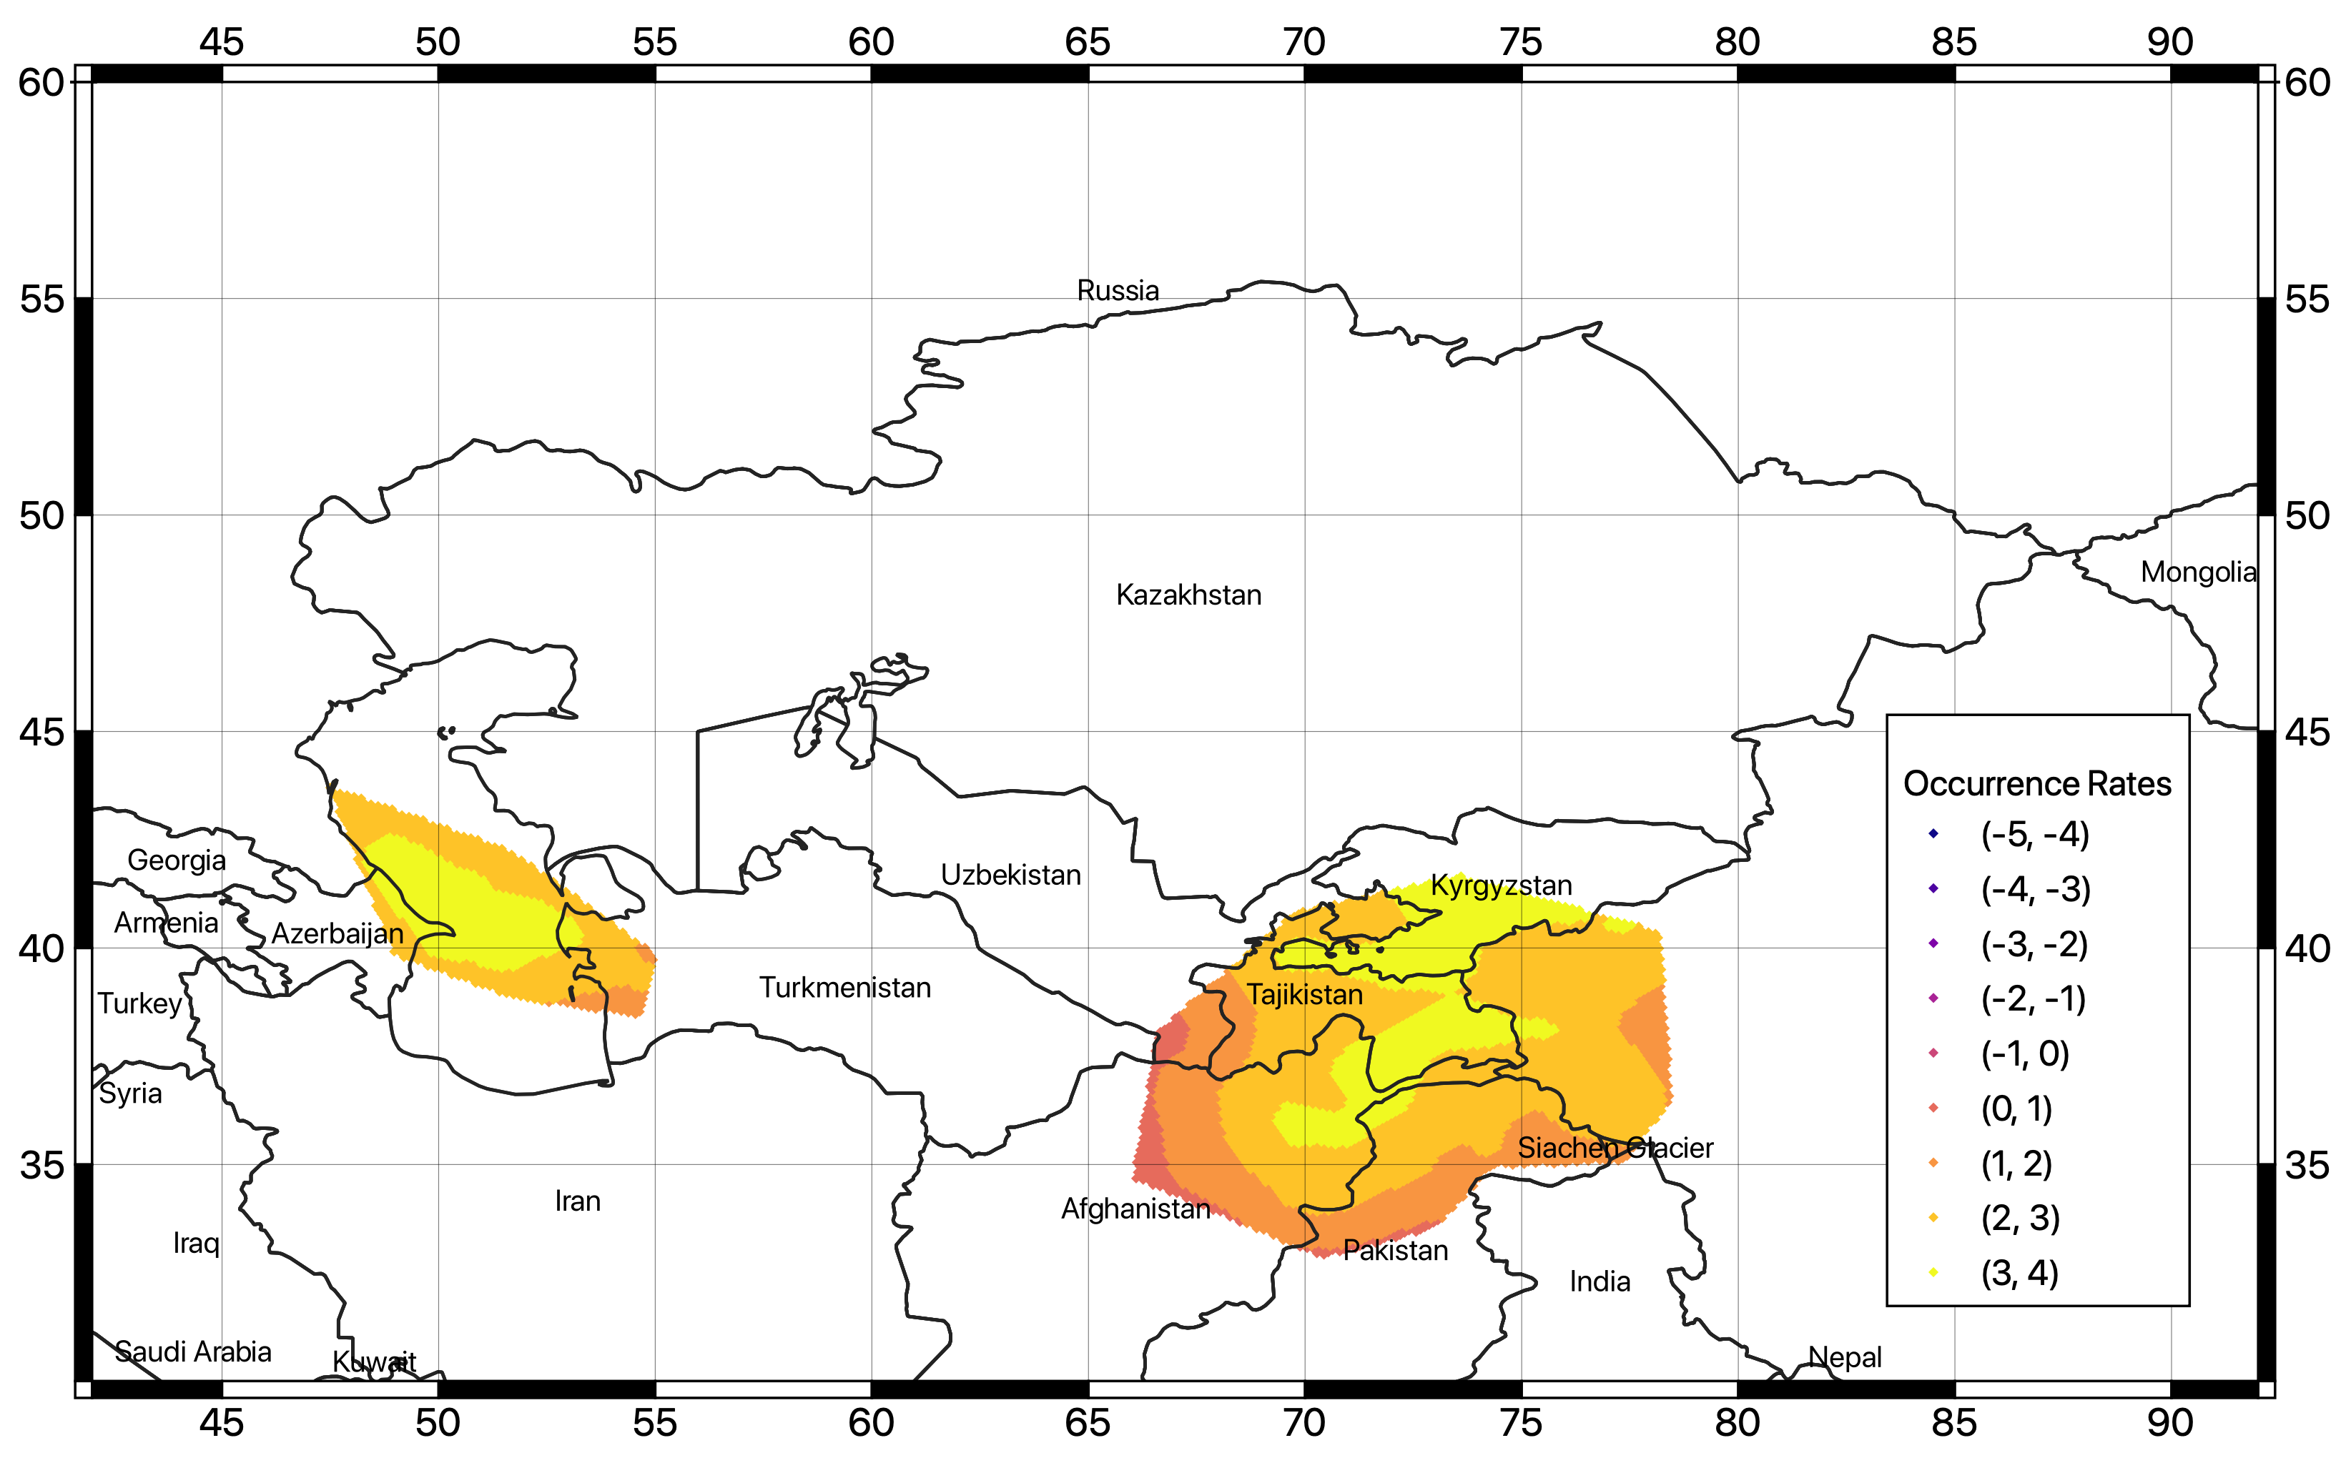
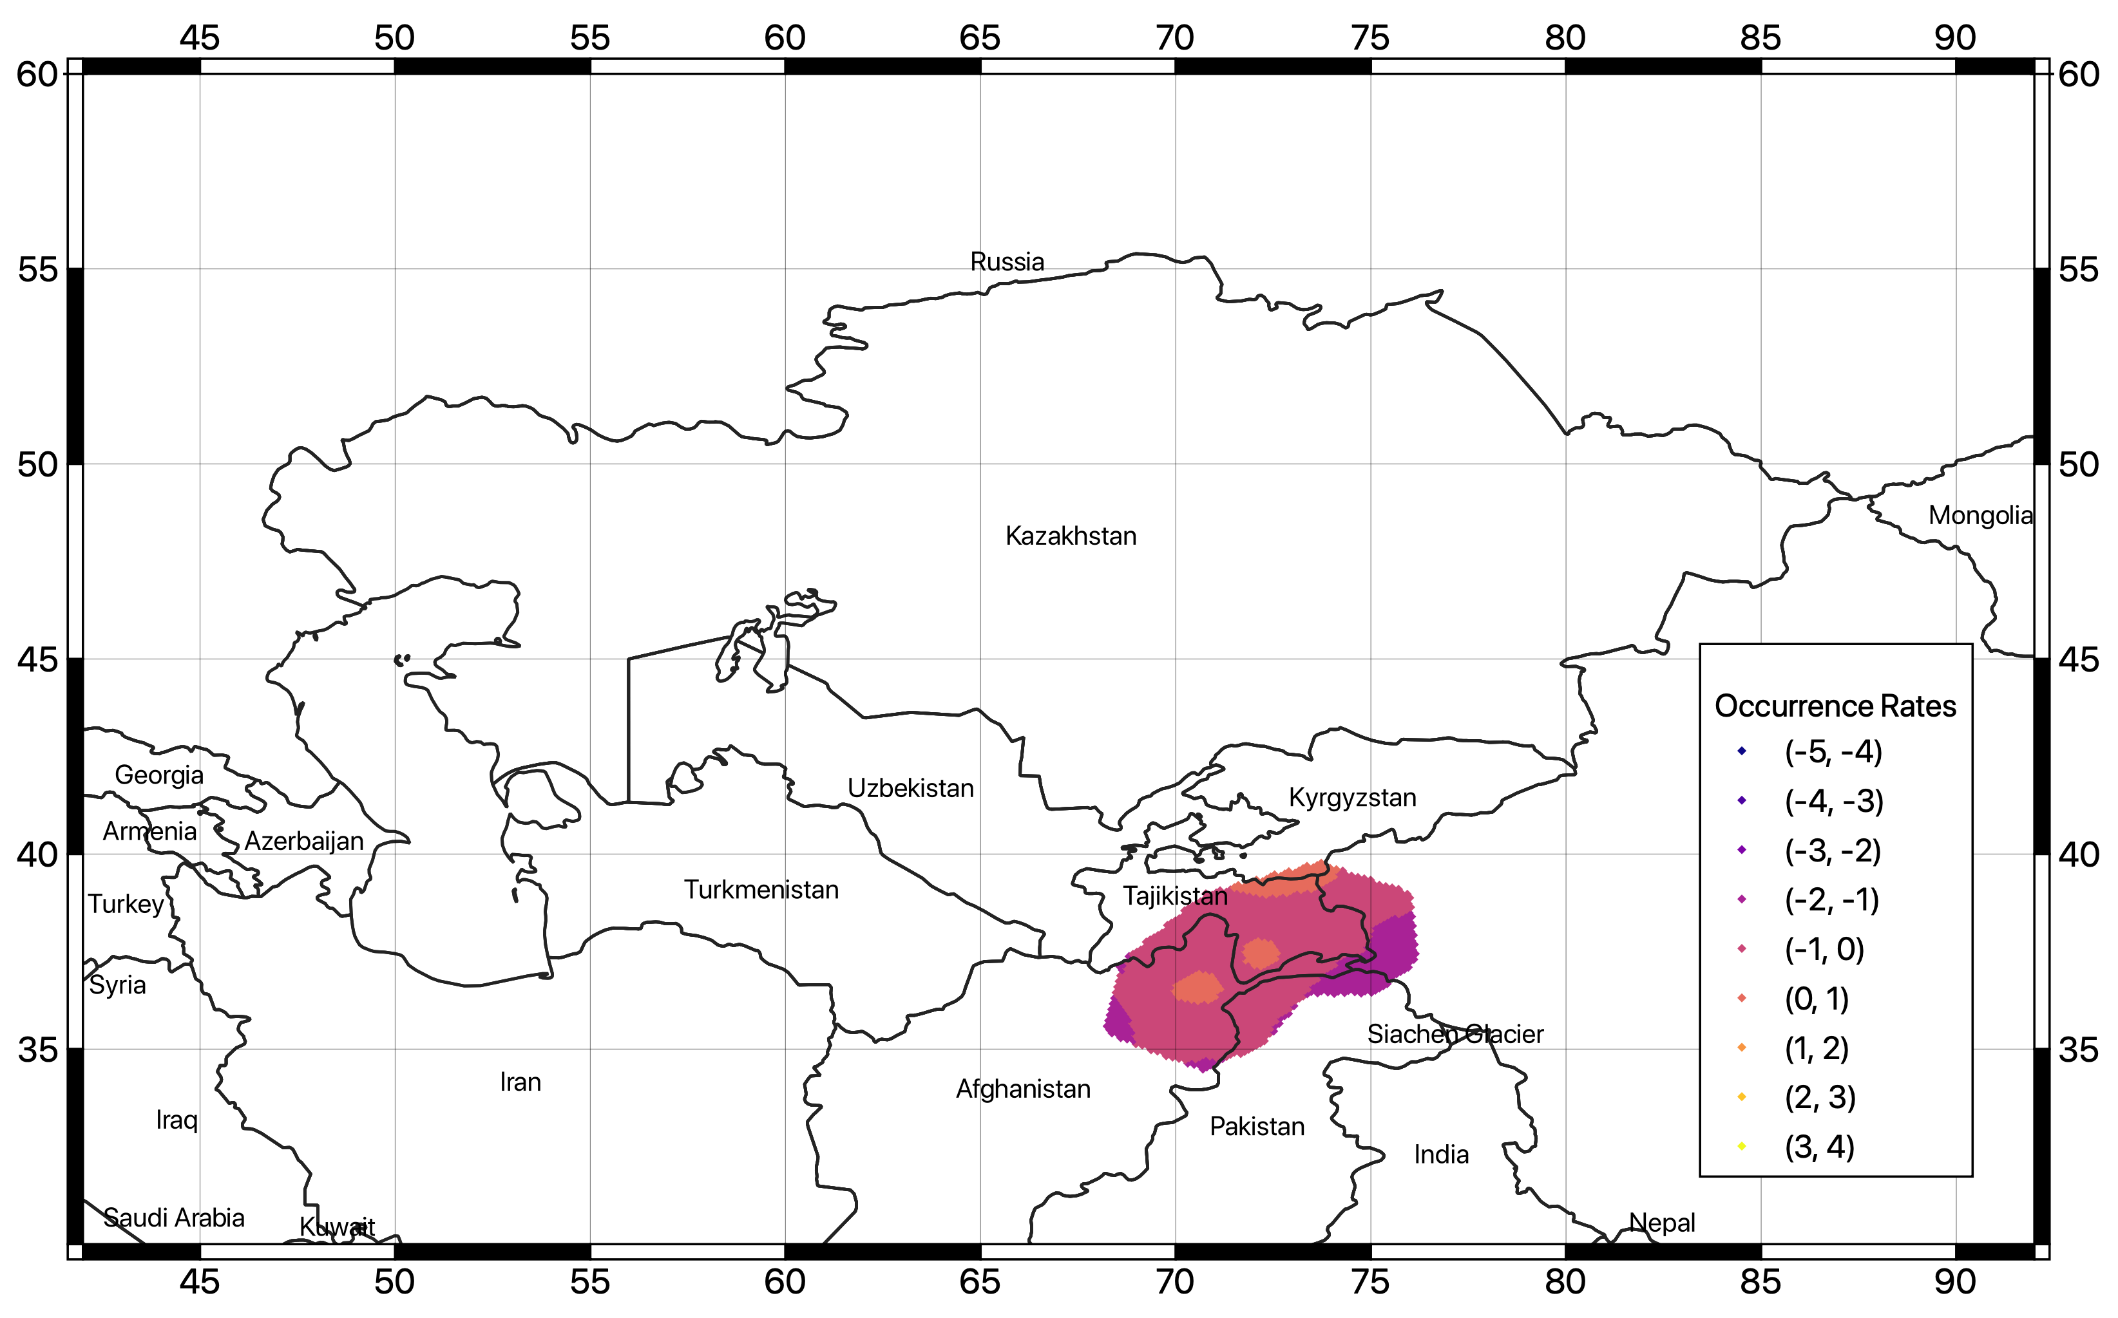
Smoothed Seismicity Model
Smoothing procedure was applied separately to the shallow, intermediate, and deep seismicity layers.
0-50km
50-150km
150-400km

Slide 22
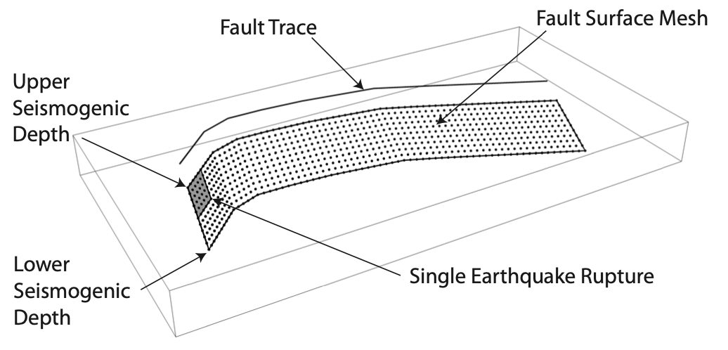
Finite Fault Model
Complementary to the distributed seismicity, the direct modelling of finite faults has the advantage of better representing ground motion in the source near field.
However, this is possible if enough information (fault geometry, kinematic parameters, displacement rates) is available for the investigated area with sufficient reliability.
In OpenQuake, finite faults can be approximated by shifting the fault trace from the Earth’s surface to the lower seismogenic depth with an inclination equal to the dip angle.
modified from “the OpenQuake-engine book: underlying hazard science”

Slide 23
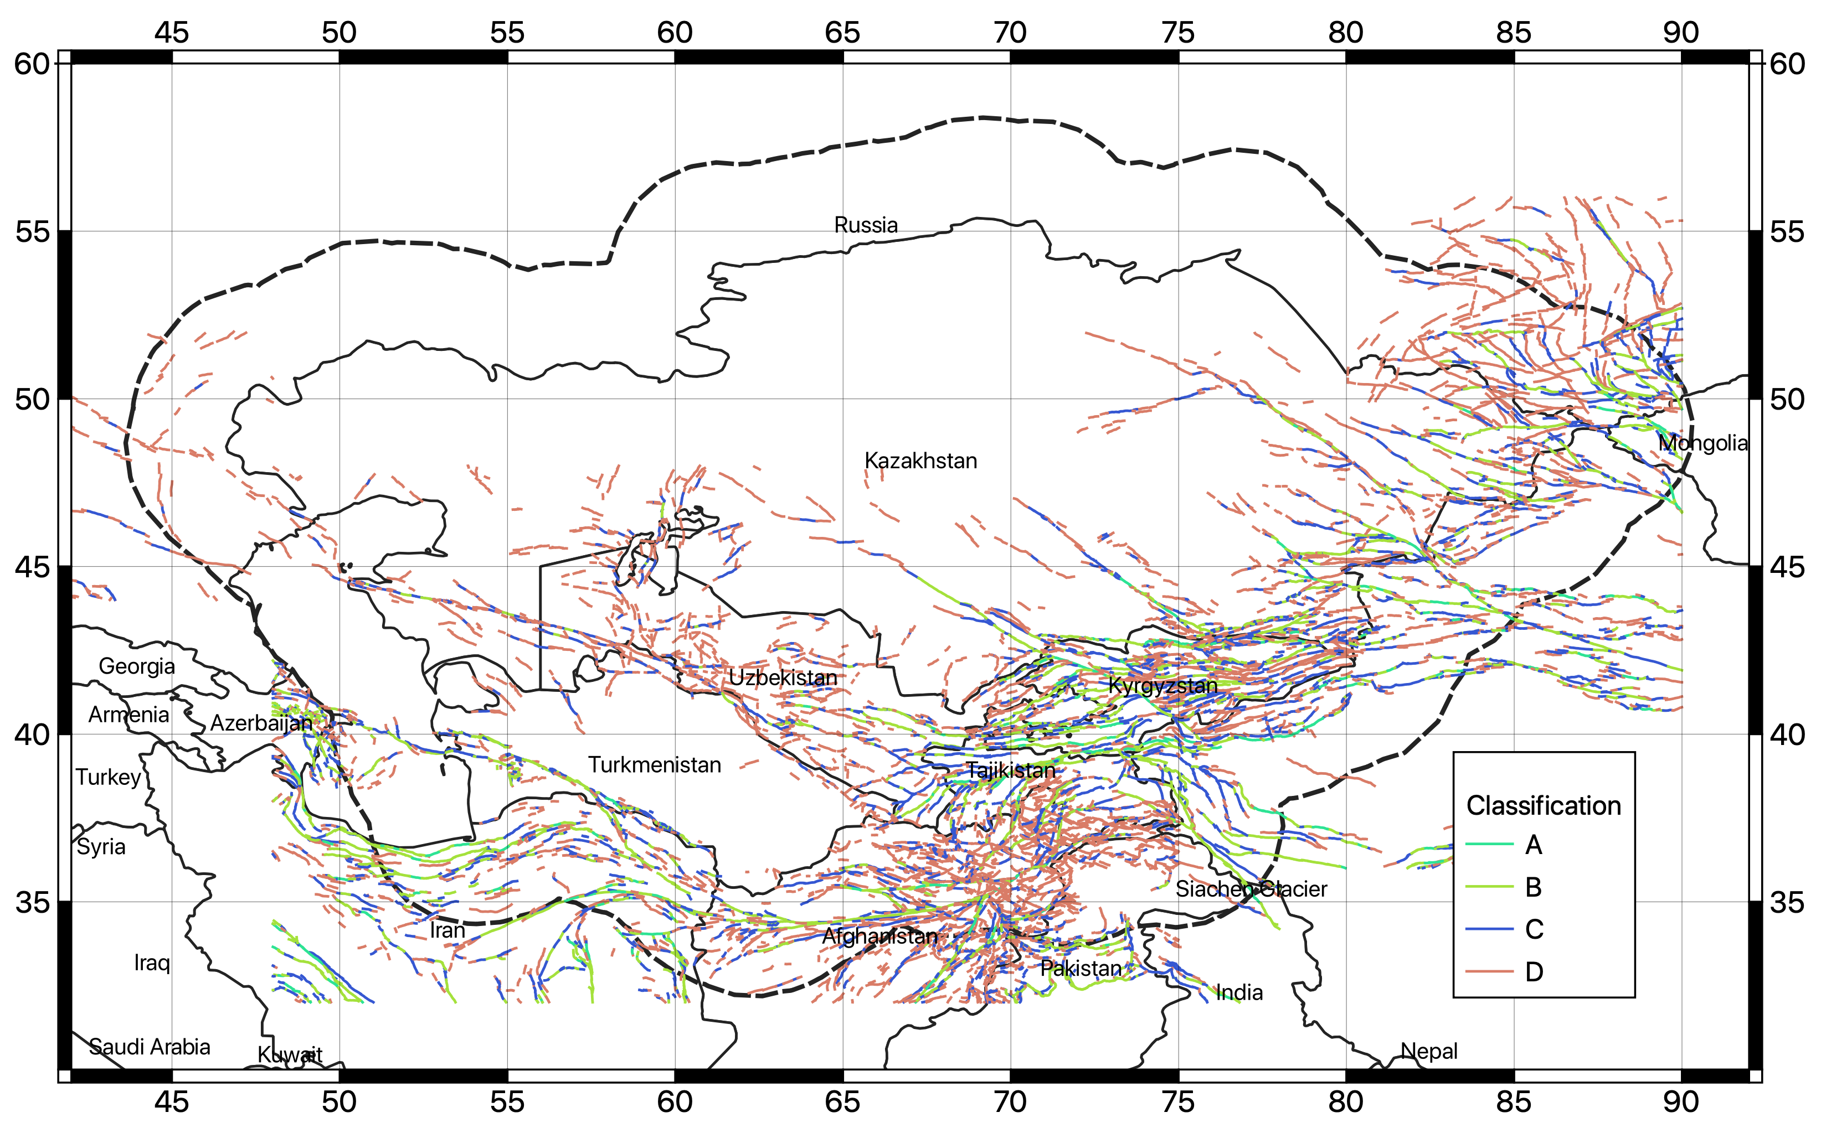
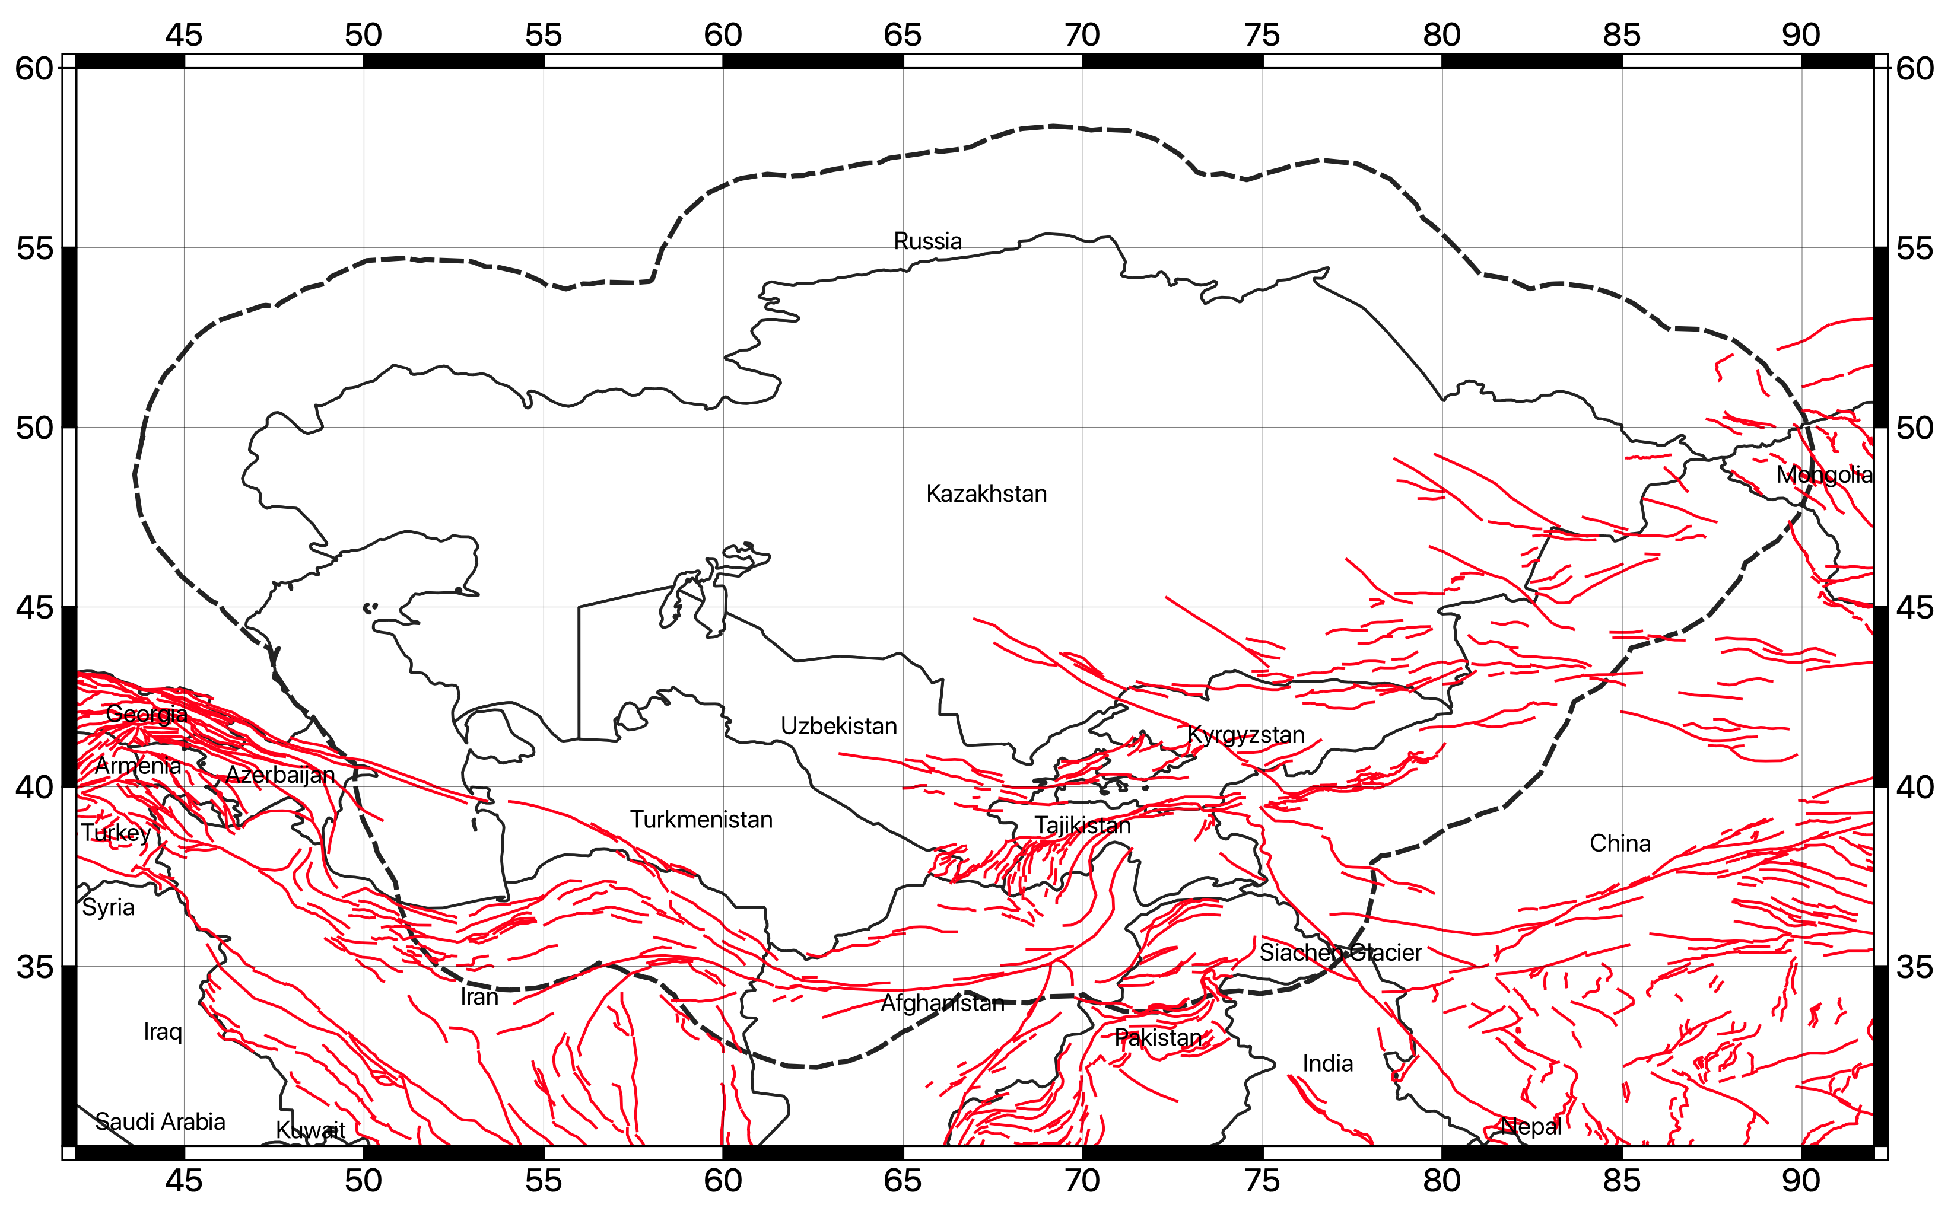
Regional Active Fault Datasets
At regional level, the most significant existing compilations are the GEM Global Active Fault Database (GEM GAF-DB, Styron and Pagani, 2020) and the Active Fault Database of Eurasia (AFEAD, Bachmanov et al., 2017), which review and summarize most of the information available from published scientific studies for the target area.
AFEAD – Active Fault Database of Eurasia
GEM Global Active Fault Database
AFEAD database was converted into GEM format

Slide 24
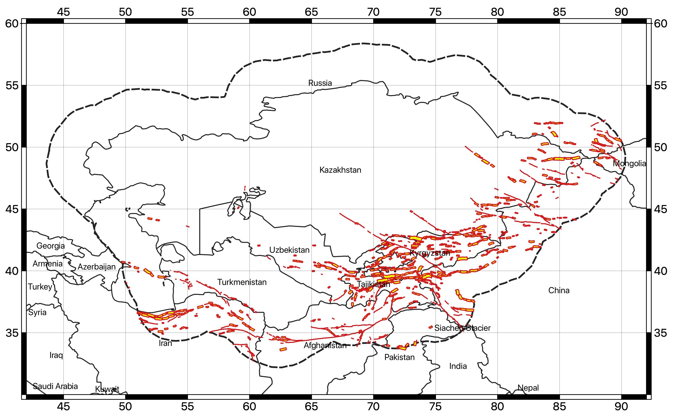
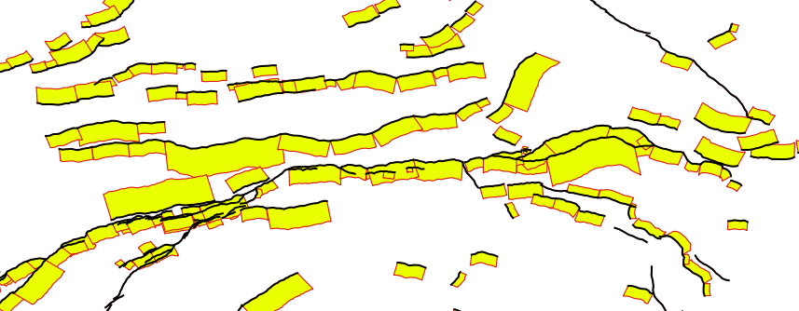
The Fault Source Model
The fault source model presently contains 1444 individual fault segments, covering the most part of the active shallow crust presently interested by active seismicity.
Occurrence rates of each fault are derived from slip rate estimates, by balancing the scalar seismic moment accumulation from the integral of the incremental MFD through a direct fitting procedure.
A background seismicity layer with magnitude cut-off of 6 was also included to complement the fault source model.

Slide 25
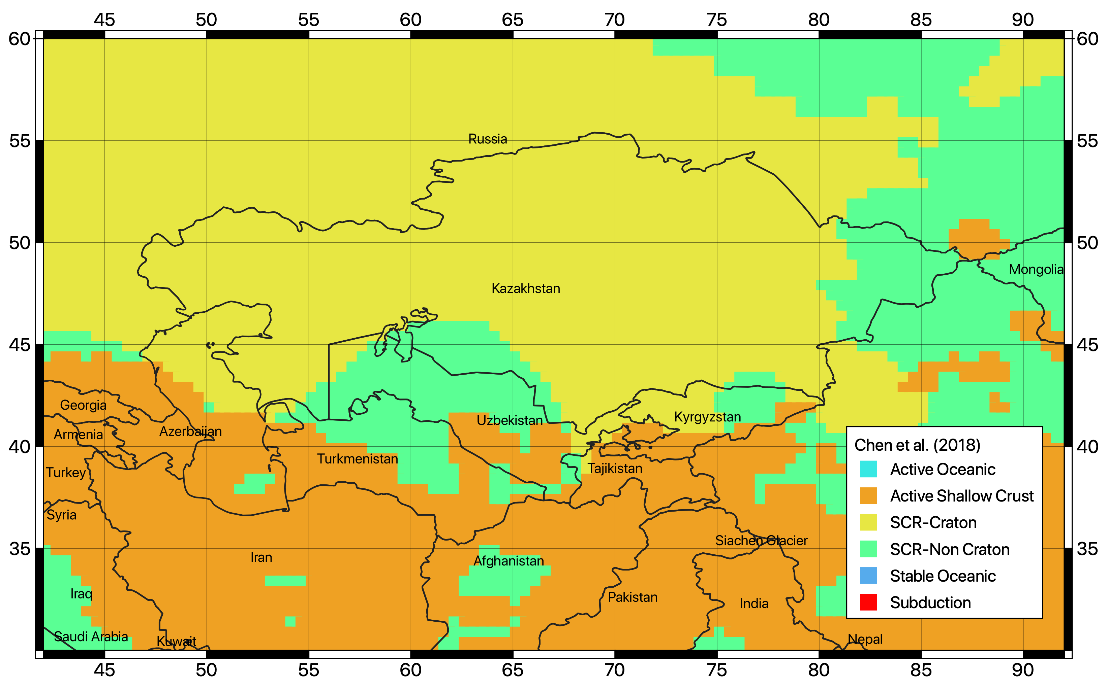
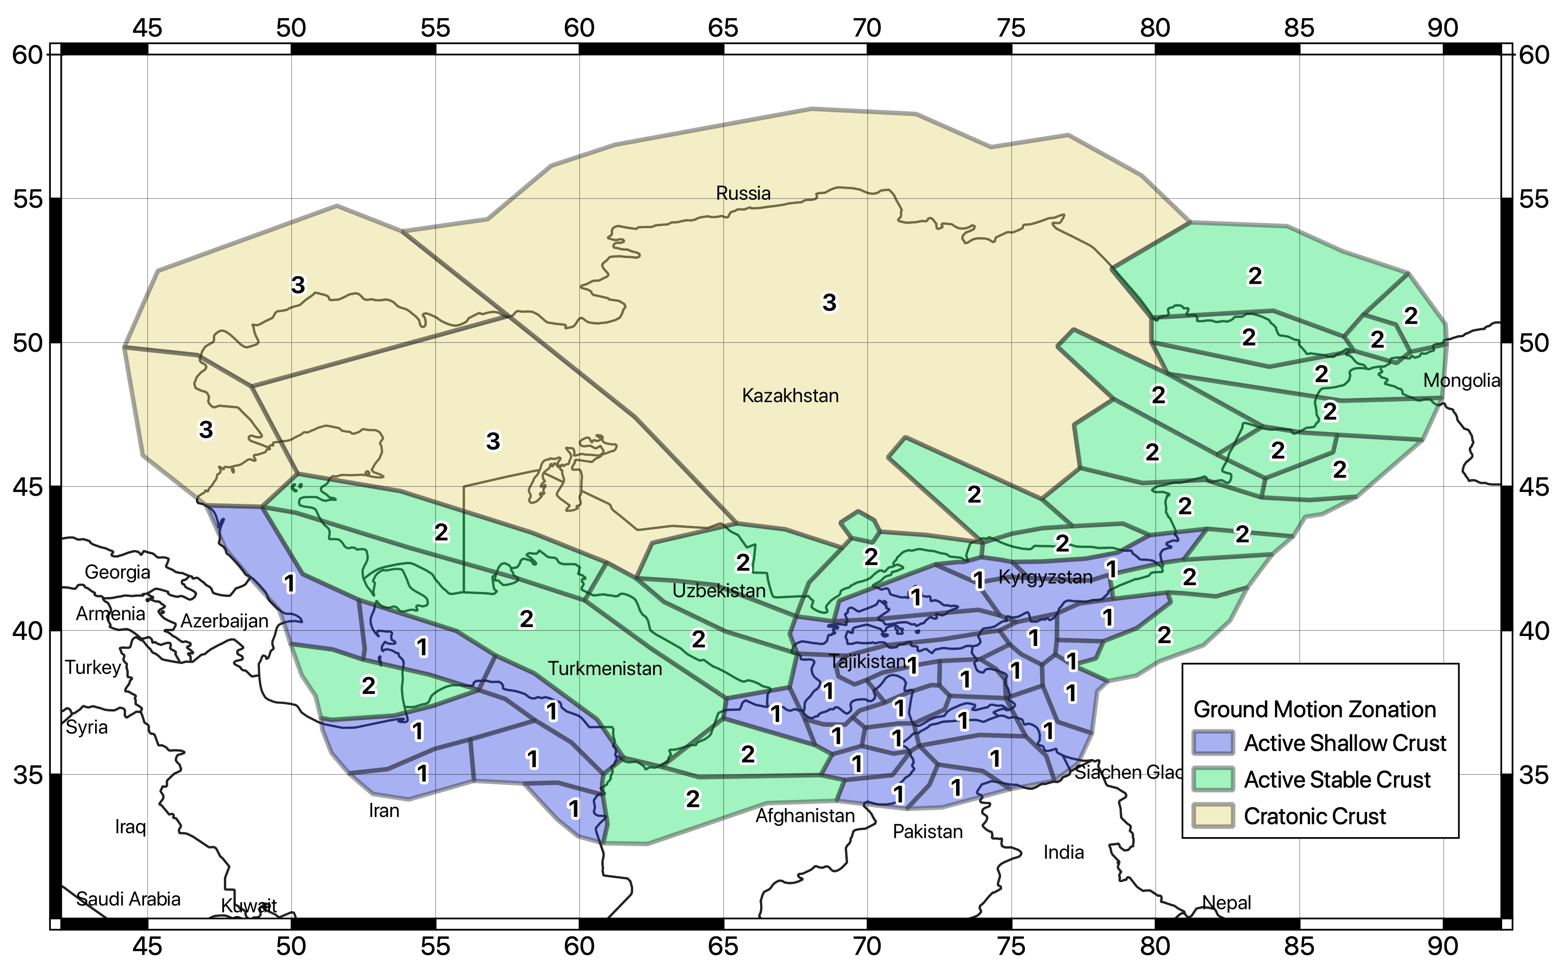
Tectonic Regionalization
To account for the variability of the ground motion attenuation across the region, a regionalization zonation was performed based on the classification proposed by Chen et al. (2018), which combines seismological, geological and geophysical data from worldwide datasets.
Three tectonic region types (TRT) were defined for shallow crust conditions, plus a fourth region for the deep source zones.
Chen et al. 2018

Slide 26
GMPE Selection
Ground motion prediction equations (GMPE) compatible with the identified TRT have first been isolated from the ground motion model library of OpenQuake (the HazardLib).
Following the selection criteria recommended by Cotton et al. (2006) and the recommendations by the local experts of the consortium, the number of suitable models was then restricted to the five most representative for the study region:
Tectonic Id | Ground Motion Prediction Equation | Weight
AS | Campbell and Bozorgnia (2014) | 0.5
 | Chiou and Youngs (2014) | 0.5
SC | Pezeshk et Al. (2011) | 0.5
 | Atkinson and Boore (2006) – Modified 2011 | 0.5
DS | Parker et Al. (2020) – for subduction interface | 1
 | AS | SC | DS
TRT 1 | 1 | 0 | 0
TRT 2 | 0.5 | 0.5 | 0
TRT 3 | 0 | 1 | 0
TRT 4 | 0 | 0 | 1
TRT weighting scheme

Slide 27
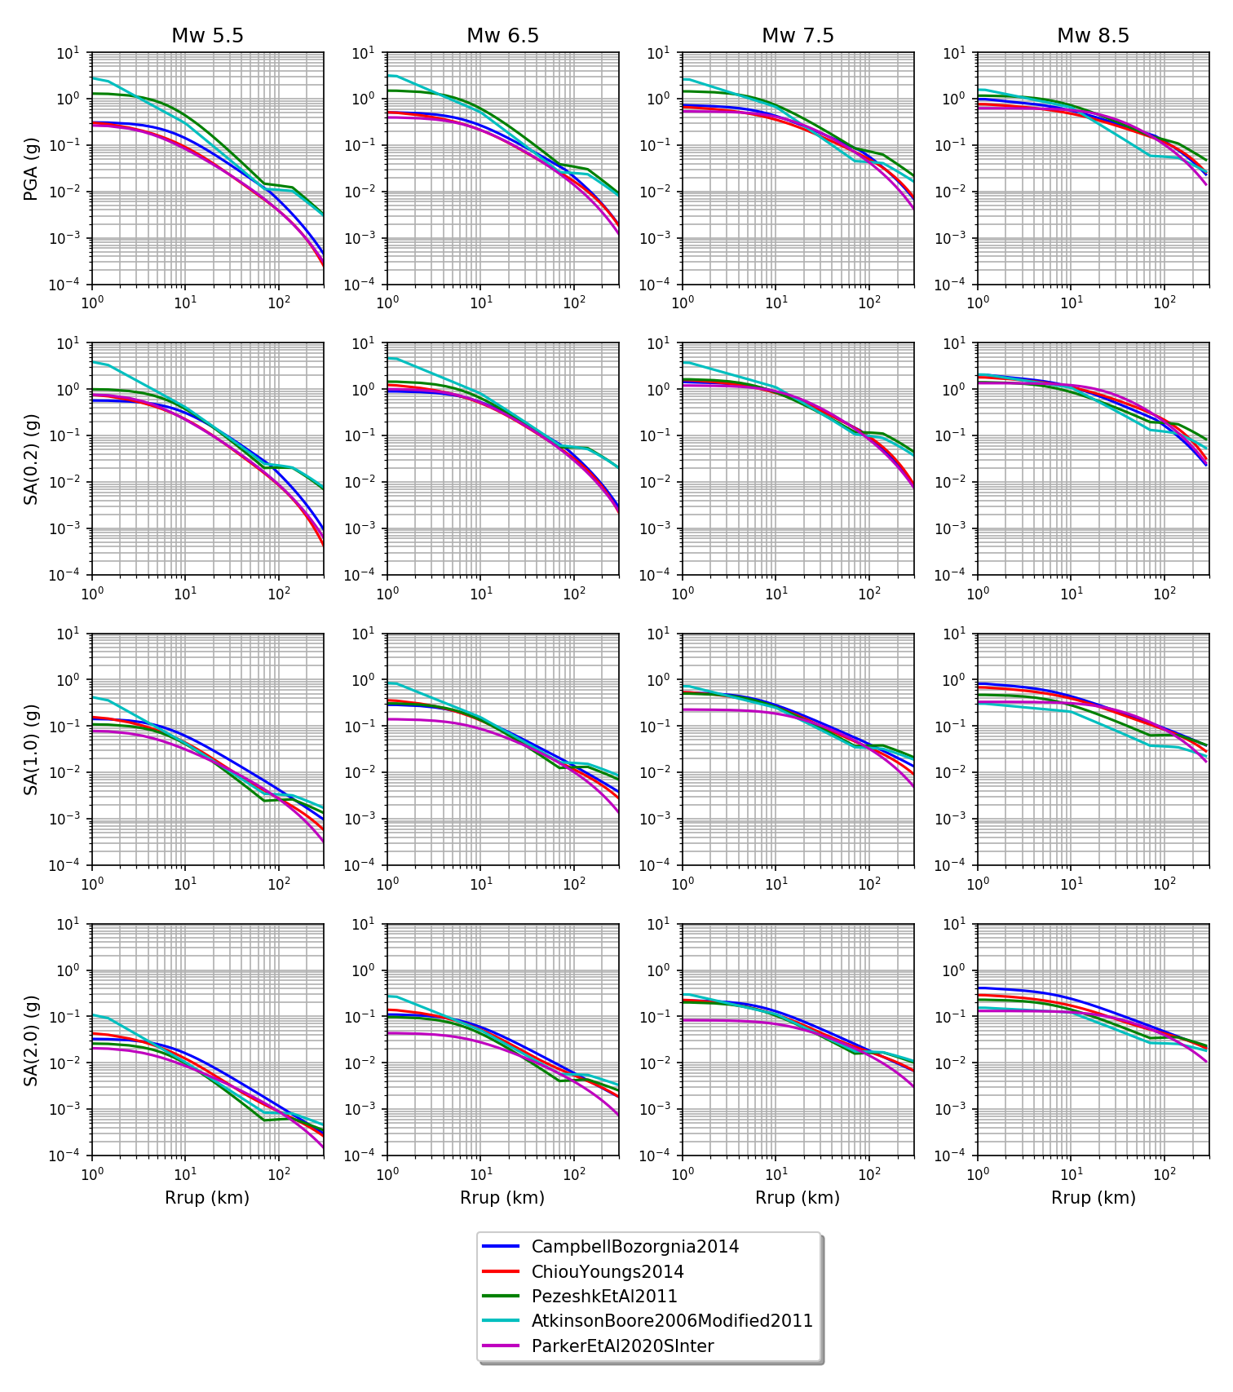
GMPE Performances
Magnitude (Mw)
The performances of the ground motion prediction models were tested for various magnitude, distance and intensity measure type combinations by means of Trellis plots.
IMT
(Periods)

Slide 28
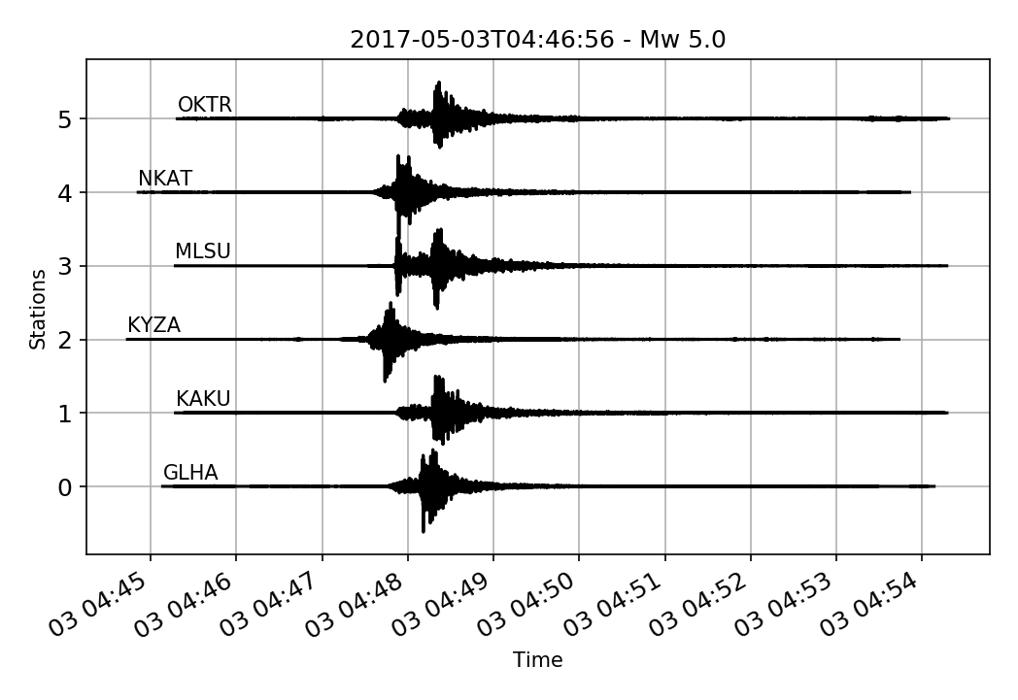
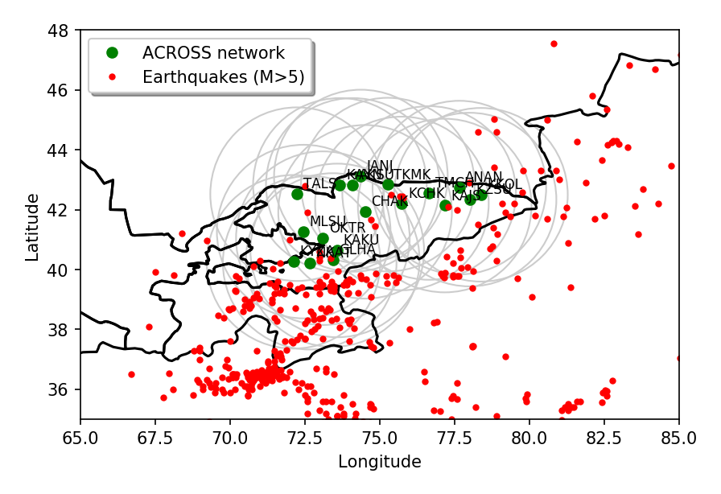
Strong Ground Motion Recordings
The ACROSS network (Parolai et al., 2017) was developed and it is currently maintained by Helmholtz GeoForschungsZentrum (GFZ, Potsdam) in cooperation with the Central Asian Institute for Applied Geosciences (CAIAG). It consists of 18 three-channel accelerometric stations deployed in Kyrgyzstan and operating since 2005.
Gray circles represent the selection distance limit of 300 km from each station

Slide 29
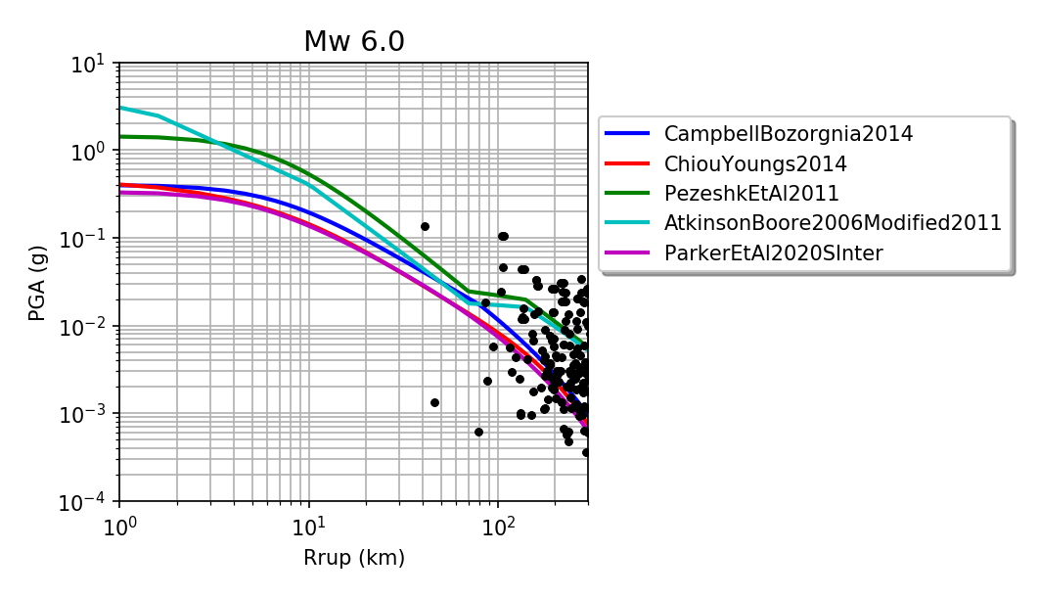
Empirical Verification of Attenuation Models
Of 708 identified regional events with magnitude larger than 5, 35 events (5<Mw<6.6) were recorded from the network within 300 km from the stations, for a total of 153 three-components waveforms.
Unfortunately, the number of waveform recordings in a significant magnitude-distance range is not sufficient for a robust validations of the selected GMPE models.
Nonetheless, visual comparison with the predicted ground motion suggests that the selected models are reasonable in the intermediate to large distance range.

Slide 30
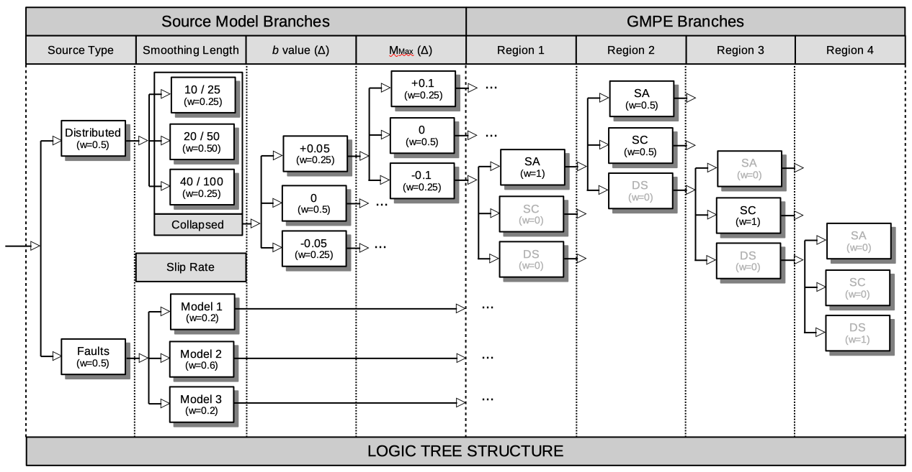
Epistemic Uncertainty and Logic Tree
Logic-tree is split between the two main components: source uncertainty (source type, rates, b-value and Mmax) and ground motion modelling variability (including GMPE regionalisation).

Slide 31
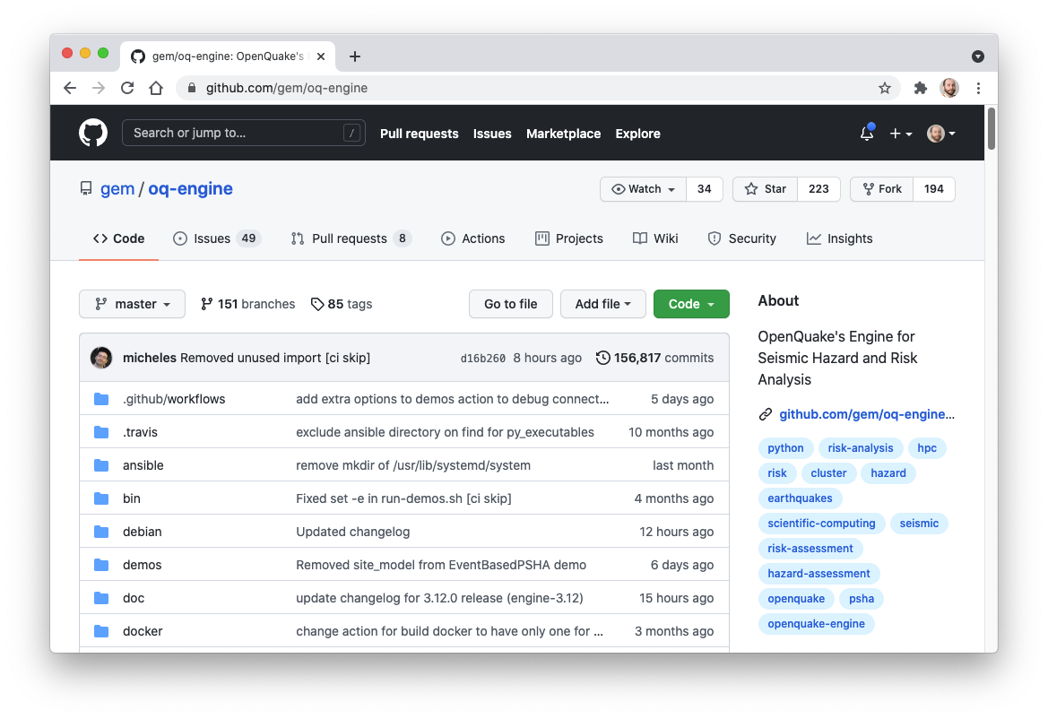


Hazard Calculations
All calculations for this study were performed using Version 3.11 of the OpenQuake engine (Pagani et al., 2014), an open-source seismic hazard and risk calculation software developed, maintained, and distributed by the Global Earthquake Model (GEM) Foundation.
https://github.com/gem/oq-engine/tree/engine-3.11

Slide 32
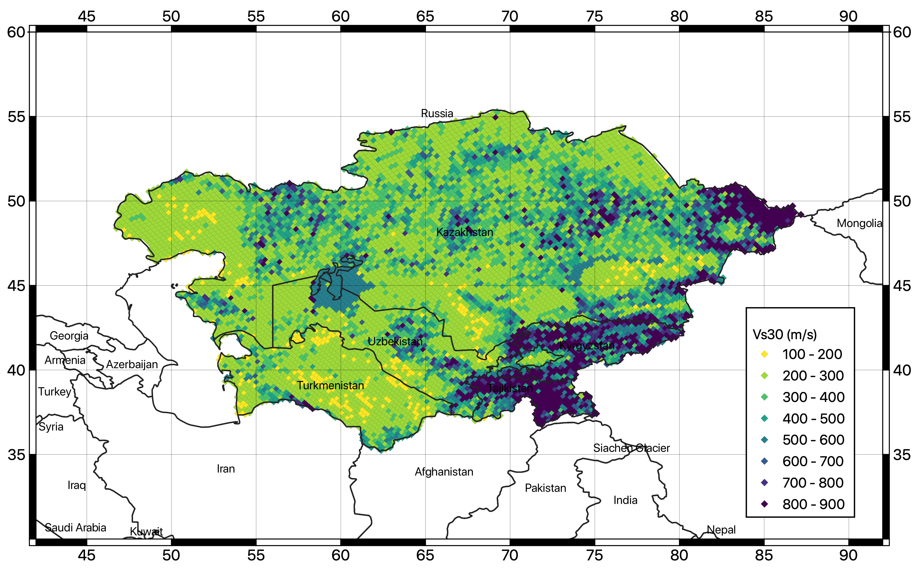
Hazard Calculations
Calculation are performed on a mesh of 8028 sites with 0.2 degrees spacing (about 20 km). Free rock conditions are assumed, with a fixed 30-metre averaged shear-wave velocity (Vs30) reference value of 800 m/s (class A).
The risk calculation, however, will be carried out by using site specific ground motion e.g., the local slope-based Vs30 values obtained from the global USGS Vs30 Map Server (Worden et al., 2015)

Slide 33
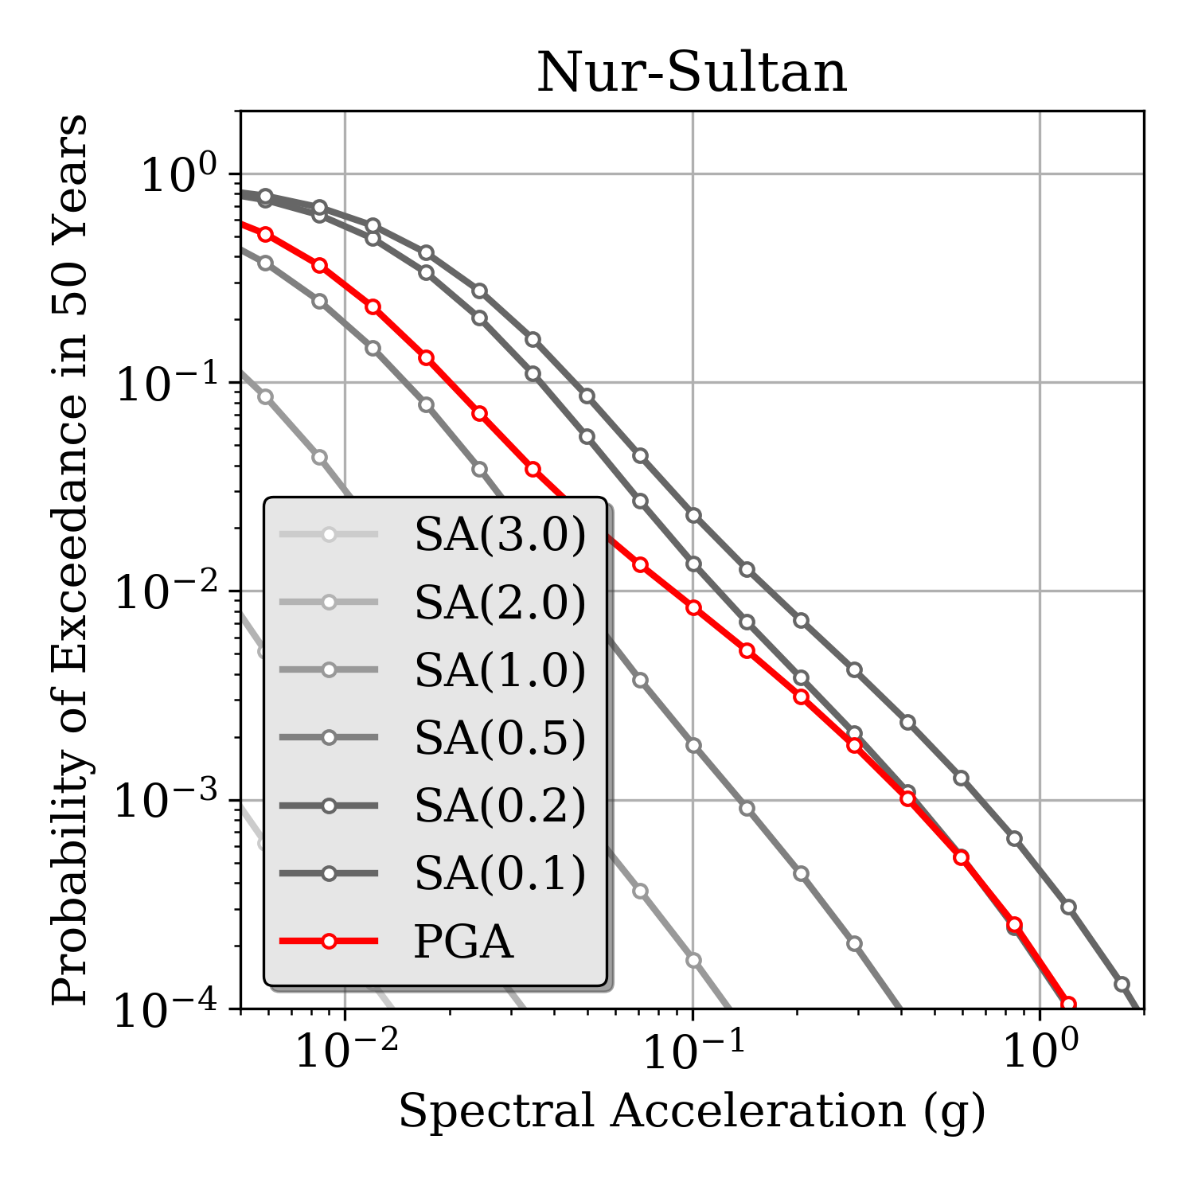


Results: Hazard Curves
Hazard curves in ground motion probability of exceedance (PoE) for 50 year observation time are computed for PGA and for 5%-damped response spectral acceleration at 0.1s, 0.2s, 0.5s, 1s, 2s and 3s (vibration periods allowed by the selected ground motion models).

Slide 34



Results: Hazard Curves (Uncertainty)
Mean and quantile (0.05, 0.15, 0.5, 0.85 and 0.95) hazard curves are computed separately for each intensity measure type (IMT) and at each site of the grid.
Uncertainty at Peak Ground Acceleration (PGA)

Slide 35



Results: Uniform Hazard Spectra
Uniform Hazard Spectra are computed for return periods of 25, 50, 100, 250, 475, 500 and 1000 years, corresponding respectively to 86, 63, 39, 18, 10, 9 and 5% probability of exceedance in 50 years observation time (assuming a Poisson earthquake occurrence model)

Slide 36




Results: Hazard Maps on Rock Conditions
5% PoE
10% PoE
39% PoE
89% PoE

Slide 37


Conversion to Intensity
To facilitate the comparison with previous hazard studies, hazard maps at the different return periods have been converted to intensity using the relation of Faenza and Michelini (2011) for MCS and Aptikaev (2012) for MSK.
10% PoE
63% PoE

Slide 38

Disaggregation of Hazard
To identify the controlling scenario for the stochastic event set calculation, magnitude-distance disaggregation was performed for all considered intensity measure types and return periods at six selected target sites, corresponding to the capitals of the five Central Asian countries (Ashgabat, Bishkek, Dushanbe, Nur-Sultan and Tashkent) plus the city of Almaty.
Dushanbe
Controlling earthquake scenarios from magnitude-distance disaggregation
IMT | Dist. (Km) | Mag. (Mw)
PGA | 15.0 | 5.5
SA(0.1) | 25.0 | 5.5
SA(0.2) | 15.0 | 5.5
SA(0.5) | 15.0 | 5.5
SA(1.0) | 25.0 | 6.5
SA(2.0) | 15.0 | 6.5
SA(3.0) | 15.0 | 6.5

Slide 39
Key Aspects of the Central Asia PSHA Model
With respect to previous regional models, the proposed model is innovative in the following aspects:
A new regional earthquake catalogue was assembled, harmonized between countries, and homogenized in moment magnitude (Mw).
A new seismogenic source zonation was developed, based on a rate-preserving smoothing kernel.
A finite fault source model was derived from regional datasets and slip rate information.
A new regionalized selection of ground motion models was defined in a new logic tree structure.
Moreover, the hazard model is meant to be a collaborative, open and transparent product, which is expected to be further extended and improved with the support of the local scientific community.
Source: https://www.ebrd.com

Slide 40
Thank you very much for your attention!
40

