Slide 1
Promoting earthquake awareness in Africa through the GEM global hazard mosaic
Valerio Poggi, Julio Garcia, Marco Pagani,, Robin Gee.,
Richard Styron, Kendra Johnson
Global Earthquake Model (GEM), Pavia Italy
December 7th, 2017, Madrid - Spain

Slide 2

Introduction to GEM
GEM (Global Earthquake Model) is a no-profit organization funded by public and private partners aimed to stimulate the awareness on seismic hazard and risk worldwide
The overall goal of the hazard component of the GEM community is:
the construction of a global mosaic of open hazard models
to provide the community with tools, datasets and knowledge to achieve this goal

Slide 3


GEM’s Philosophy
All GEM products (models, software, databases, training material) are meant to be:
Collaborative
We promote interaction and collaboration between scientists, professionals and experts from national institutions and worldwide
2) Open and transparent
All input information, data and results are openly accessible to the community for verification, improvement or any other use

Slide 4

GEM’s Philosophy
Why is it useful?
Transparency and reproducibility can increase acceptability
It can reduce erroneous criticism
Testing becomes a more effective process (feedback process, identification of bugs…)
Only in this way it’s possible to ensure long term maintenance, incorporate newest ideas and features and aim at a large community of users

Slide 5
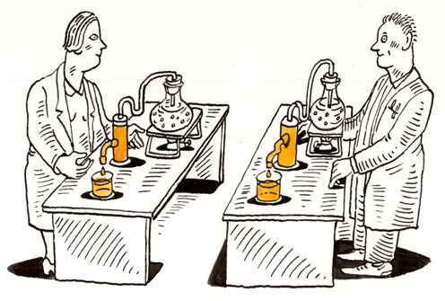
Reproducibility in Seismic Hazard
What’s a reproducible PSHA model?
The basic information used for its construction is openly accessible on public repositories
The tools used for the construction of the hazard model are accessible on a public repository
The model building process is documented in a way that an independent modeller will be able to reproduce the model
The calculation are performed with a freely accessible software (possibly open-source)

Slide 6



GEM Hazard - Open Products
Basic datasets
Tools for pre-processing data and build models
QA and testing
GEM COMMUNITY
Hazard calculation engine
Hazard models
database

Slide 7




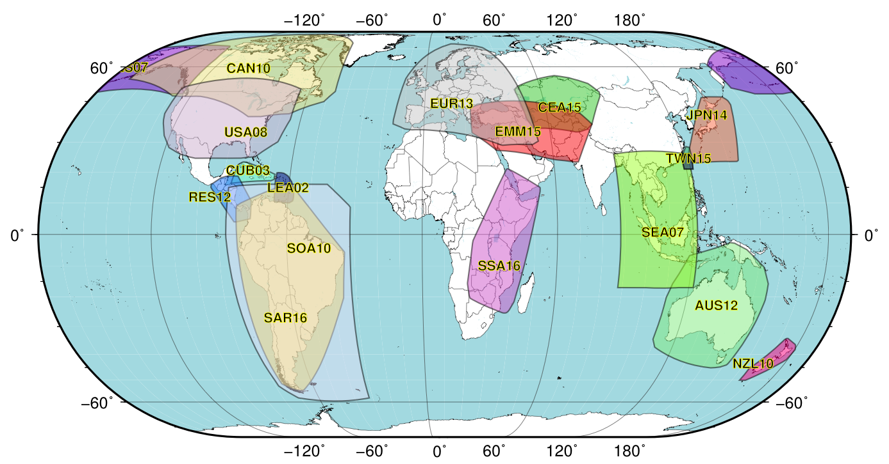






GEM Global Database of Hazard Models
The DB contains hazard models developed by national agencies and international projects which are openly distributed
RESIS 2
Project
SARA
Project
SSAHARA Project

Slide 8
GEM Global Database of Hazard Models
Canada model
CGS 2015
North Africa
GEM 2017
South East Asia
SEA collaboration 2018
USA model
USGS 2016
Caribbean and Central America
CCARA project 2018
South Africa
CGS 2017

Slide 9
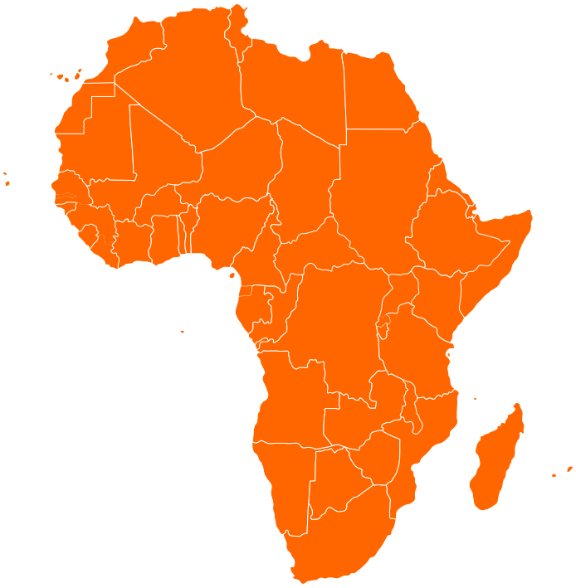
Earthquake Hazard in North Africa: a GEM product
Besides the East African Rift System, significant seismicity also occurs along a wide belt bounding the Mediterranean coastline
Several past large earthquakes caused a non-negligible level of damage
A reliable risk assessment is therefore essential, which requires a state-of-art hazard assessment for the region
There is a need for a new probabilistic seismic hazard model based on the most recent and up to date available information

Slide 10
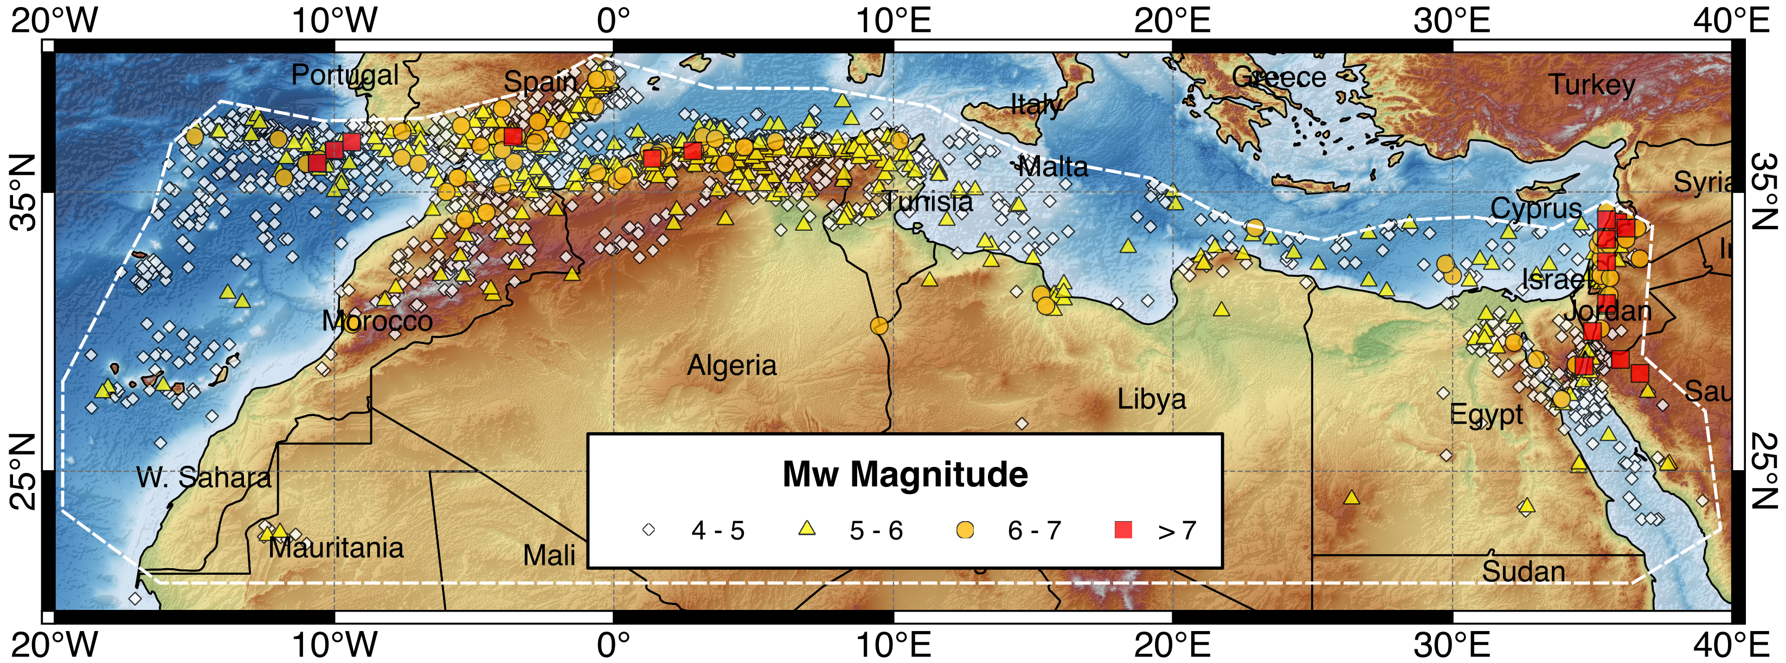
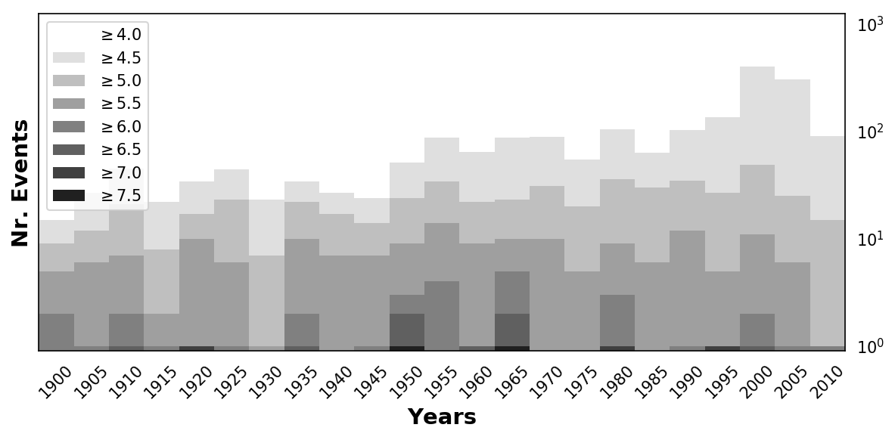
North Africa Homogenized Earthquake Catalogue
Mw
The catalogue is obtained by harmonization of global bulletins with data from local agencies and published studies
Number of Events: 5170
Year Rage: 1016 - 2013
Magnitude Rage: 4.0 - 8.5

Slide 11
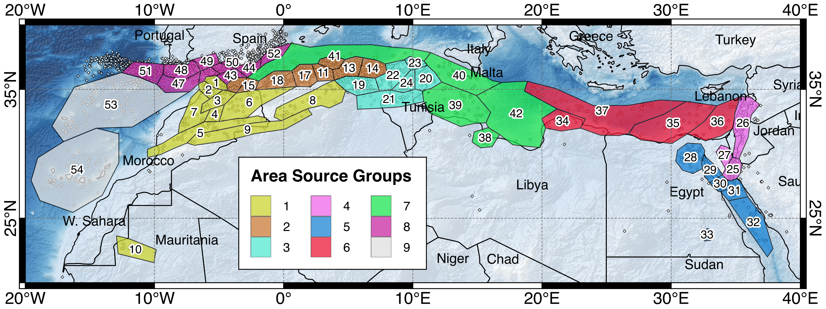
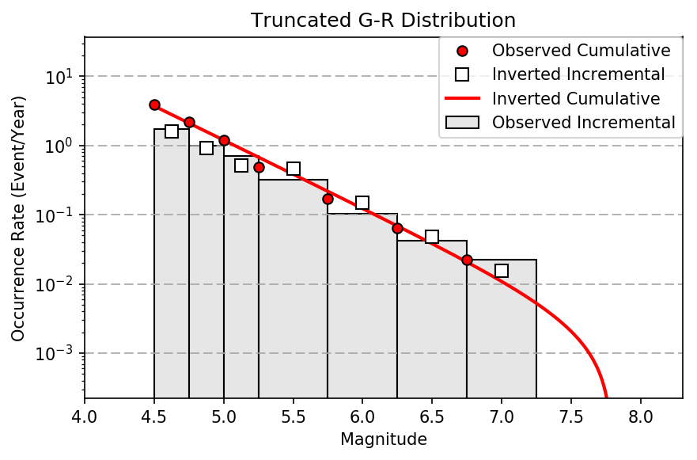
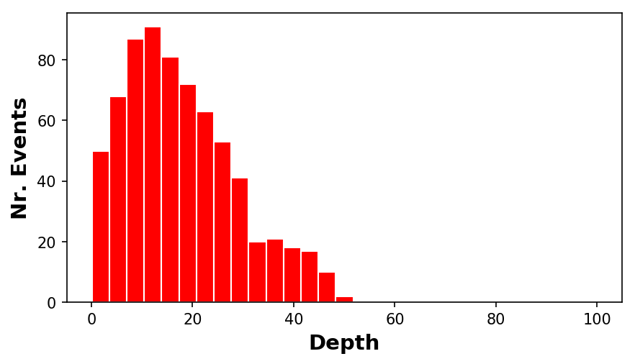
Source Model - Regional Seismicity Analysis
Earthquake
Source Zones
Seismicity
Distribution
Earthquake Rates

Slide 12
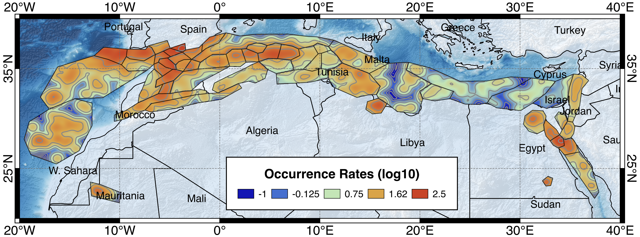
Occurrence Rate Redistribution
For the definition of the background seismicity model we have implemented a smoothing procedure based on area source zonation, where the observed rates are spatially redistributed according to the seismicity pattern of the area

Slide 13
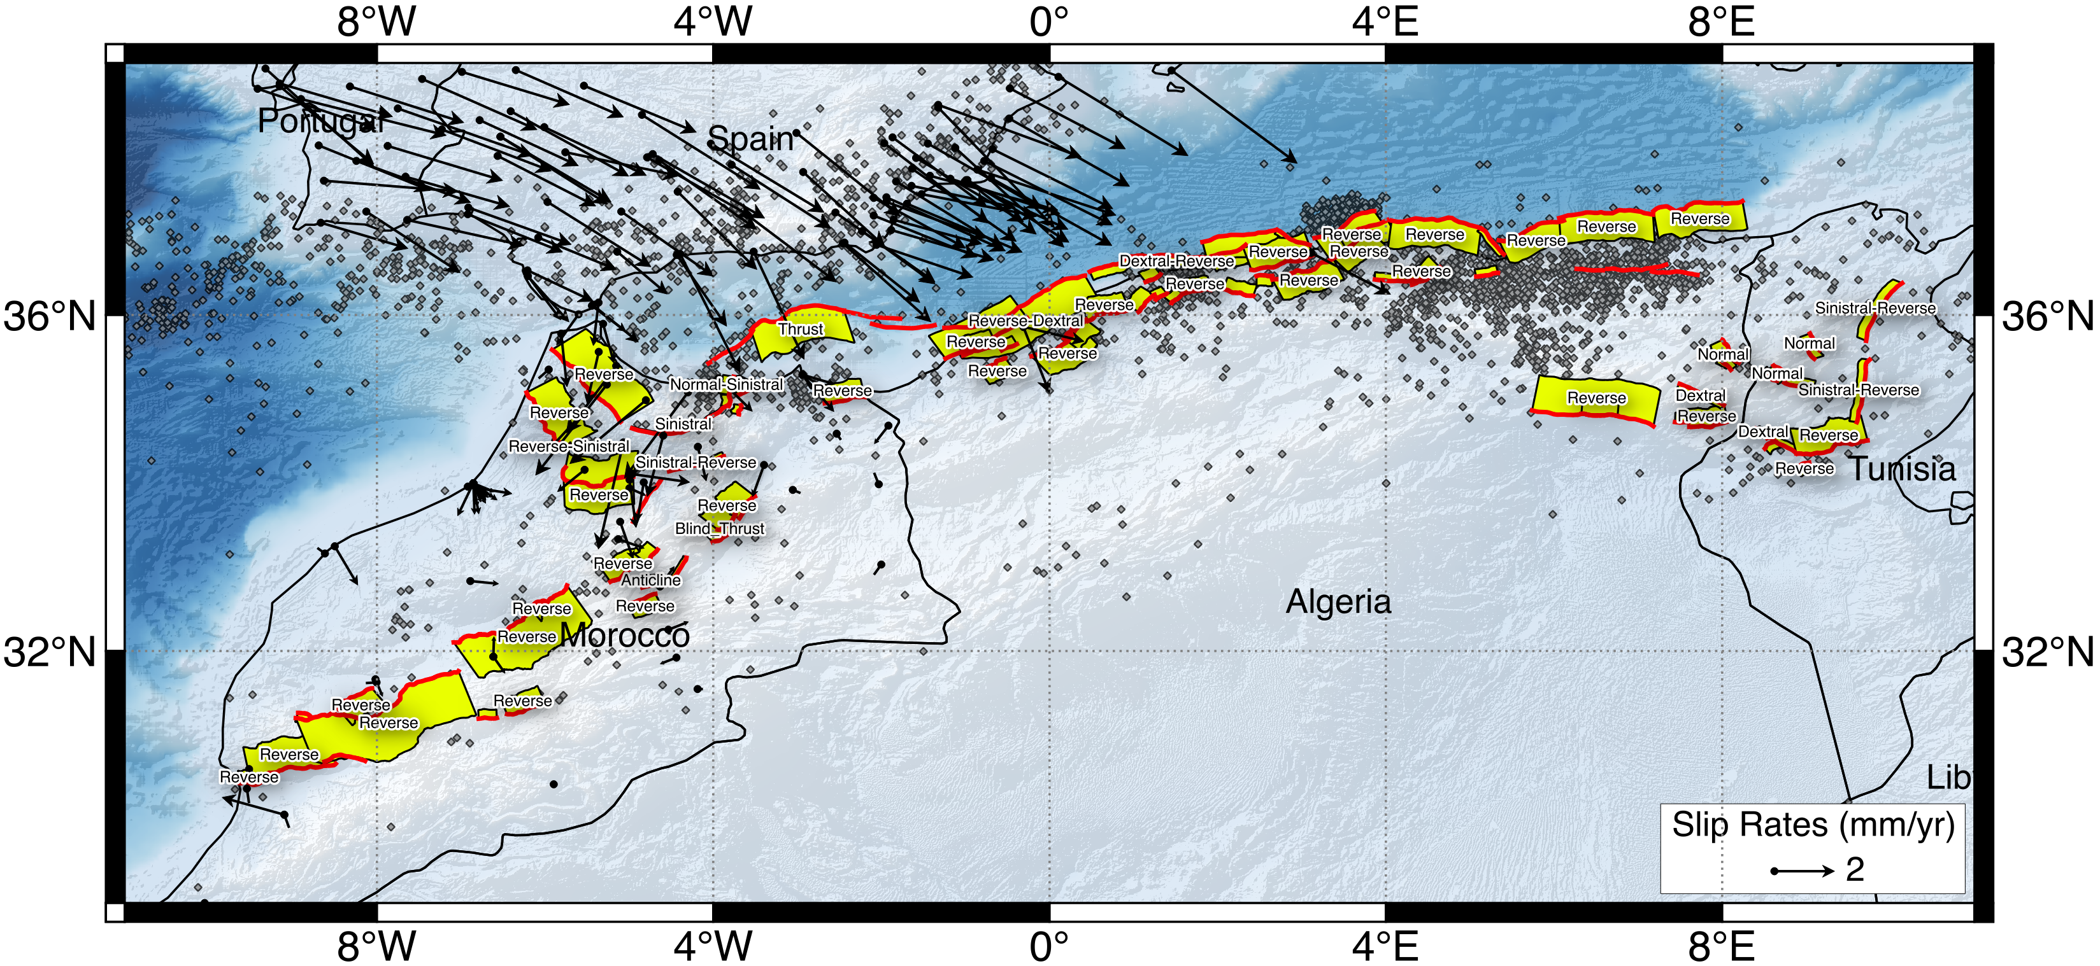
Global Active Fault Database
New database of active faults from Morocco to Sinai
143 structures mapped from literature, satellite imagery, topography, seismicity
Slip taken from literature or estimated from GPS
Public and open-source (Creative Commons Attribution license)

Slide 14
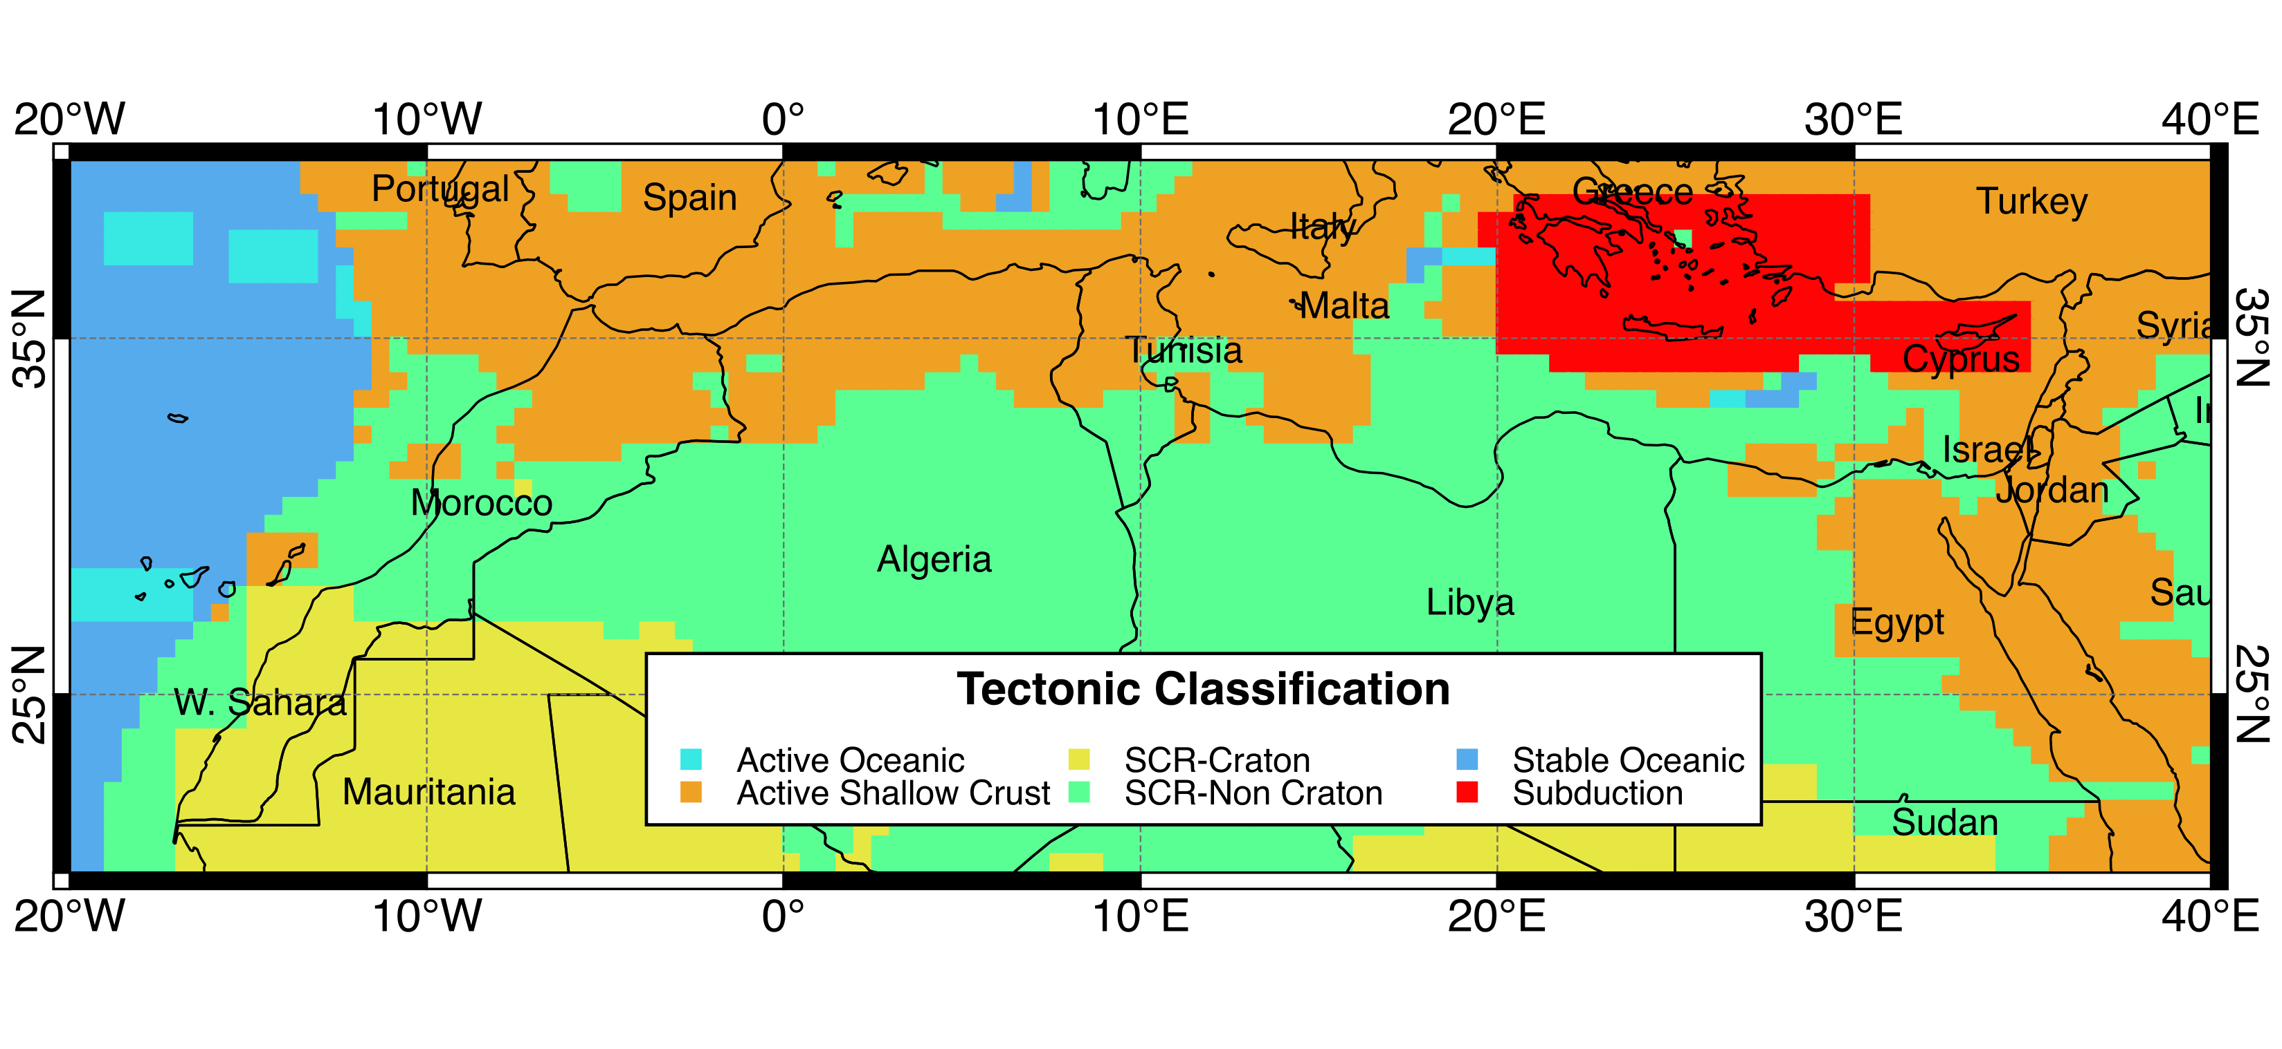
Tectonic Regionalization using Fuzzy Logic
Chen et al. 2017
(Under review)
Merging information from:
Seismicity (magnitude)
Smoothed Moment rate
S-wave velocity
Q_{LG} distribution

Slide 15
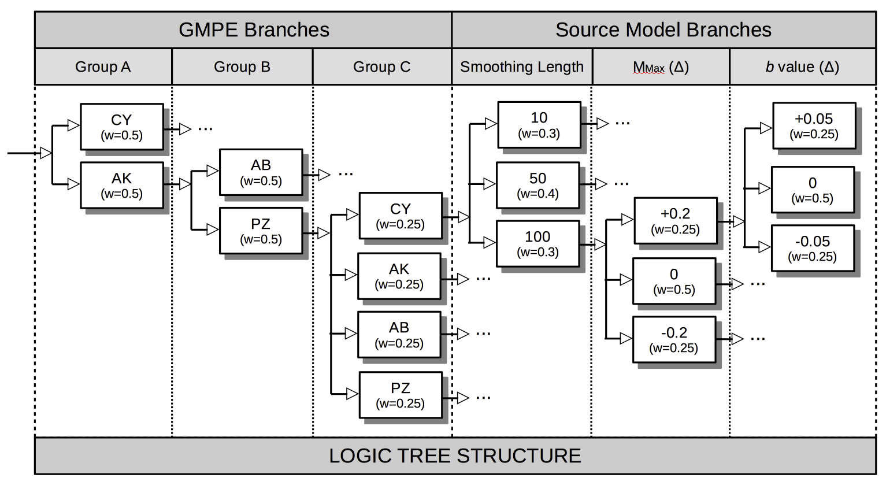
GMPE Selection and Logic-Tree Approach
Given the peculiar seismoteconic setting of the North Africa, an hybrid attenuation behavior might be expected. Four suitable GMPEs have been selected:
Chiou & Youngs (2014)
Akkar et al. (2014)
Atkinson & Boore (2006)
Pezeshk et al. (2011)
→ Active Shallow Crust
→ Stable Continental Crust
Three main tectonic groups are then identified, each with a different GMPE weighting scheme
Logic Tree

Slide 16
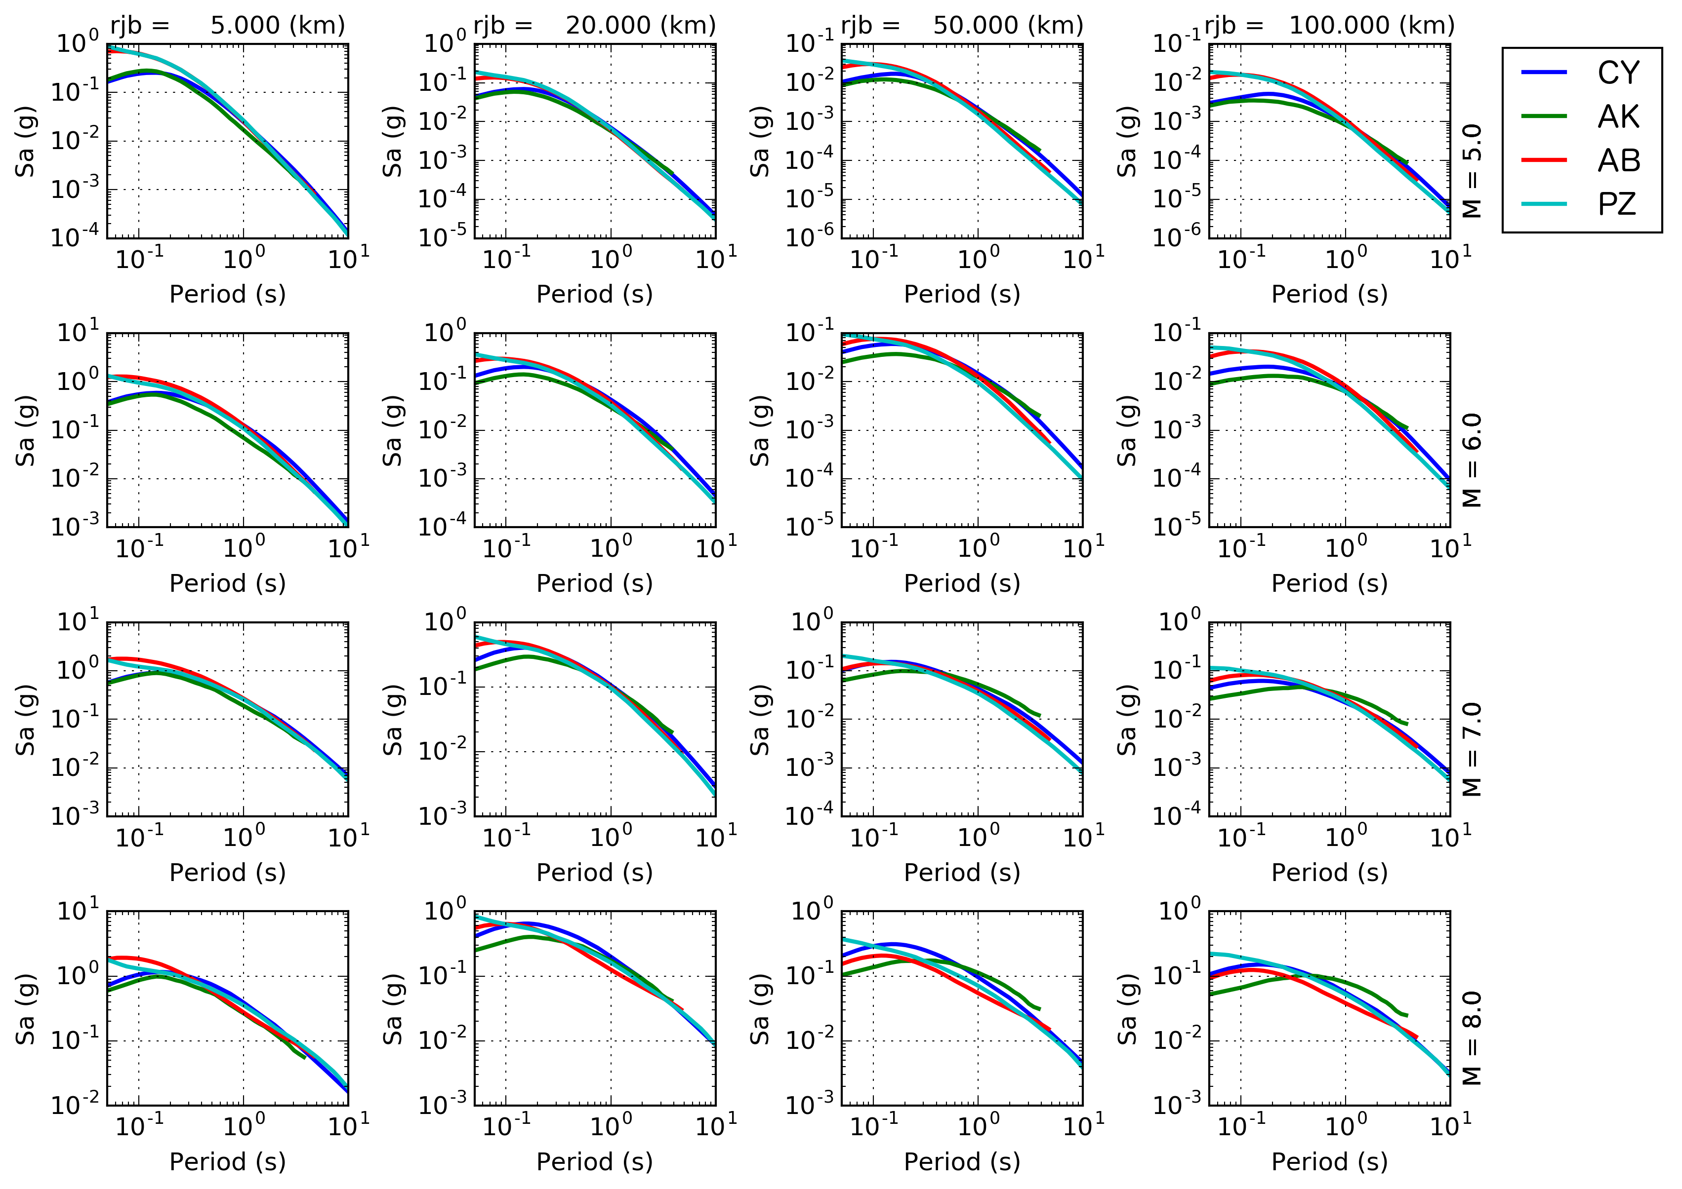
GMPE Selection – Comparing Ground Motion
Distance (rjb)
Selection needs verification with empirical data….
Magnitude

Slide 17
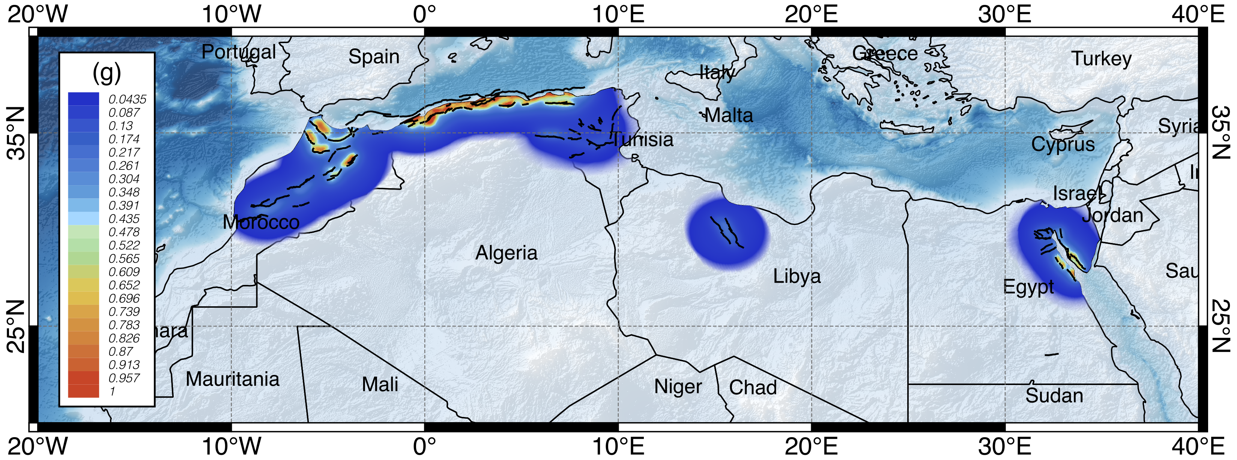
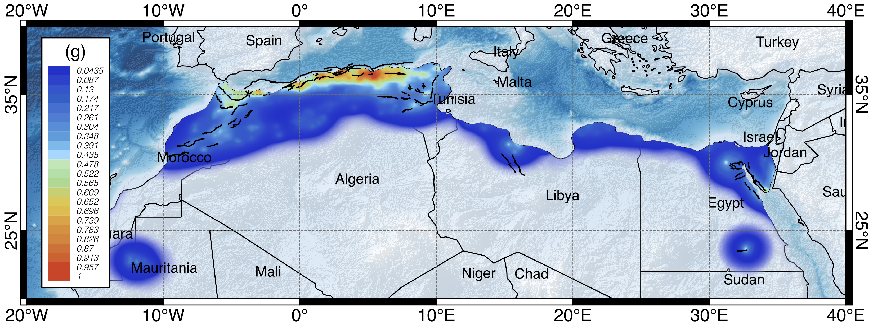
Preliminary Hazard Results
Fault Source Model
10% POE in 50 years (0.2s)
Smoothed Seismicity Model

Slide 18
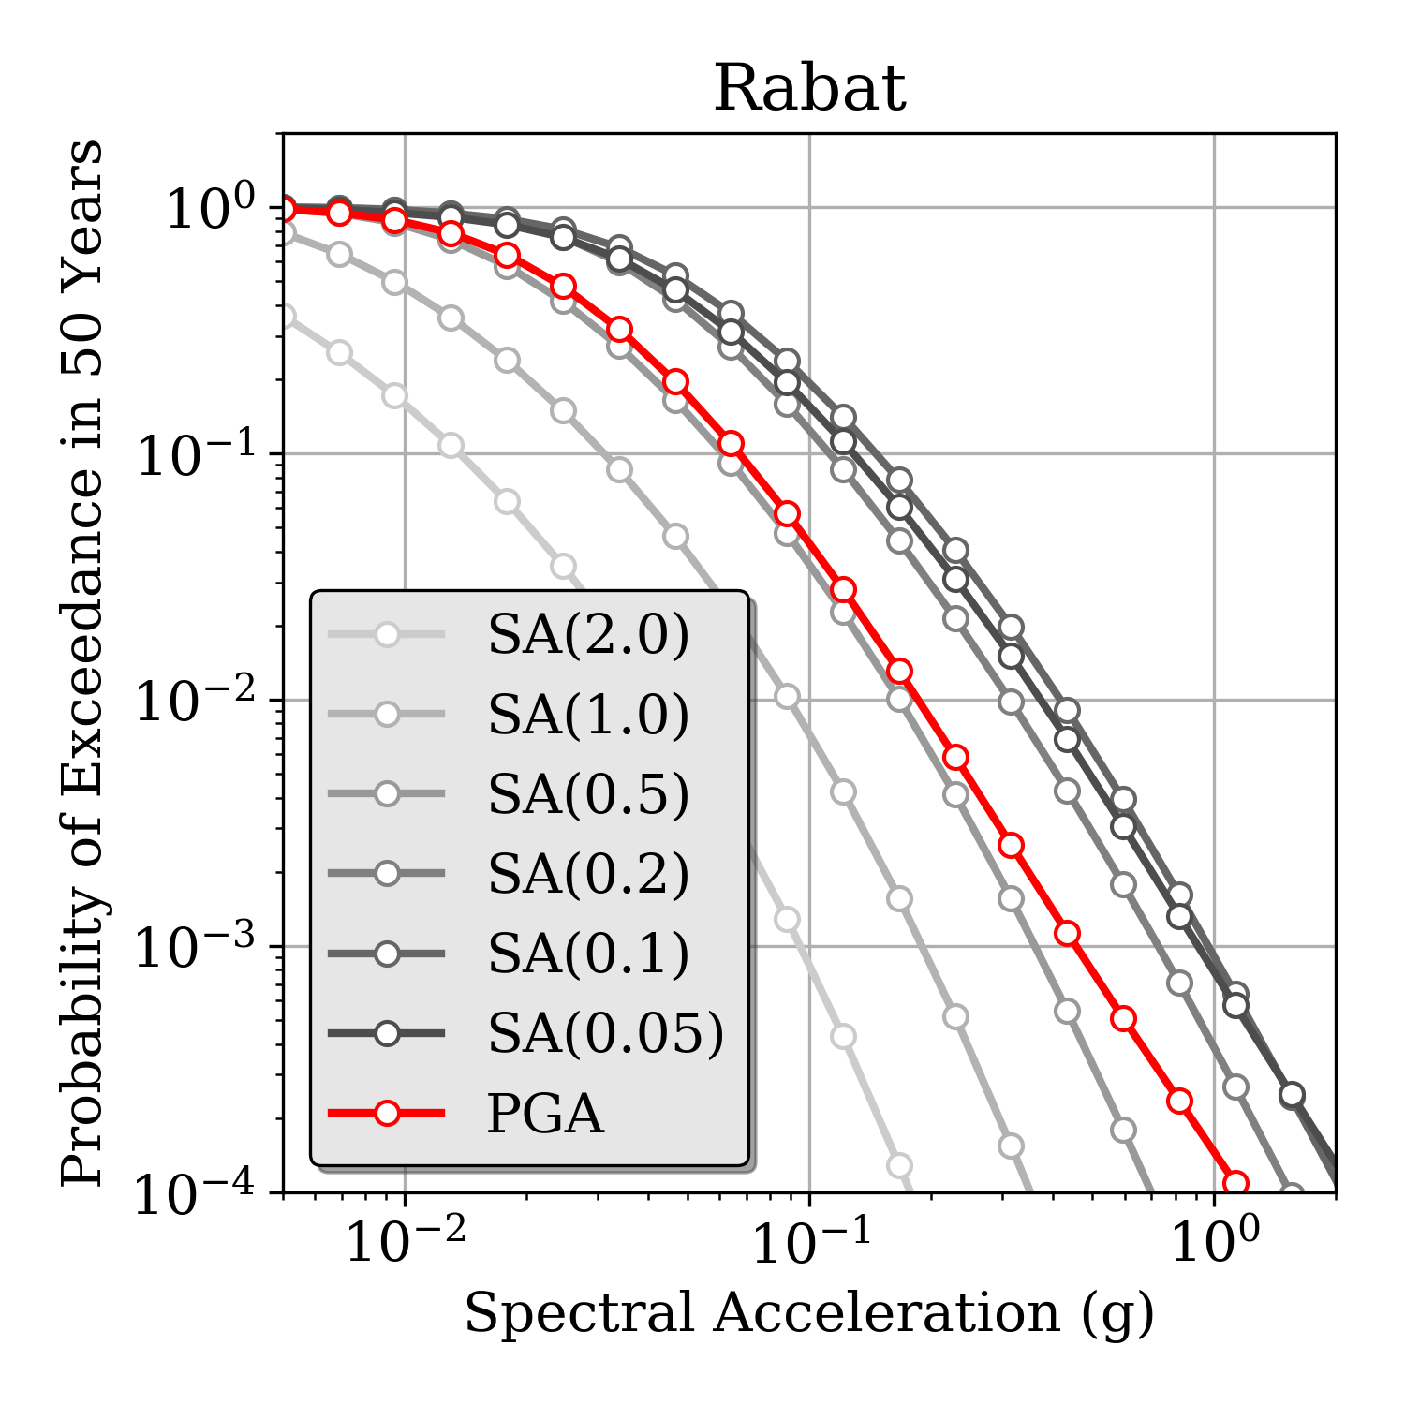
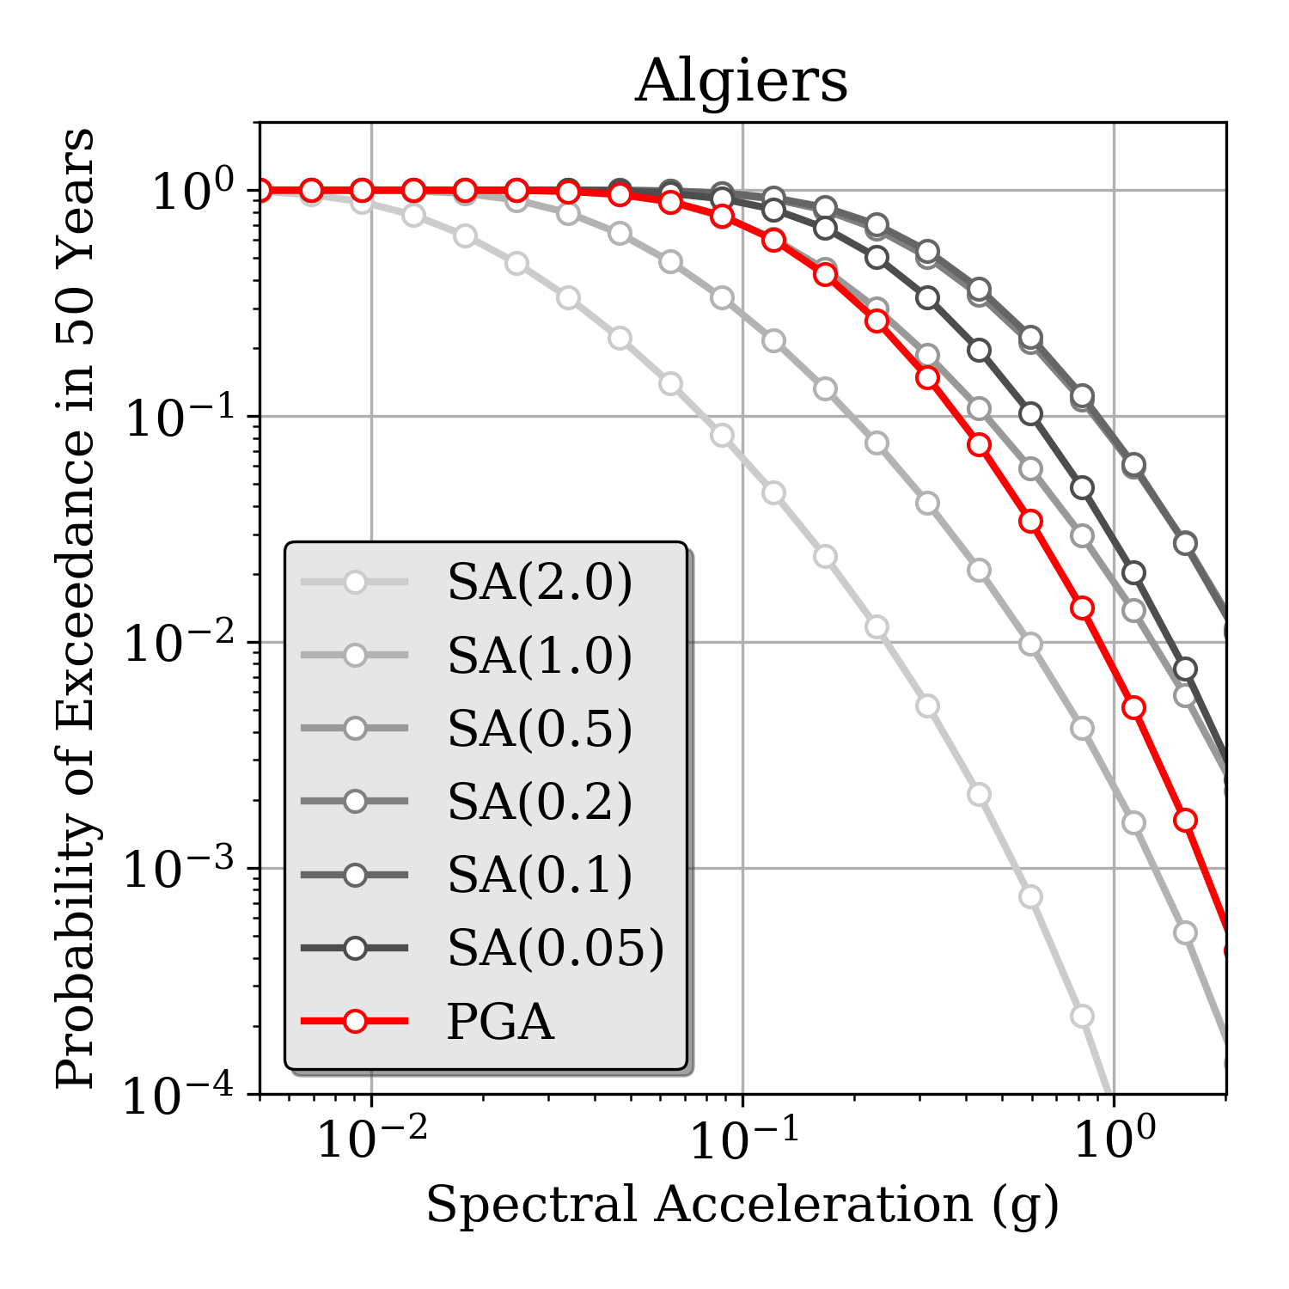
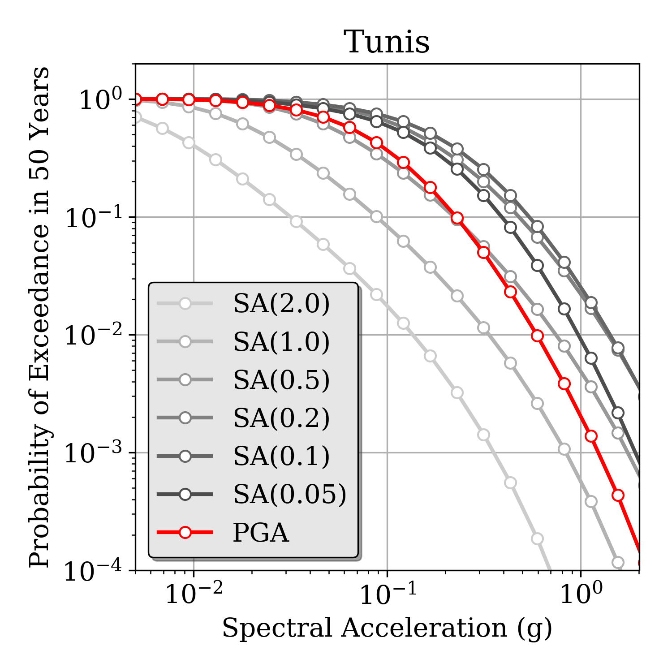
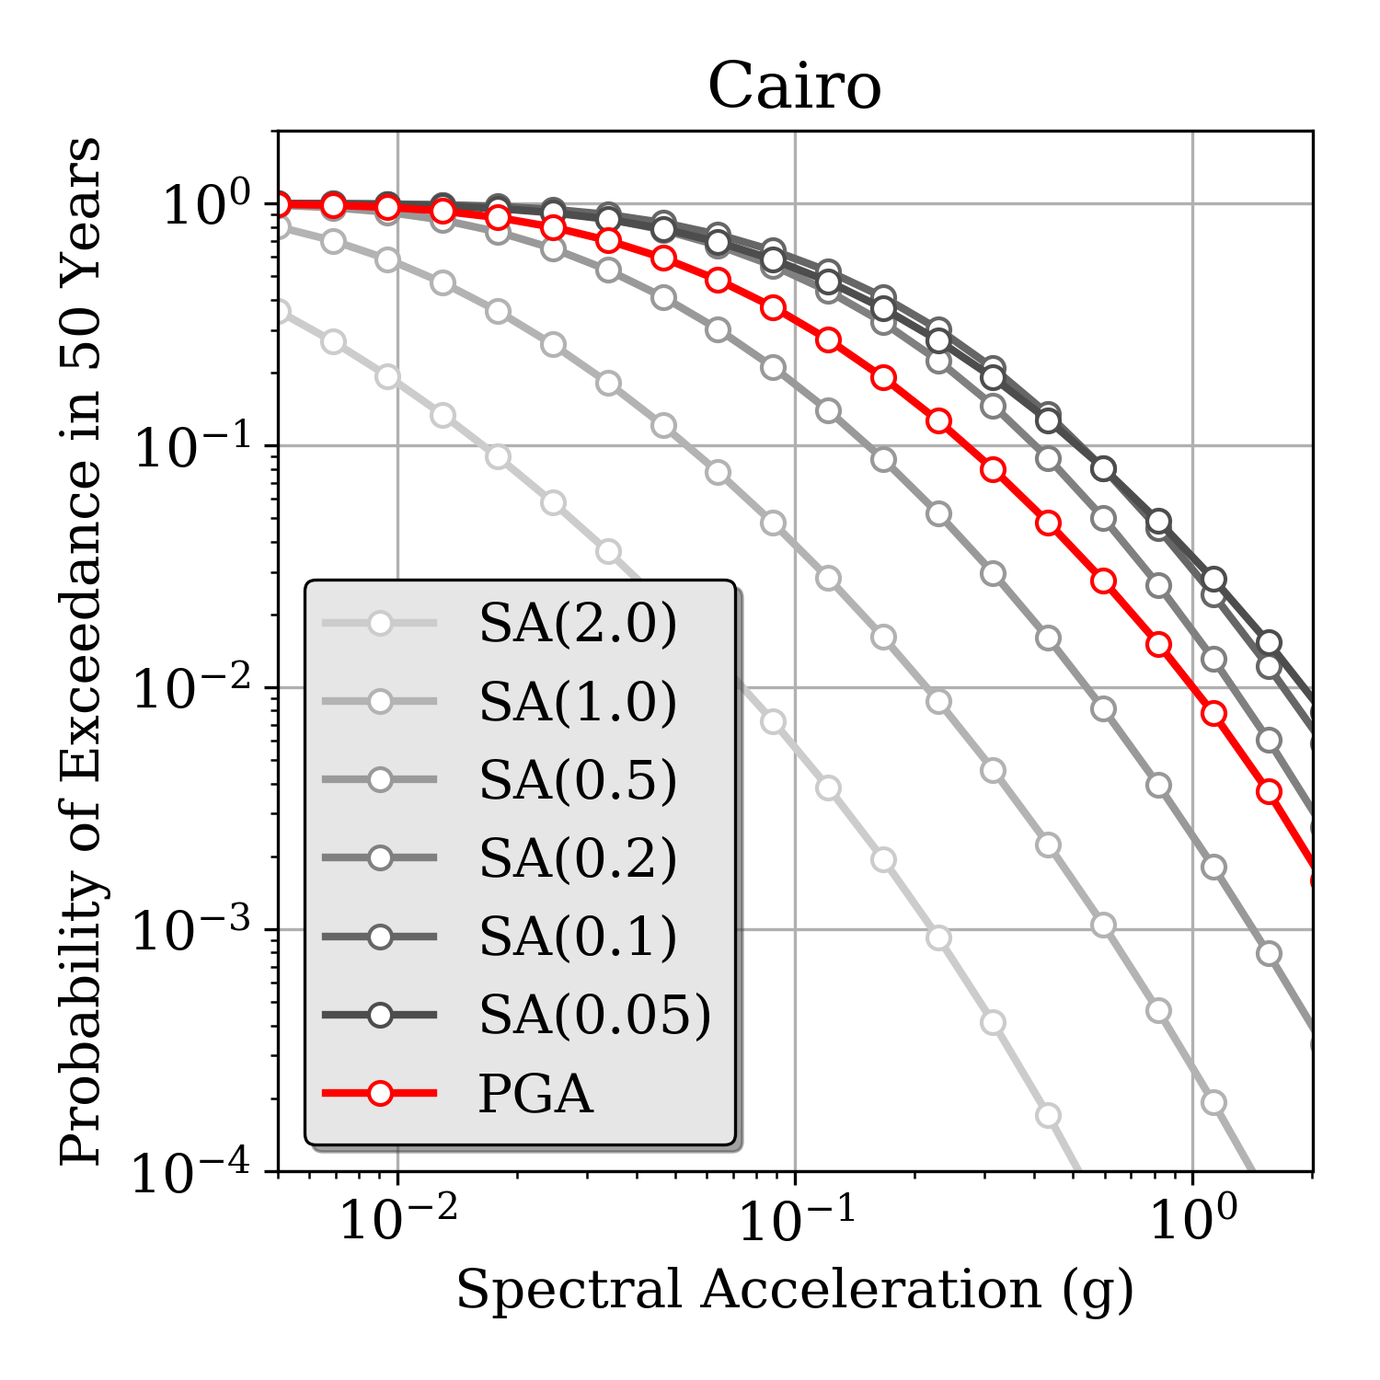
Hazard Curves @ African Capitals
Morocco
Algeria
Tunisia
Egypt
PRELIMINARY

Slide 19
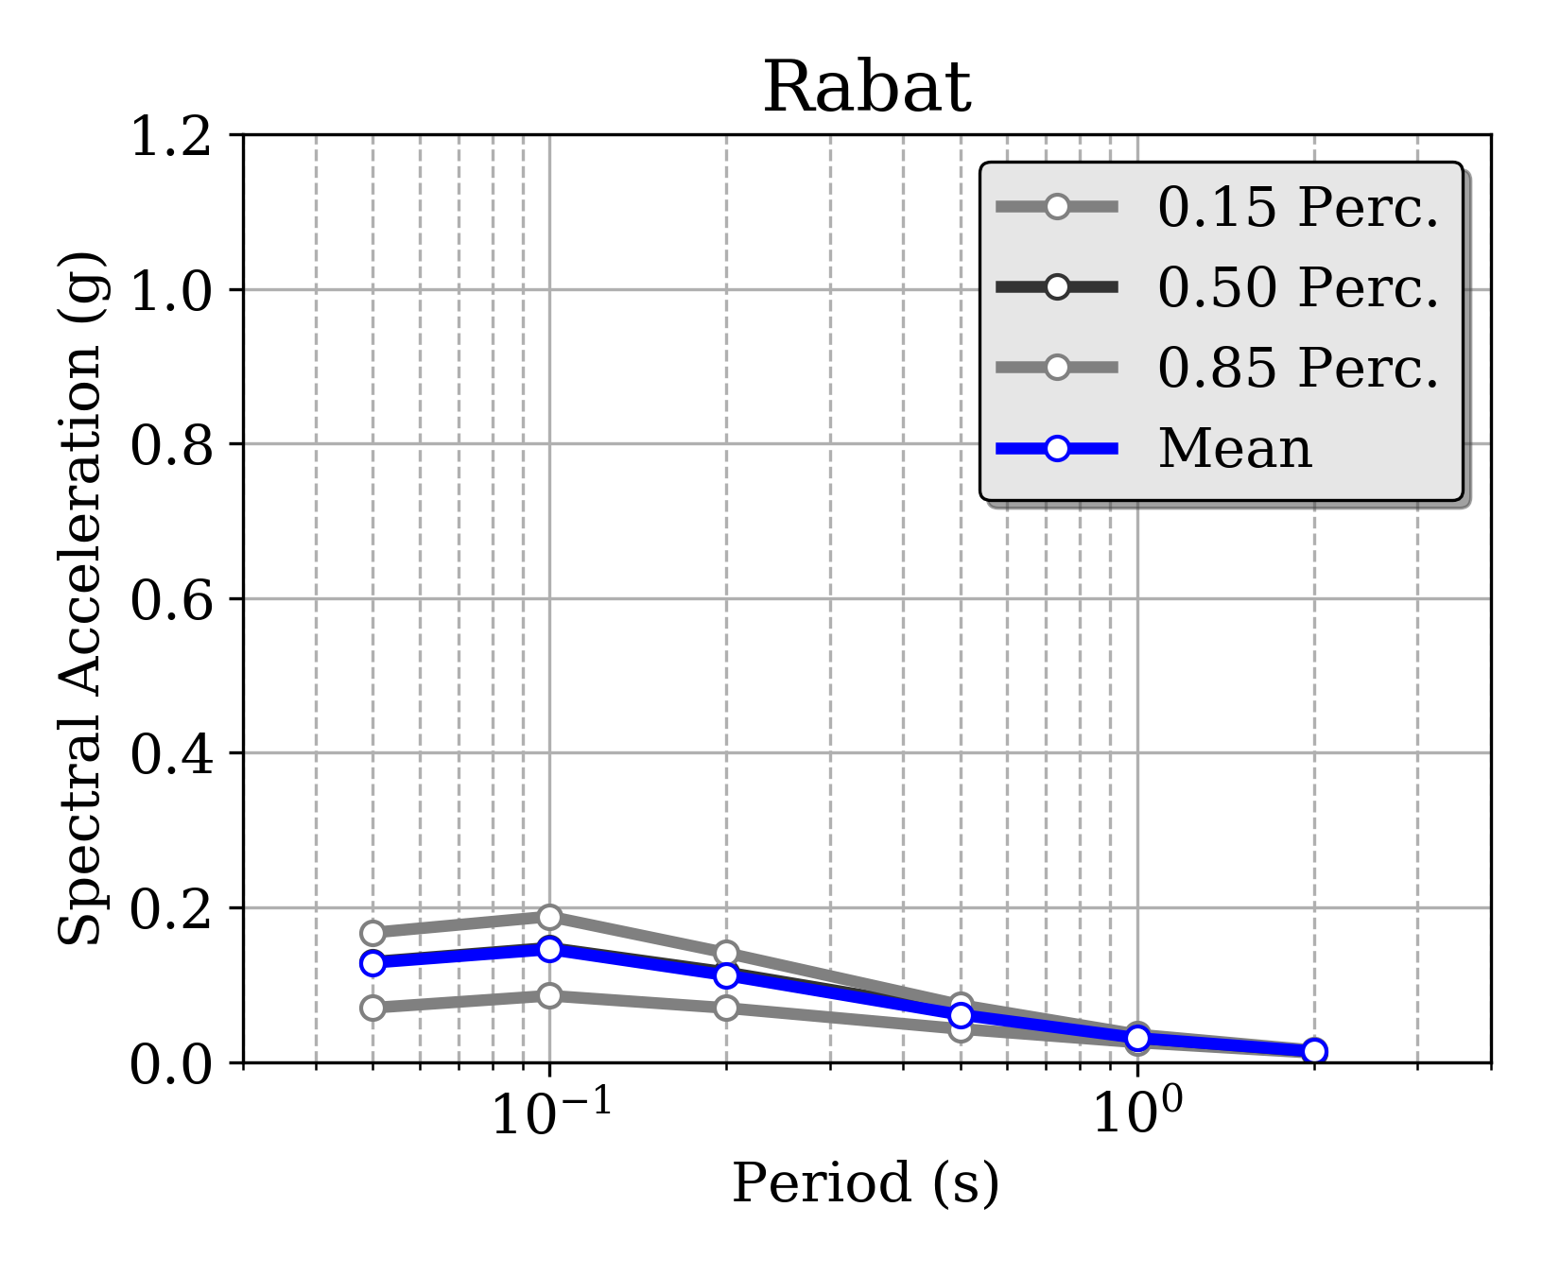
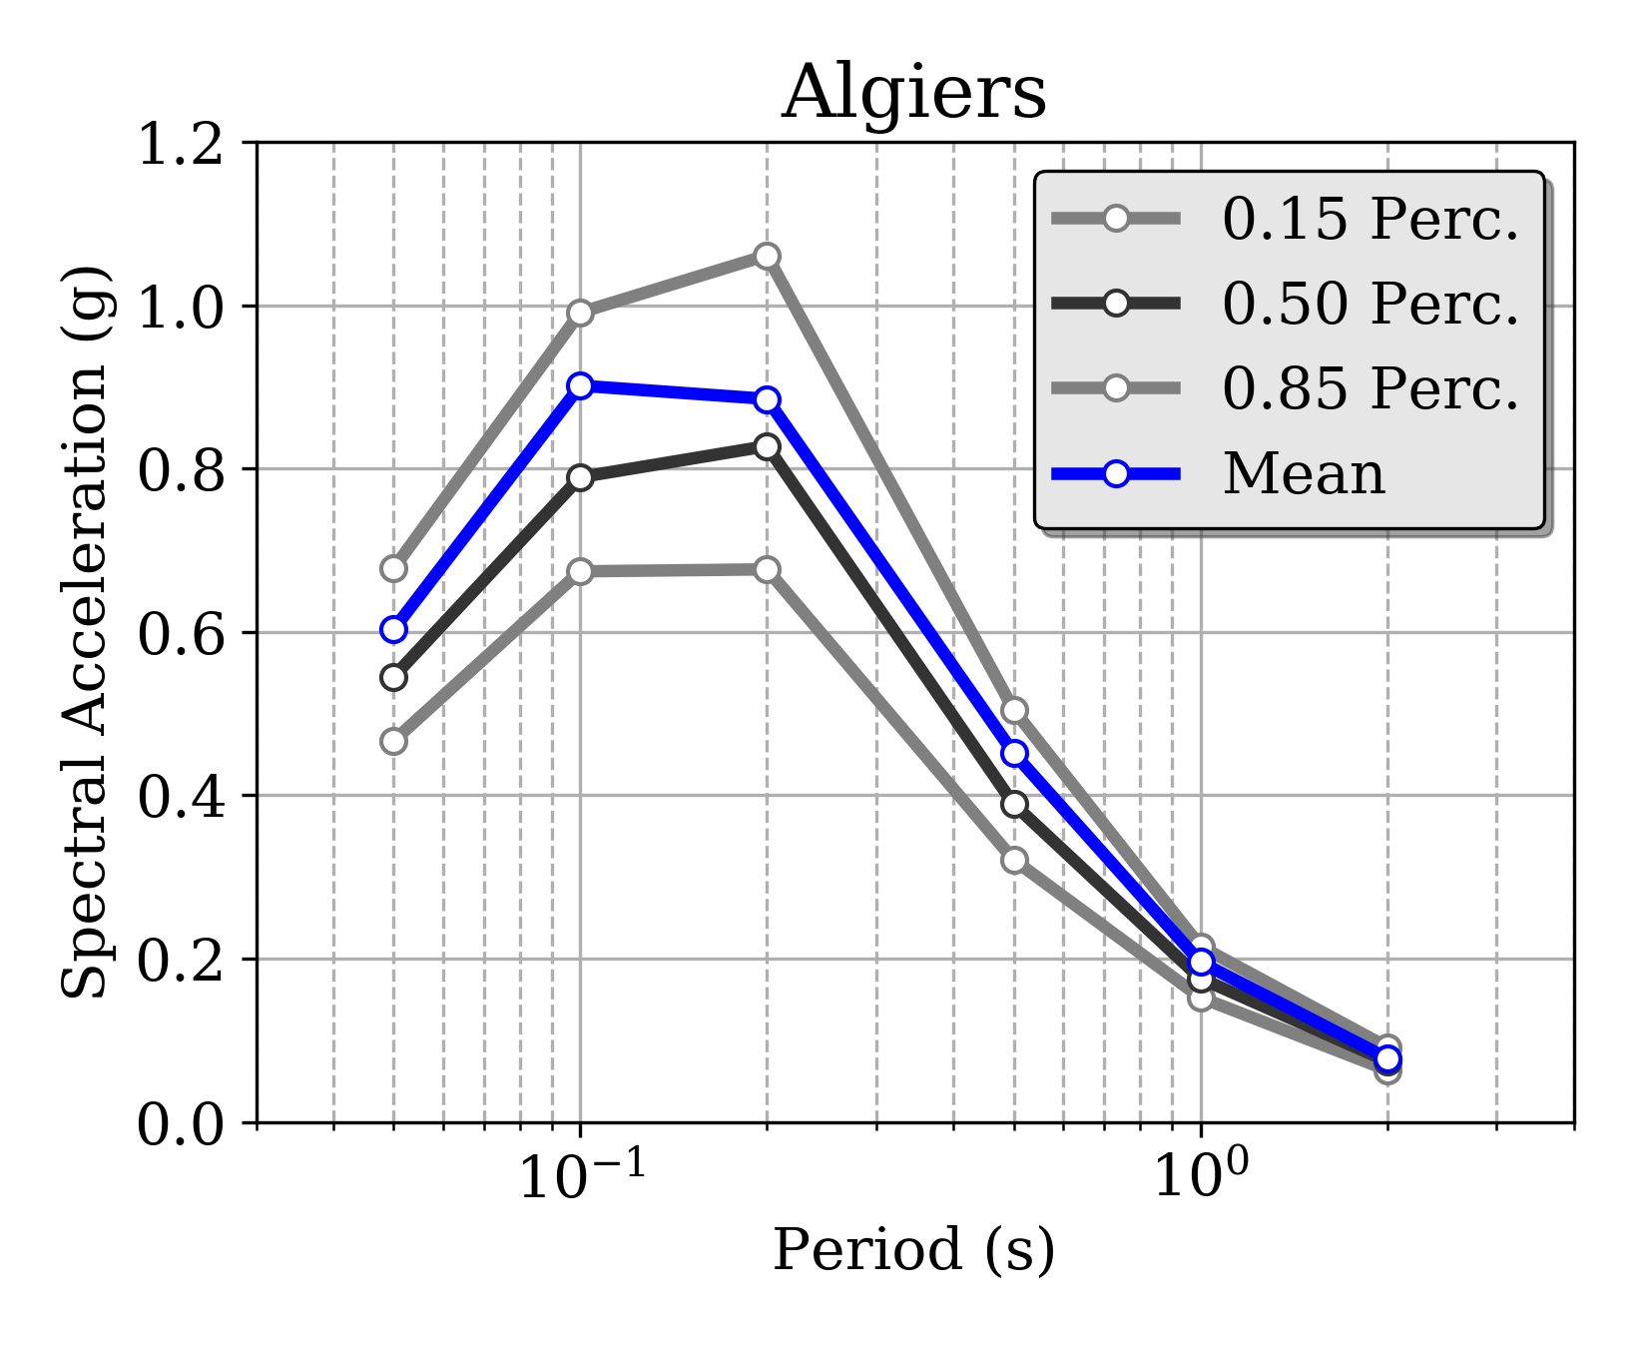
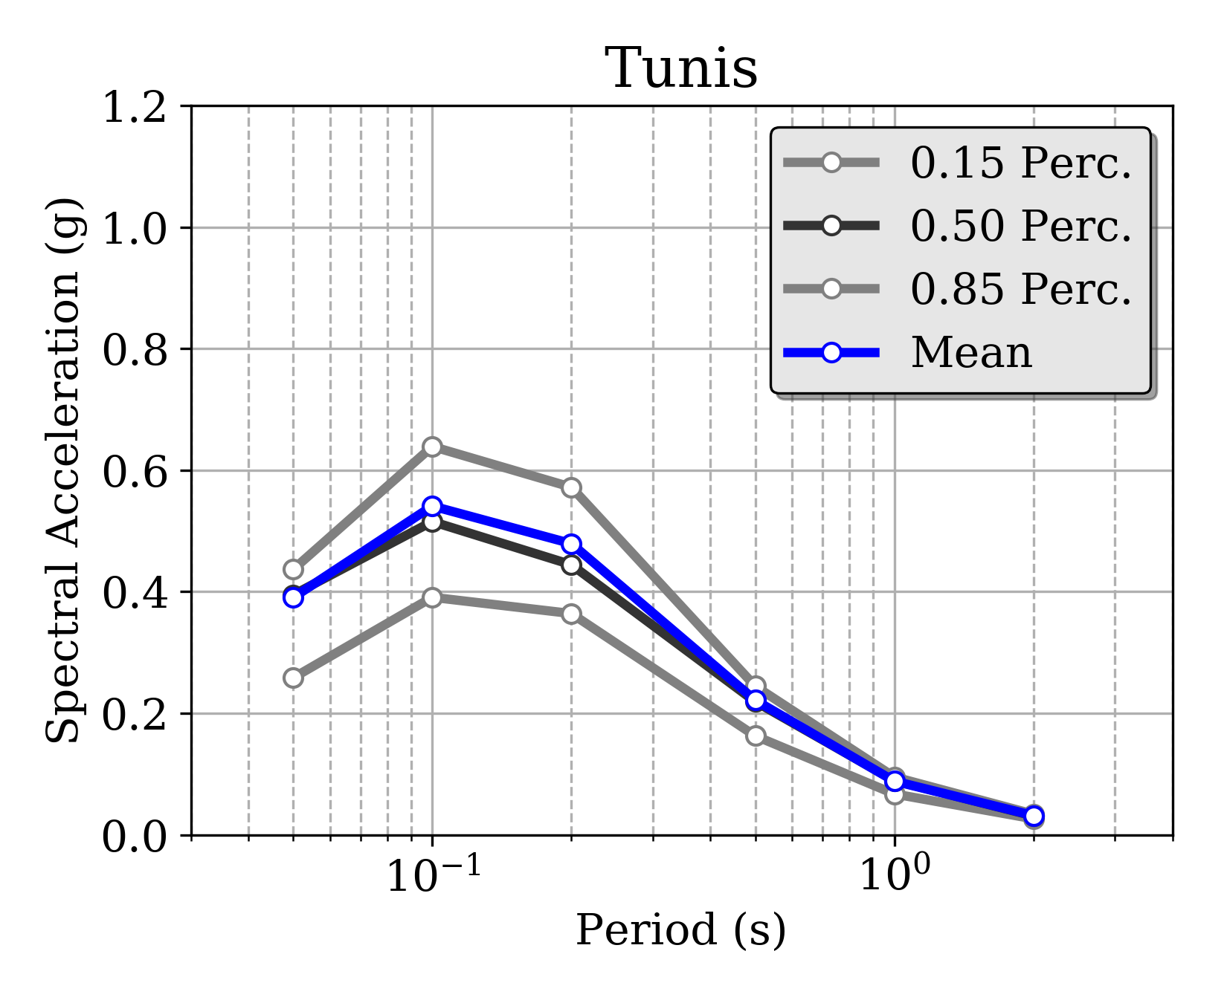
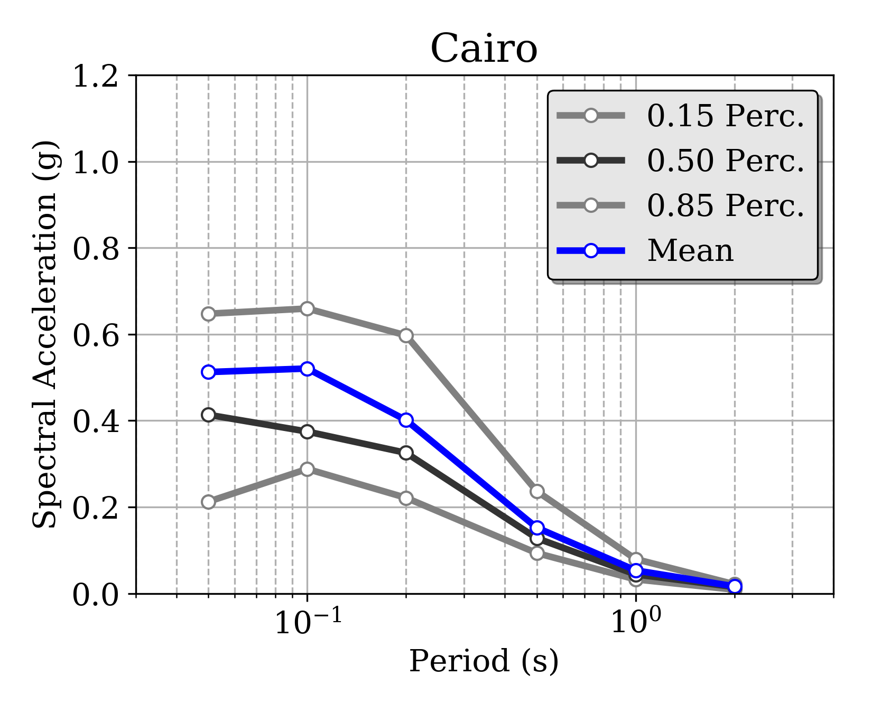
Uniform Hazard Spectra @ African Capitals
Morocco
Algeria
Tunisia
Egypt
PRELIMINARY
10% POE in 50 years

Slide 20

Missing Components / Improvements
The North-Africa Hazard model is presently just in a GEM product, but it is meant to be improved and expanded with the collaboration of the African and worldwide scientific community
While existing components can be improved, many other components are still missing, such as:
Integration of local hazard studies
Strong motion recordings from local networks
Site-specific studies and microzonation
Need for a collaborative effort

Slide 21

Thank you!
  Except where otherwise noted, this work is licensed under https://creativecommons.org/licenses/by-nc-nd/3.0/
  Please attribute to the GEM Foundation with a link to
  www.globalquakemodel.org

