Slide 1

Probabilistic Seismic Hazard Assessment of North Africa: a GEM's Product
Valerio Poggi, Julio Garcia, Richard Styron, Robin Gee
Global Earthquake Model (GEM), Pavia Italy
36th General Assembly of the
European Seismological Commission
September 3rd, 2018, Valletta - Malta

Slide 2


Introduction to GEM
GEM (Global Earthquake Model) is a no-profit organization funded by public and private partners aimed to stimulate the awareness on seismic hazard and risk worldwide
The overall goal of the hazard component of the GEM community is:
the construction of a global mosaic of open hazard models
to provide the community with tools (such as OpenQuake), datasets and knowledge to achieve this goal

Slide 3




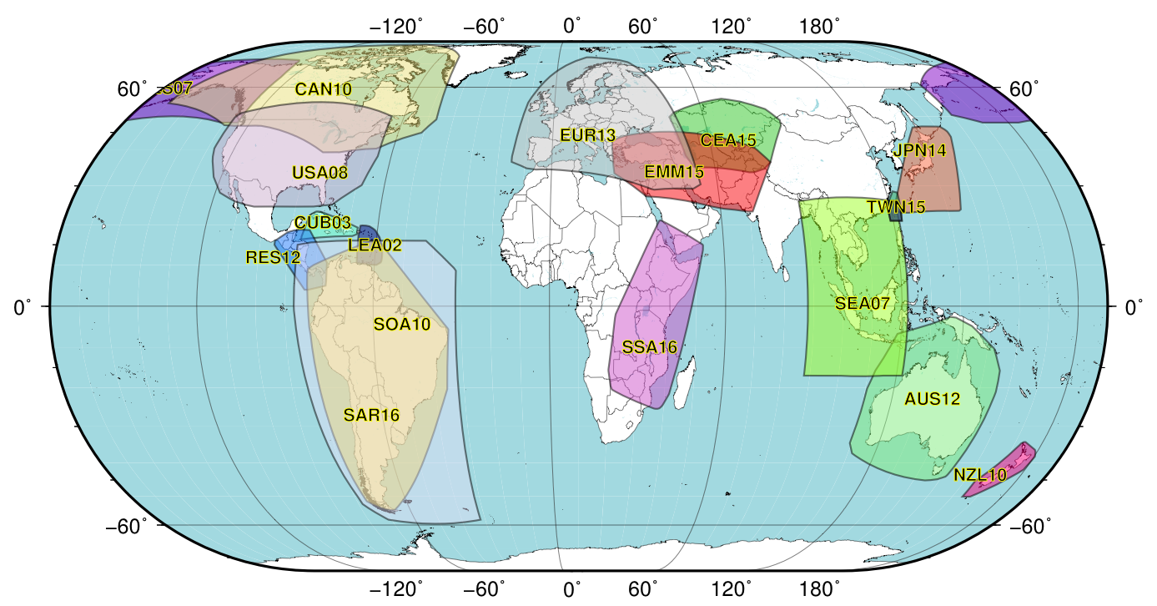






GEM Global Database of Hazard Models
The DB contains hazard models developed by national agencies and international projects which are openly distributed
NWA18
NAF18
RESIS 2
Project
SARA
Project
SSAHARA Project

Slide 4
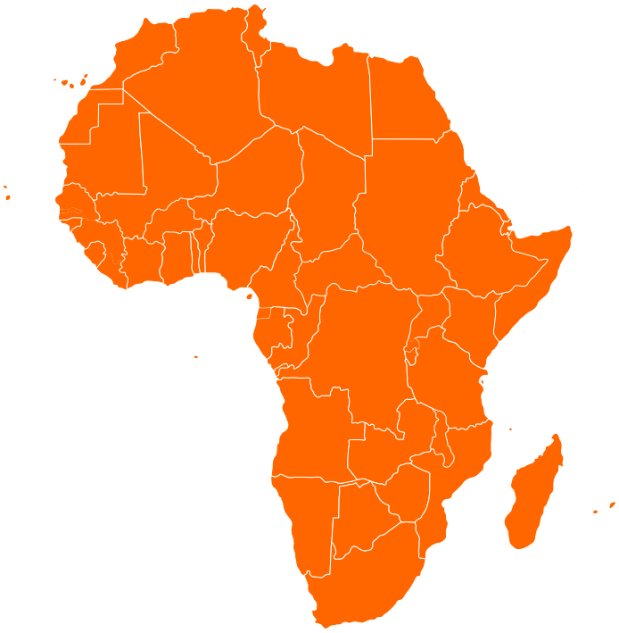
Earthquake Hazard in North Africa
Besides the East African Rift System, significant seismicity also occurs along a wide belt bounding the Mediterranean coastline
Several past large earthquakes caused a non-negligible level of damage
A reliable risk assessment is therefore essential, which requires a state-of-art hazard assessment for the region
There is a need for a new probabilistic seismic hazard model based on the most recent and up to date available information
NAF18

Slide 5
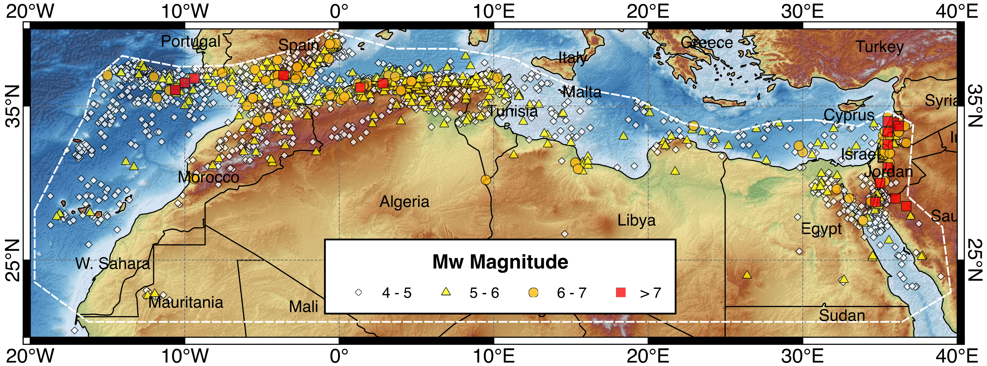
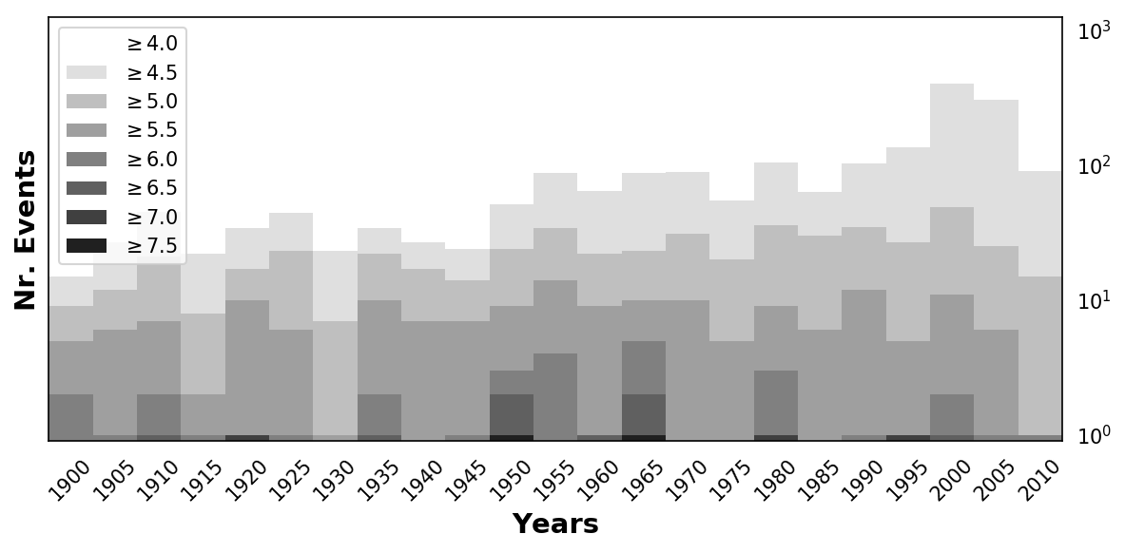
North Africa Homogenized Earthquake Catalogue
ISC-GEM
ISC Reviewed
GCMT
IGN
GEM-GHEC
EMEC
Literature
Mw
The catalogue is obtained by harmonization of global bulletins with data from local agencies and published studies
Number of Events: 5170
Year Rage: 1016 - 2013
Magnitude Rage: 4.0 - 8.5

Slide 6
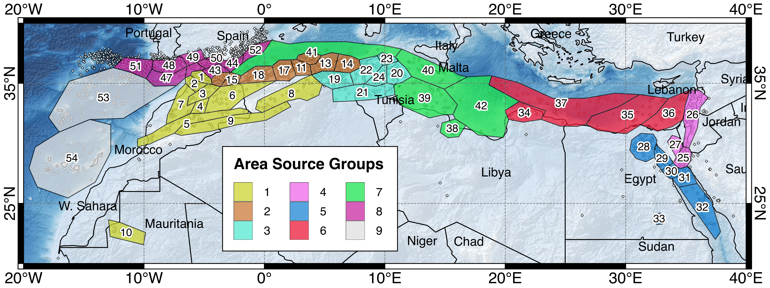
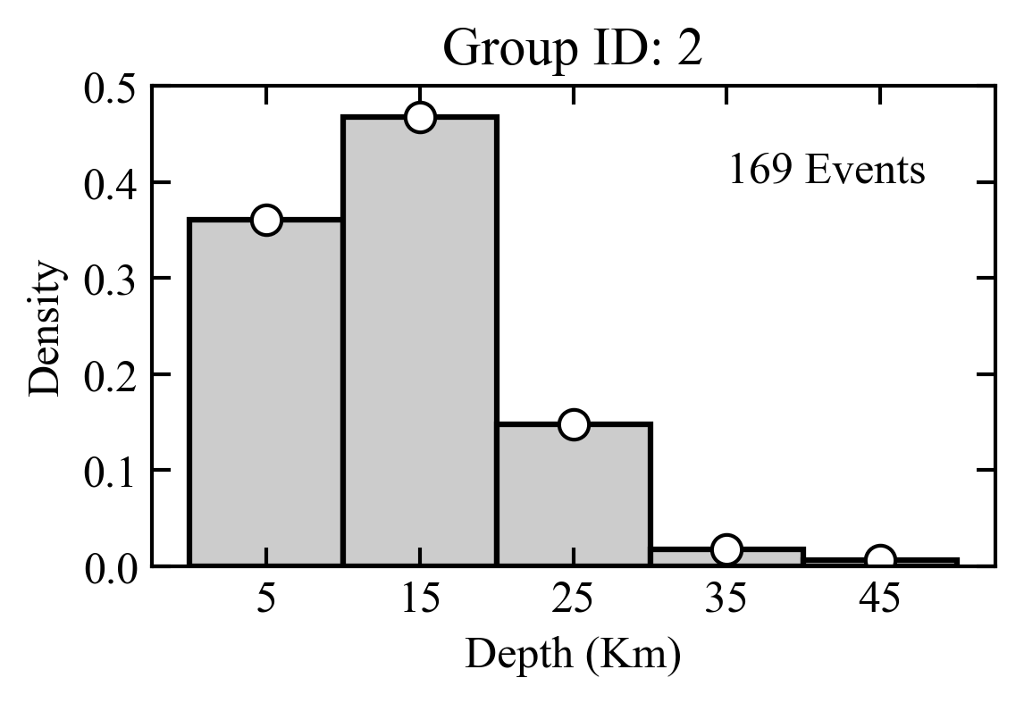
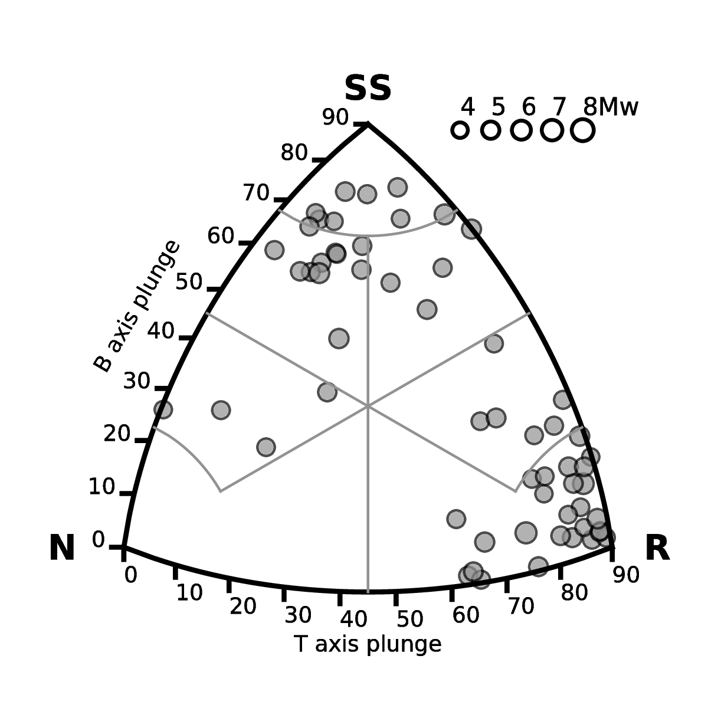
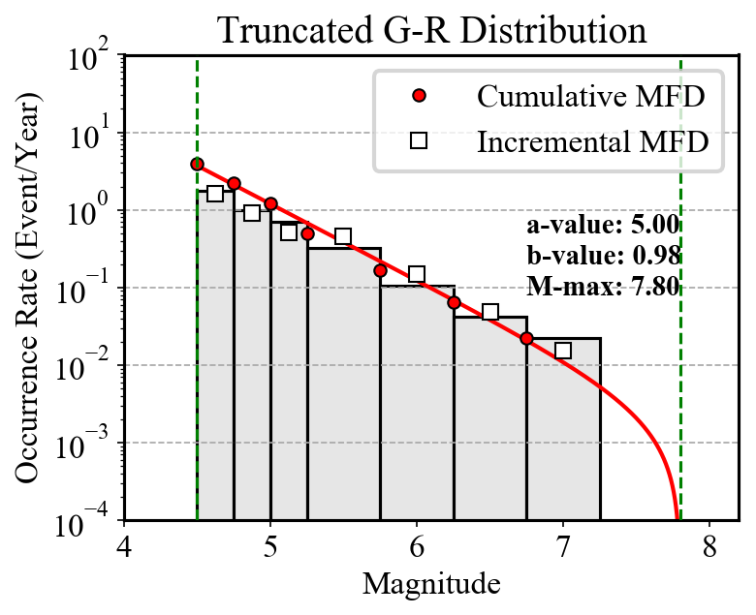
Source Model - Regional Seismicity Analysis
Earthquake
Source Zones
Rupture Mechanism
Identification
Magnitude-Frequency
Analysis
Hypocentral Depth
Distribution

Slide 7
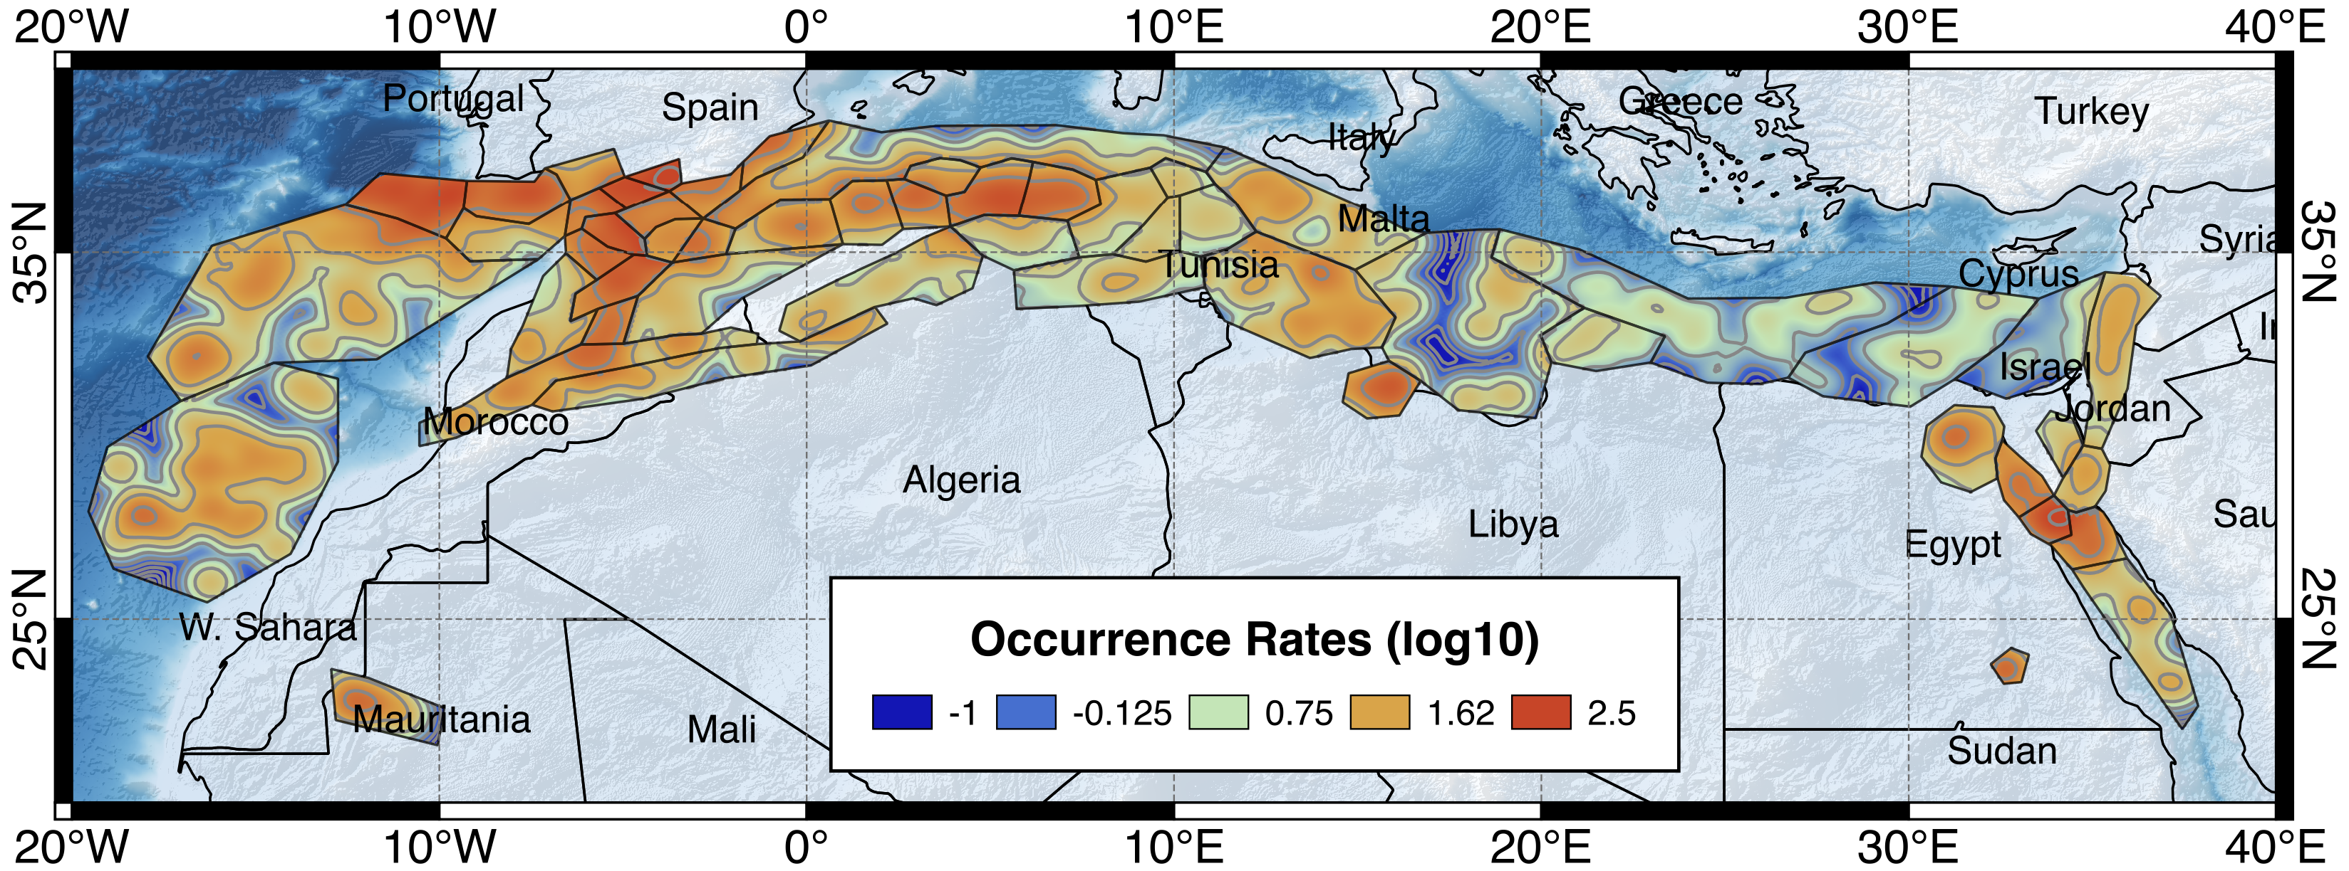
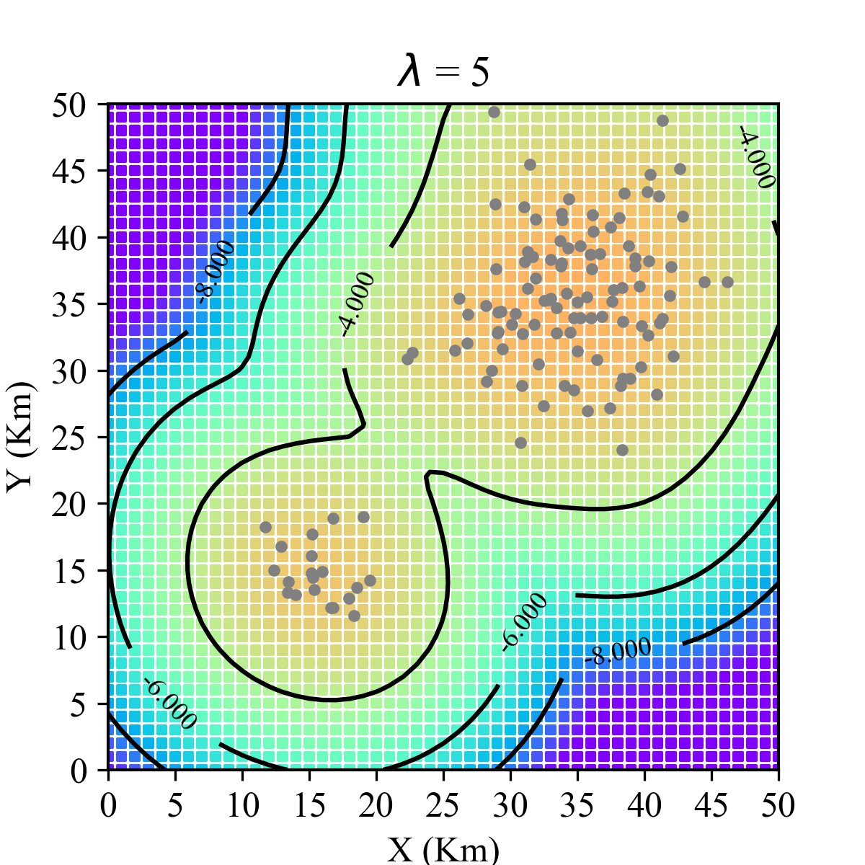
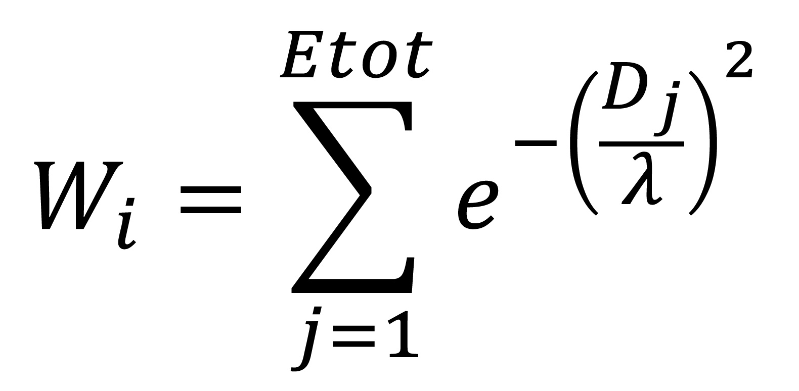
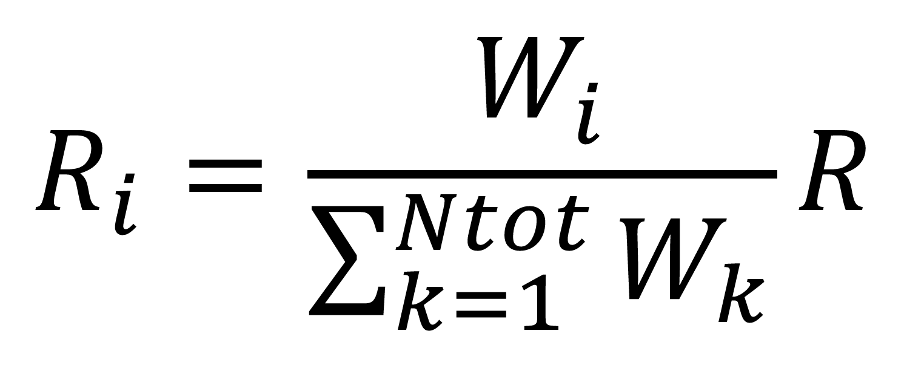
Occurrence Rate Redistribution
We have implemented a smoothing procedure based on area source zonation, where the observed rates (R) are spatially redistributed according to the seismicity pattern of the area, while keeping the overall rate balance unmodified:

Slide 8
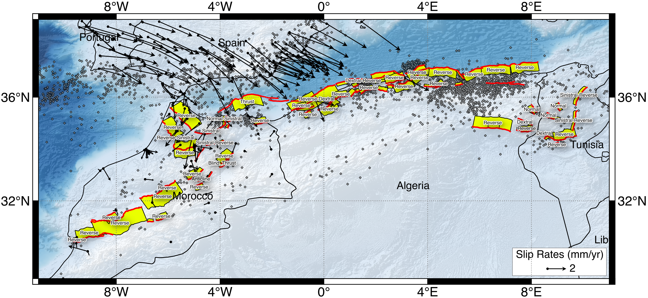
Global Active Fault Database
New database of active faults from Morocco to Sinai
143 structures mapped from literature, satellite imagery, topography, seismicity
Slip taken from literature or estimated from GPS
Public and open-source (Creative Commons Attribution license)

Slide 9
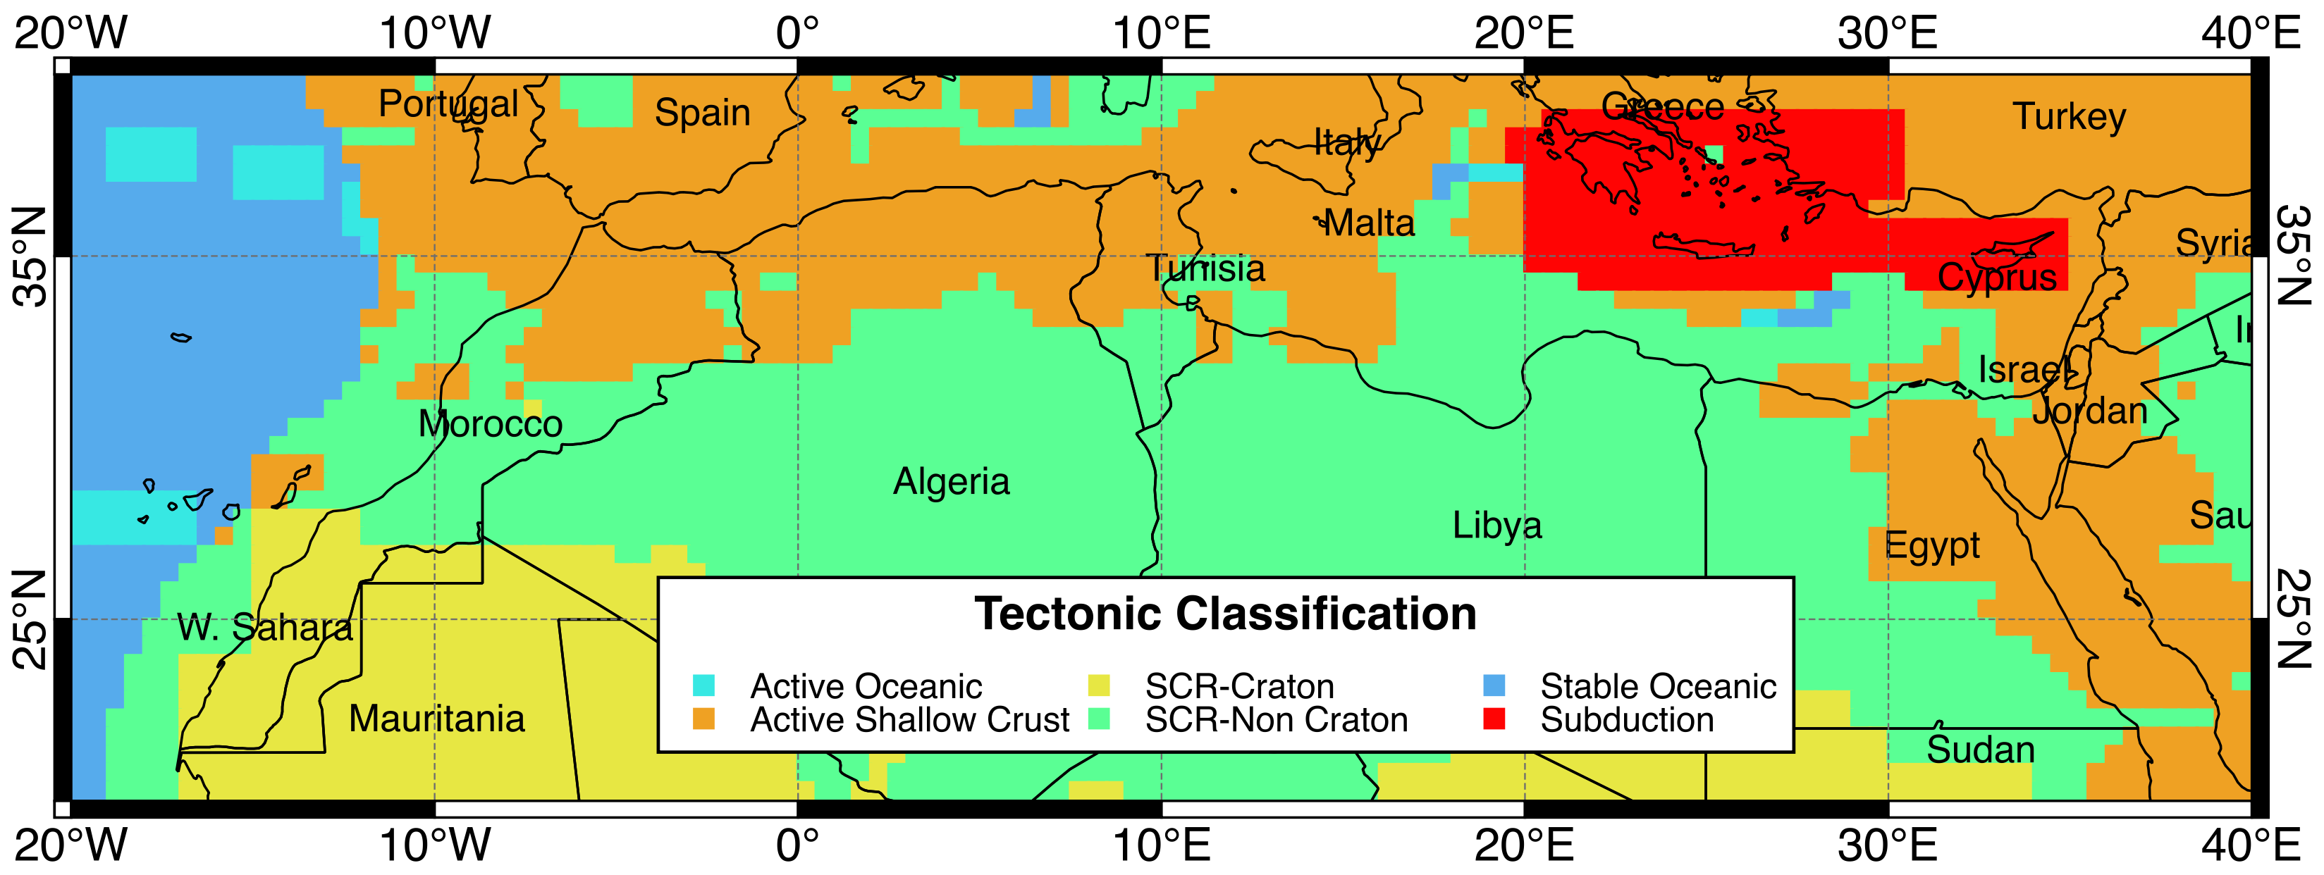
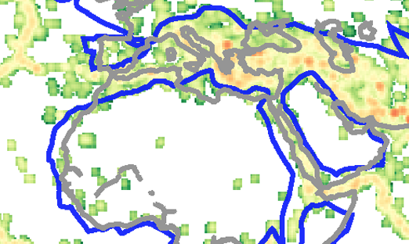
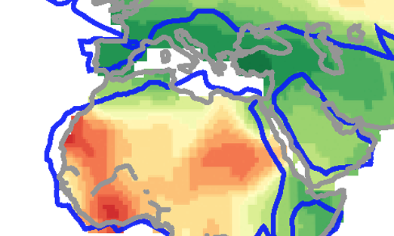
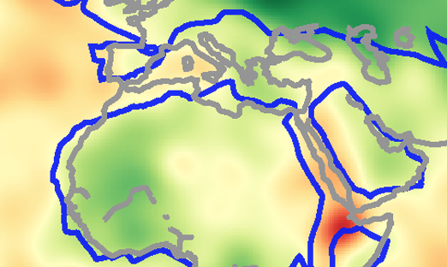
Tectonic Regionalization using Fuzzy Logic
Group A
Group B
Chen et al. 2017
Merging information from:
Seismicity (magnitude)
Smoothed Moment rate
S-wave velocity
Q_{LG} distribution

Slide 10
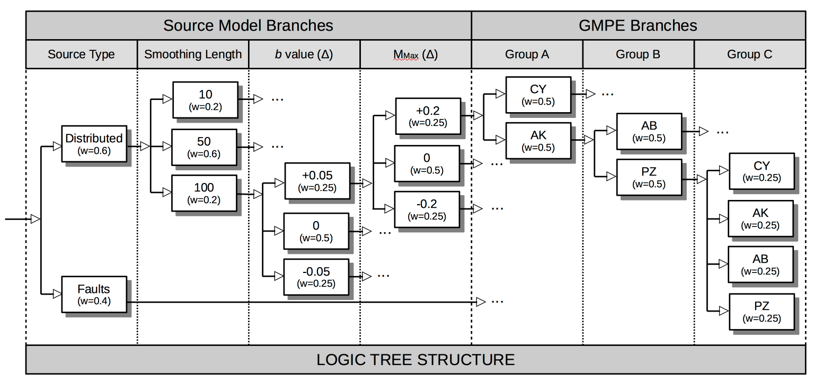
GMPE Selection and Logic-Tree Approach
Given the peculiar seismoteconic setting of the North Africa, an hybrid attenuation behavior might be expected. Four suitable GMPEs have been selected:
Chiou & Youngs (2014)
Akkar et al. (2014)
Atkinson & Boore (2006)
Pezeshk et al. (2011)
→ Active Shallow Crust (Group A)
→ Stable Continental Crust (Group B)
Three main tectonic groups are then identified, each with a different GMPE weighting scheme
Logic Tree

Slide 11
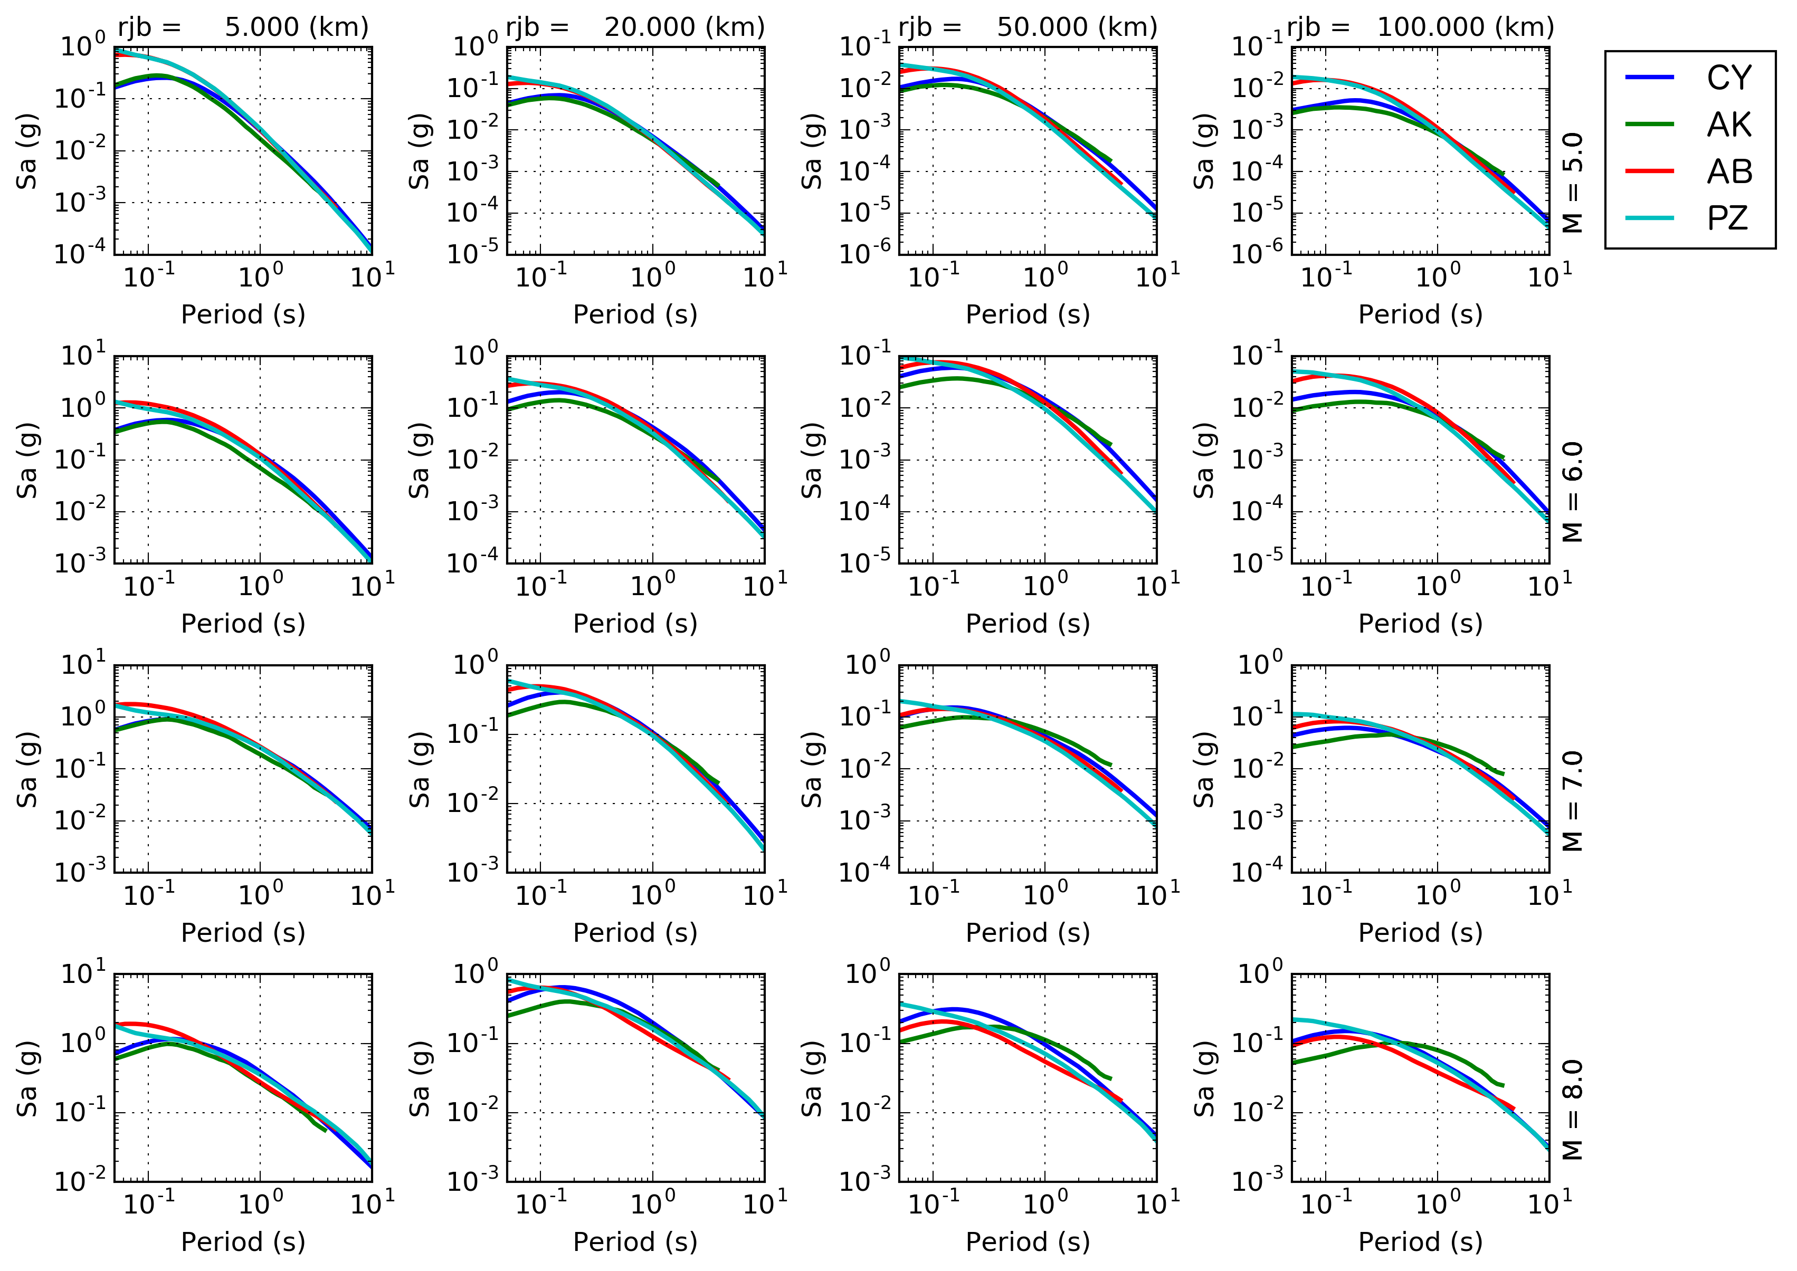
GMPE Selection – Comparing Ground Motion
Distance (rjb)
Selection needs verification with empirical data….
Magnitude

Slide 12

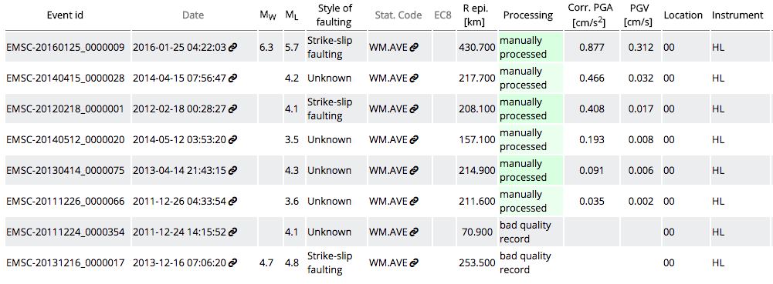
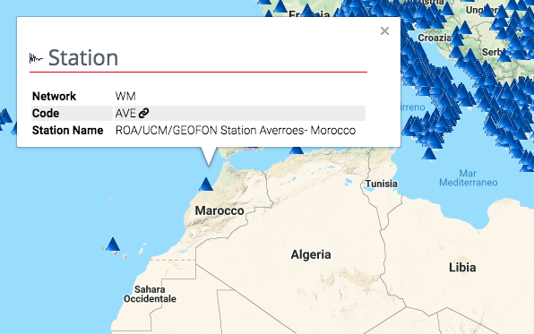
1 station in Morocco: 8 Events available
(6 usable)
2 stations in Algeria: 2 Events
Need data from local agencies (e.g. CRAAG) or neighboring countries

Slide 13
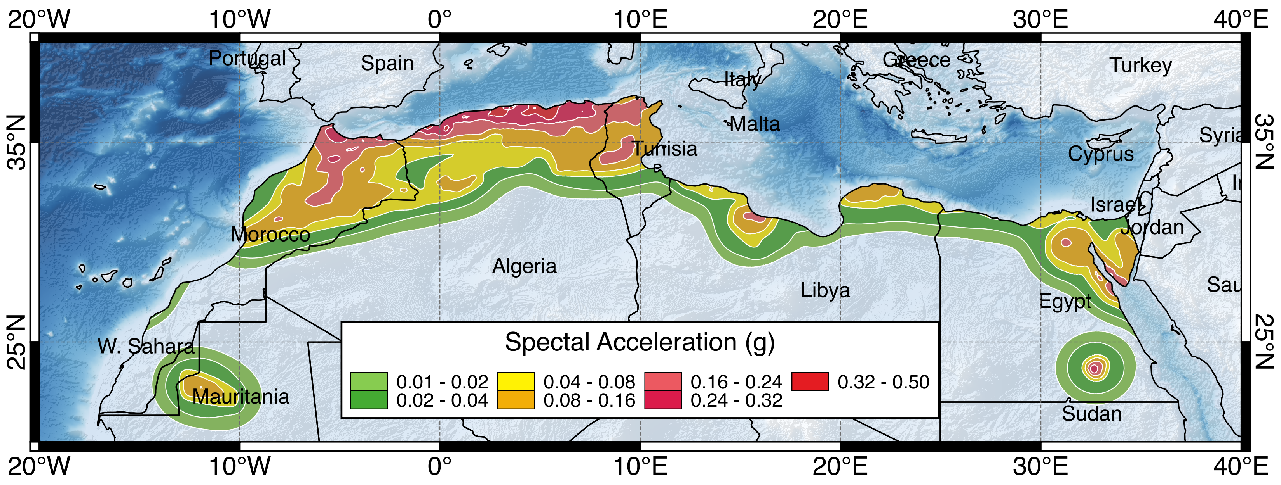
Preliminary Hazard Results
Fault Source Model
+
Area Sources (Background)
10% POE in 50 years (0.2s)
Smoothed Seismicity Model

Slide 14
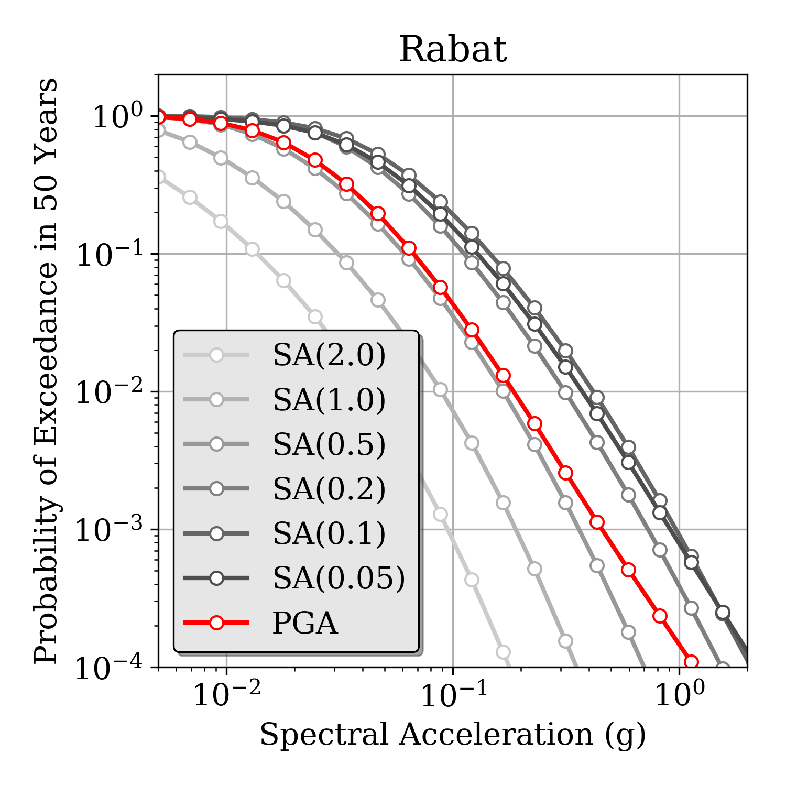
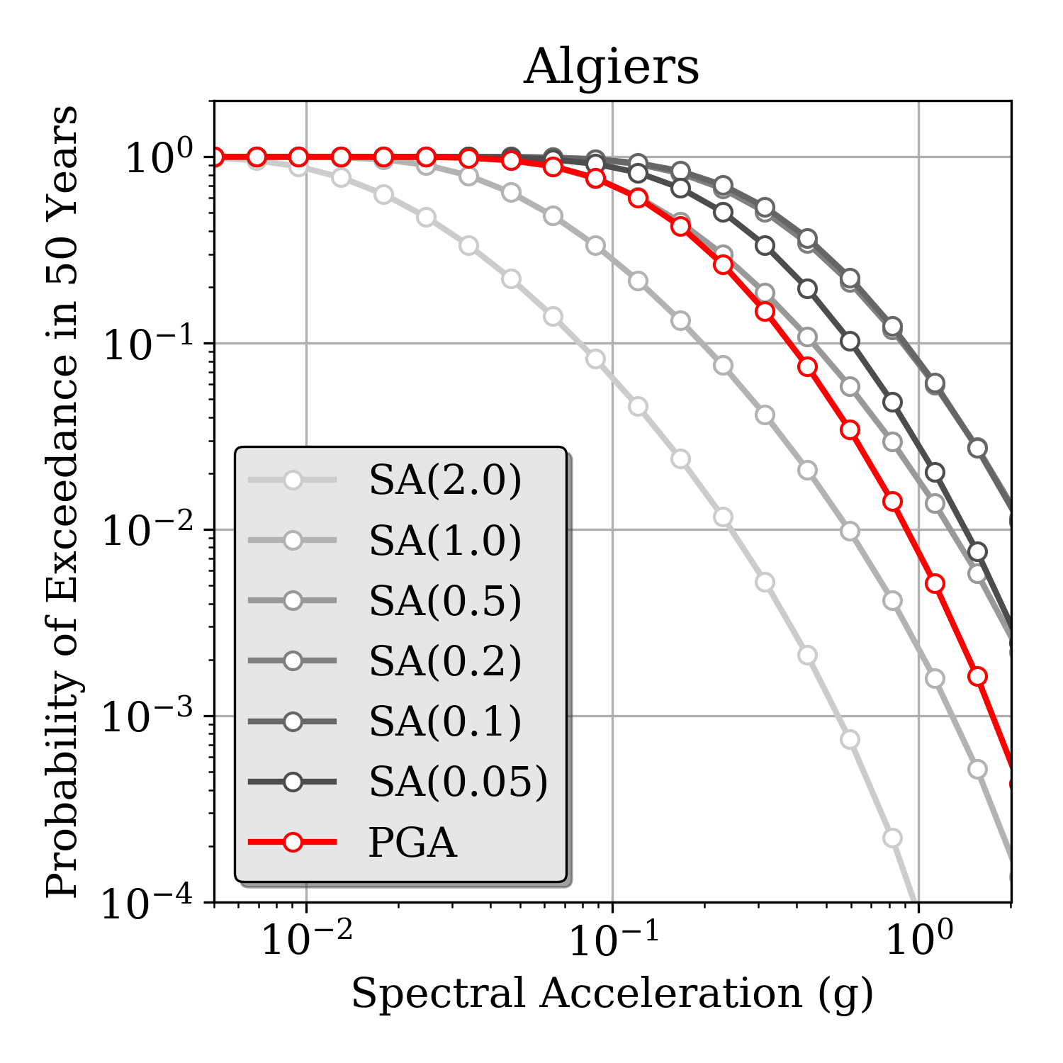
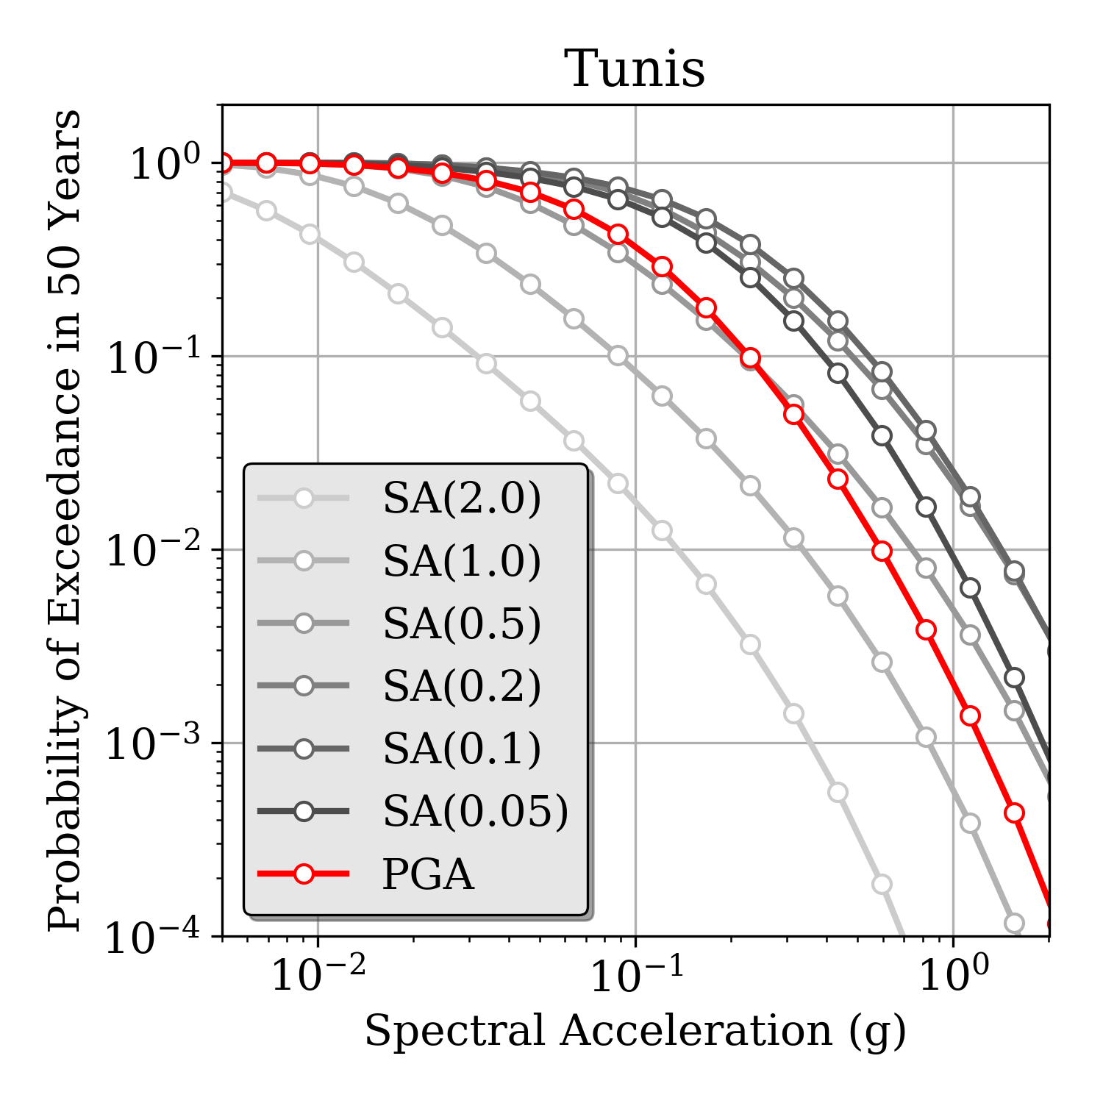
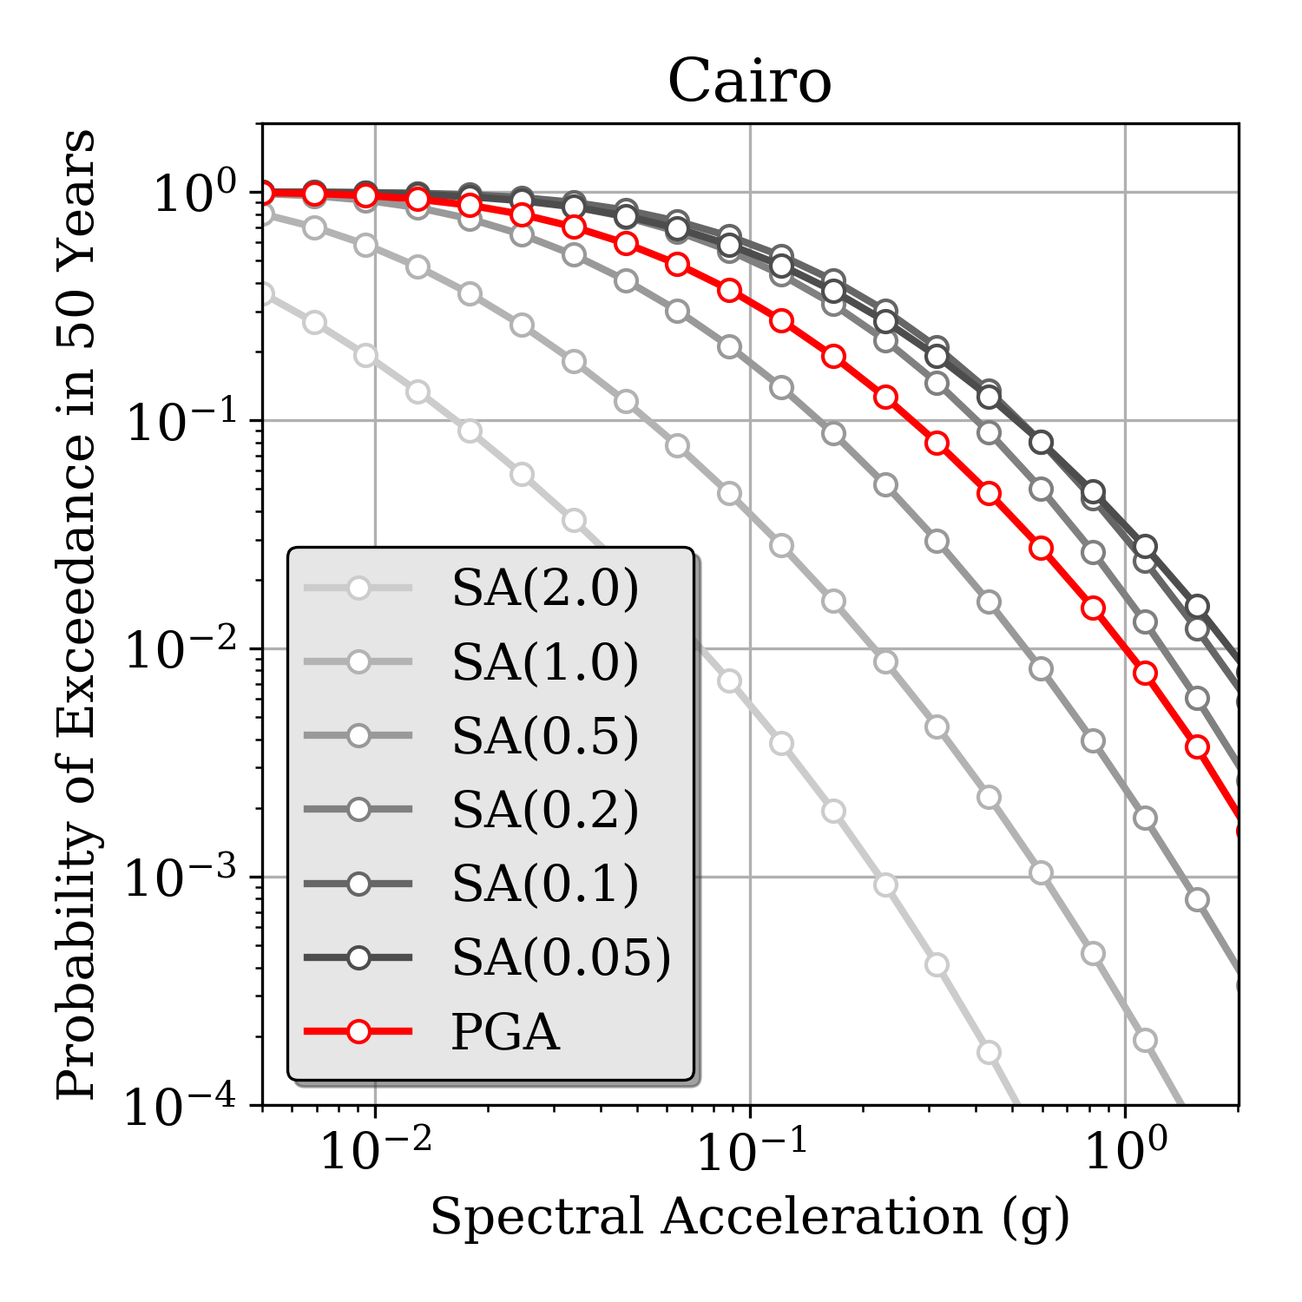
Hazard Curves @ African Capitals
Morocco
Algeria
Tunisia
Egypt

Slide 15
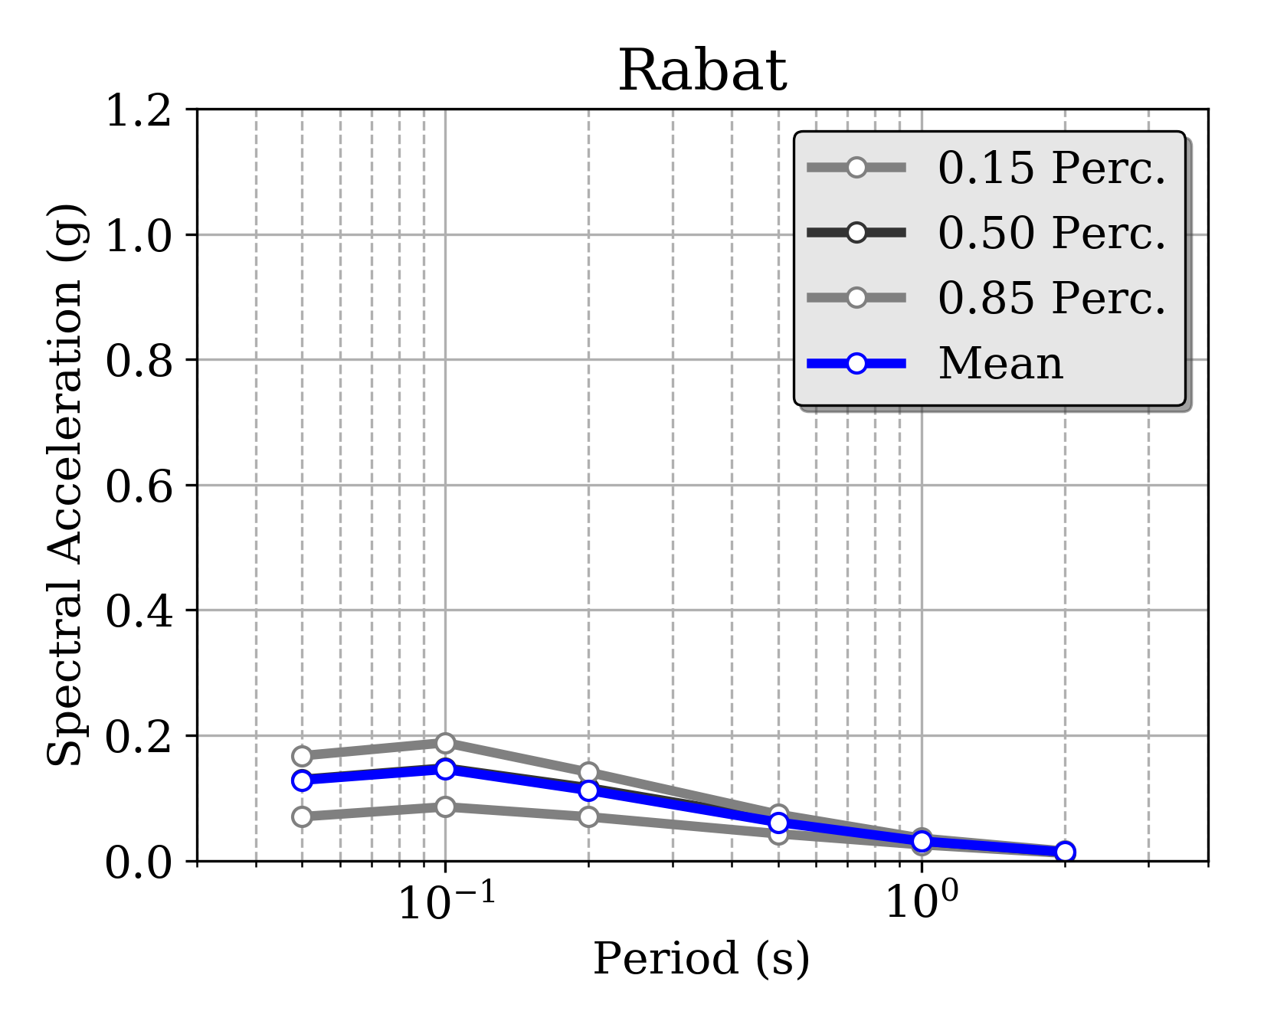
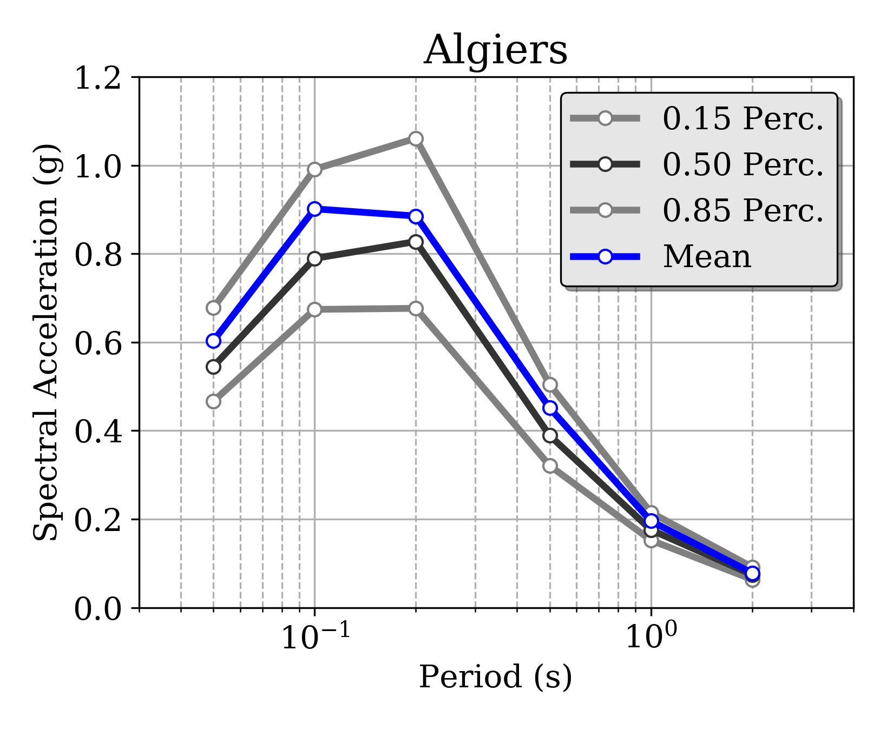
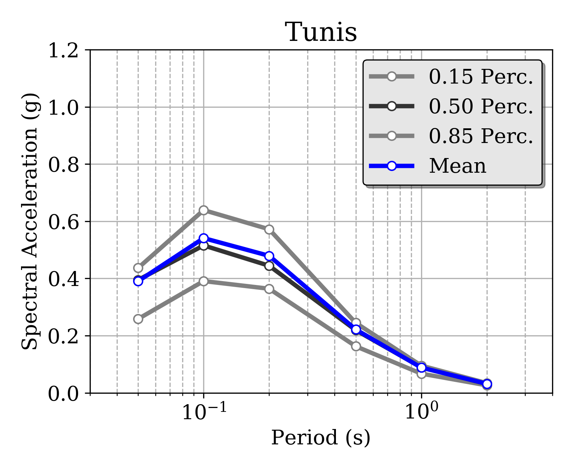
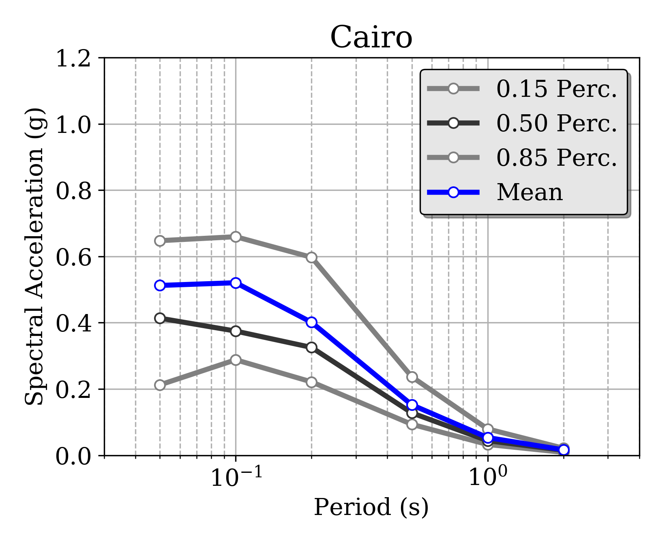
Uniform Hazard Spectra @ African Capitals
Morocco
Algeria
Tunisia
Egypt
10% POE in 50 years

Slide 16
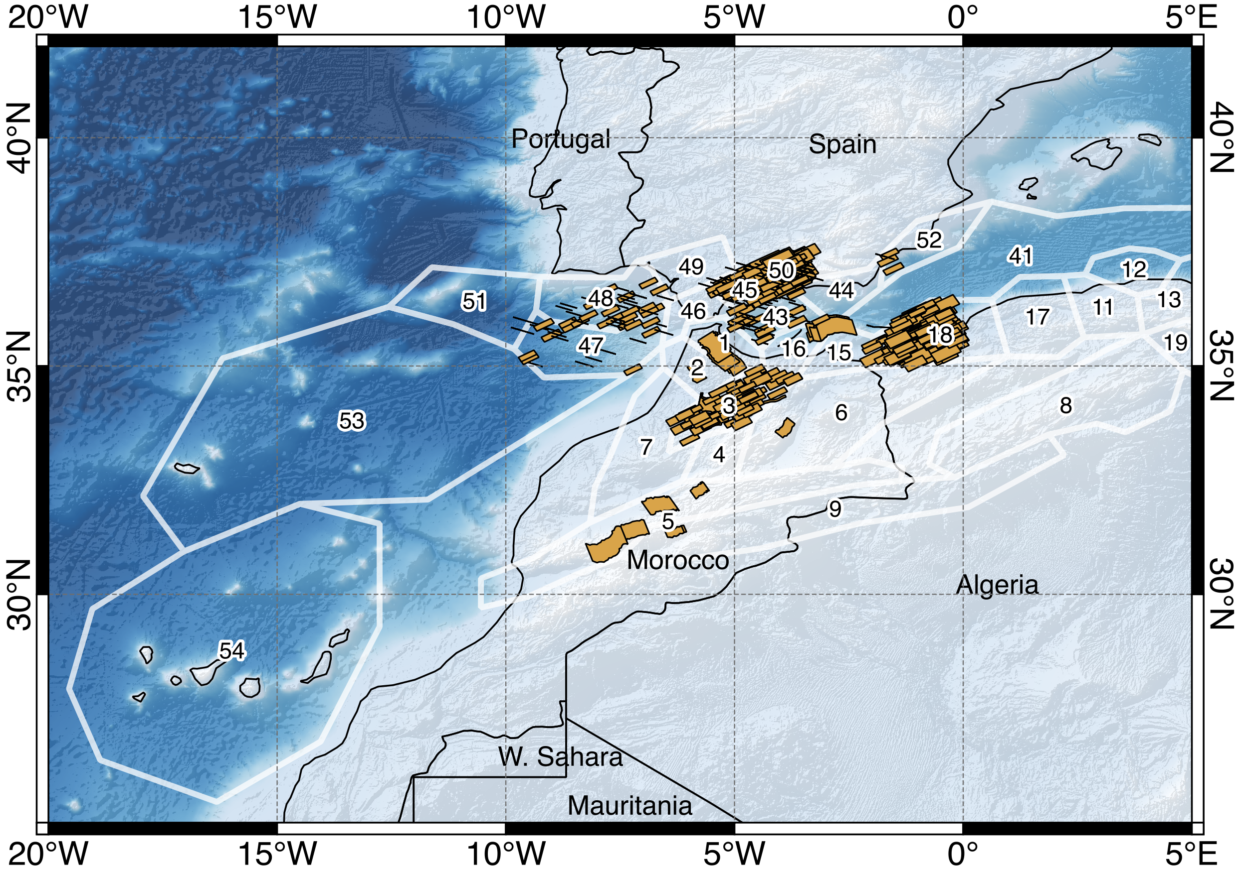
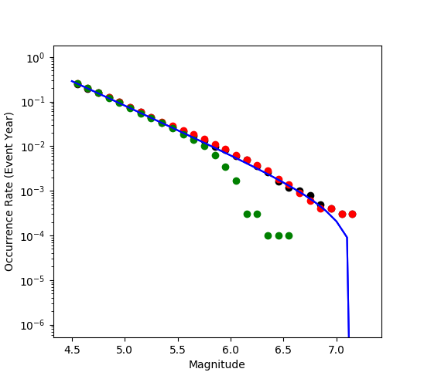
Model Verification: Stochastic Ruptures
Zone 3 – Cumulative MFD
Smoothed
Background
Catalogue MPD
Stochastic earthquake catalogue for a 10.000 years investigation time
Relevant sources have been considered for verification
Sampling of the full logic-tree
All ruptures with Mw>4.5

Slide 17
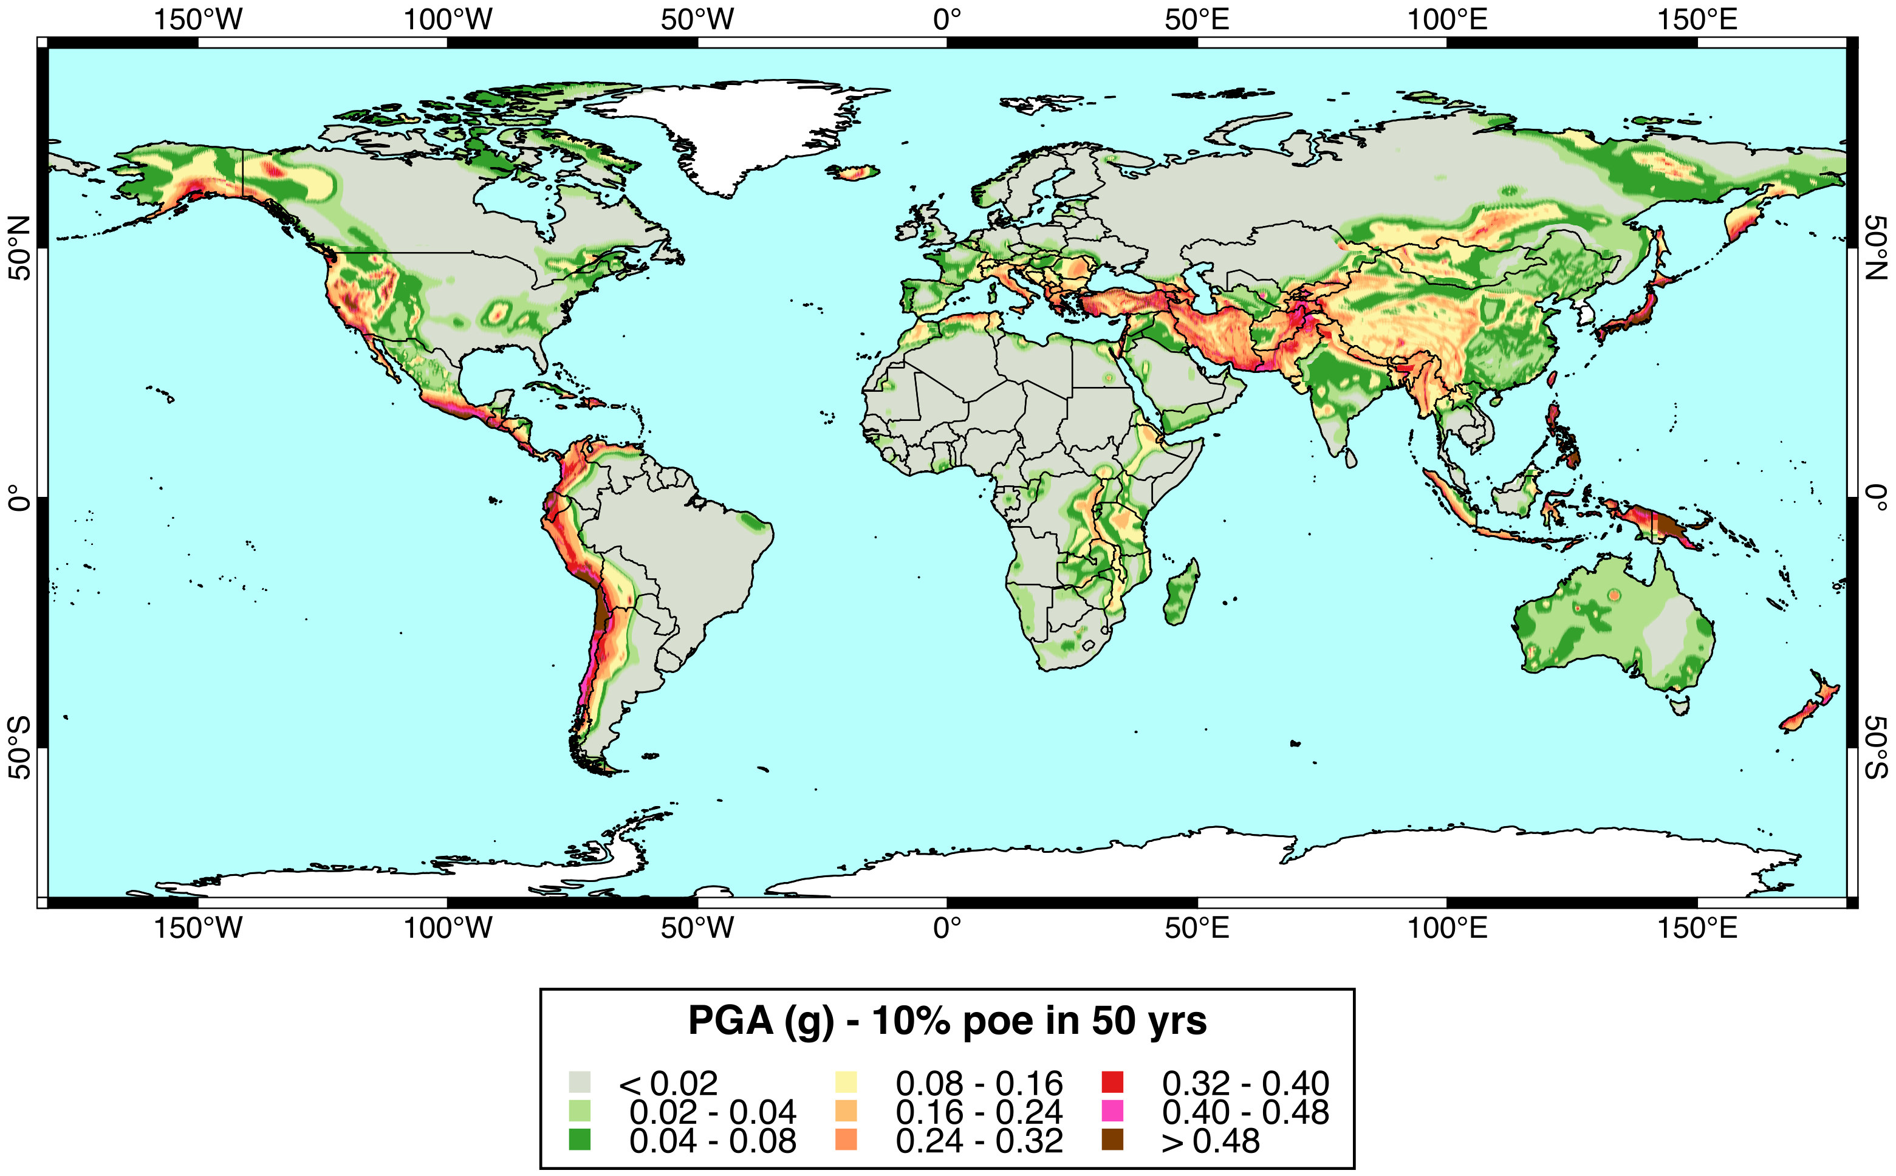
GEM Global Mosaic of Hazard Models
PRELIMINARY
PRELIMINARY

Slide 18

Missing Components / Improvements
The North-Africa Hazard model is presently just a GEM product, but it is meant to be improved and expanded with the collaboration of the African and worldwide scientific community
While existing components can be improved, many other components are still missing, such as:
Integration of local hazard studies
Strong motion recordings from local networks
Site-specific studies and microzonation
Need for a collaborative effort

Slide 19

Thank you!
  Except where otherwise noted, this work is licensed under https://creativecommons.org/licenses/by-nc-nd/3.0/
  Please attribute to the GEM Foundation with a link to
  www.globalquakemodel.org

Slide 20
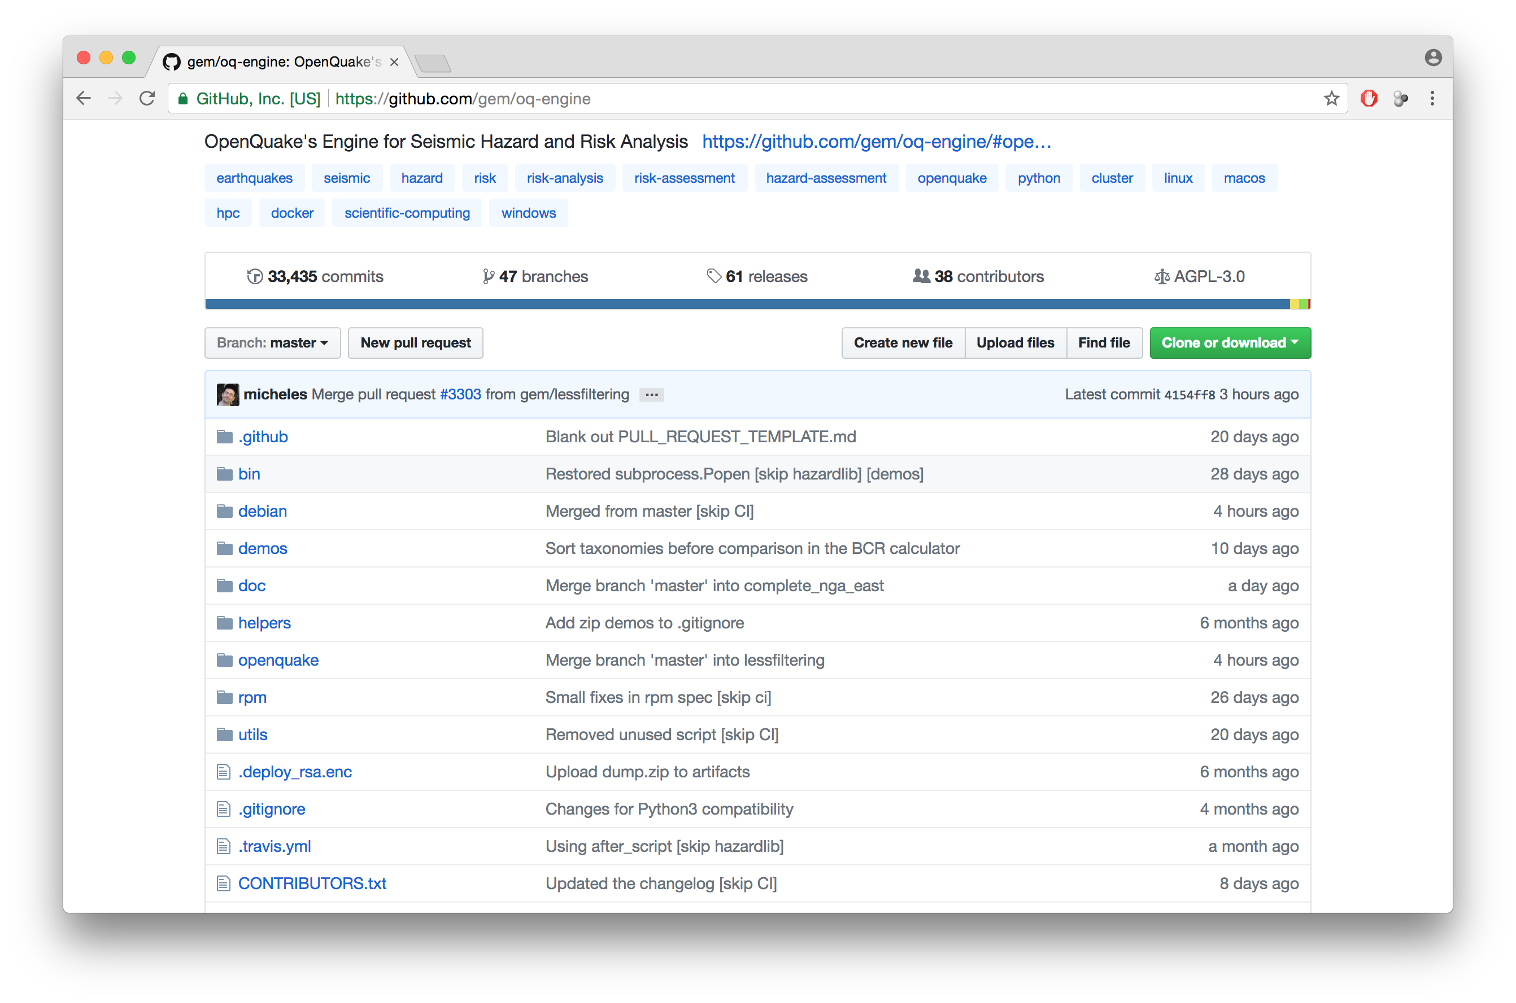
OpenQuake Engine - GitHub repository

Slide 21
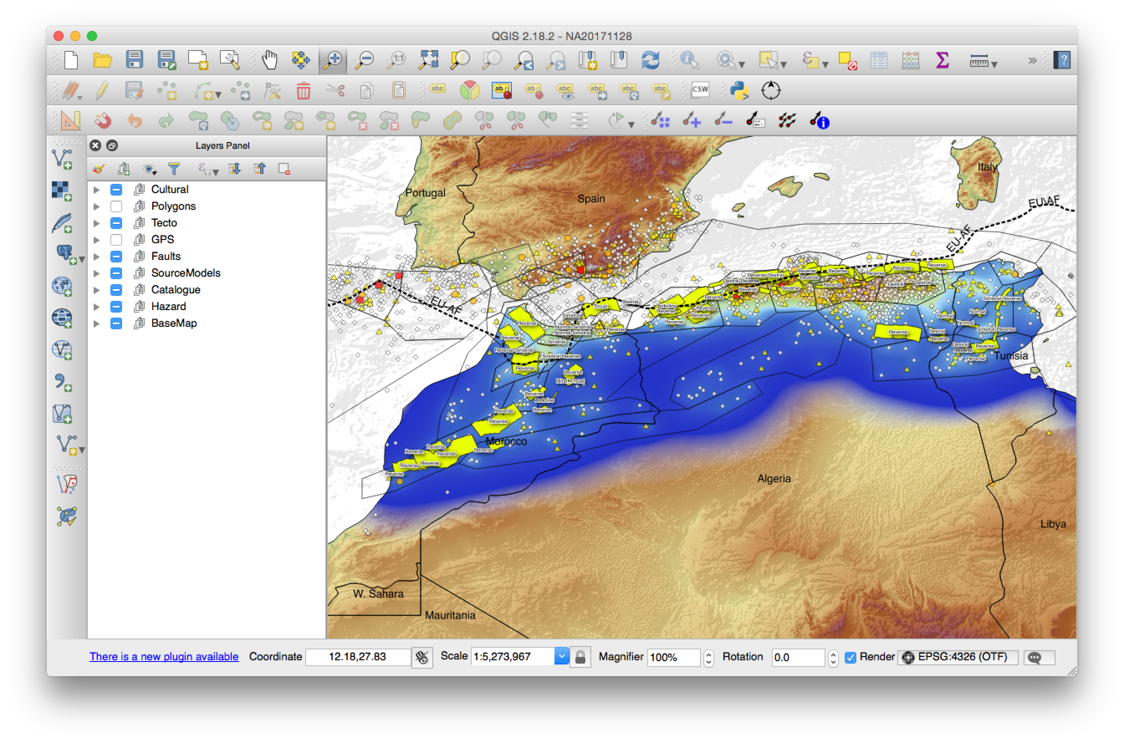

OpenQuake Engine – QGIS integration
From/To
OpenQuake
Source
Model

Slide 22
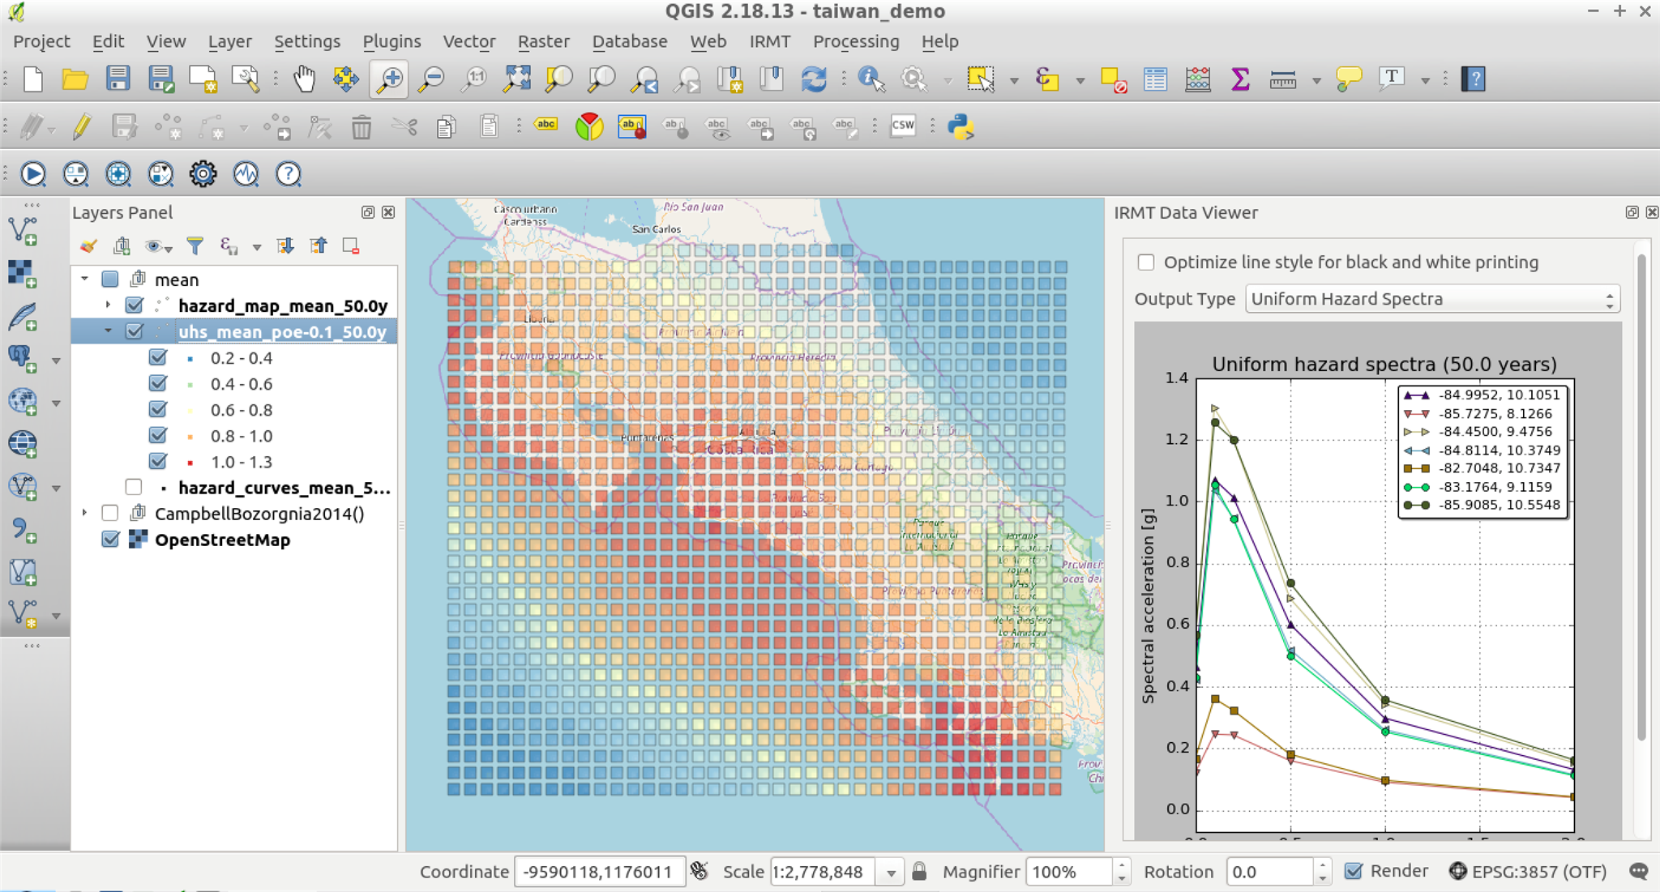
OpenQuake Engine – QGIS integration (2)

Slide 23
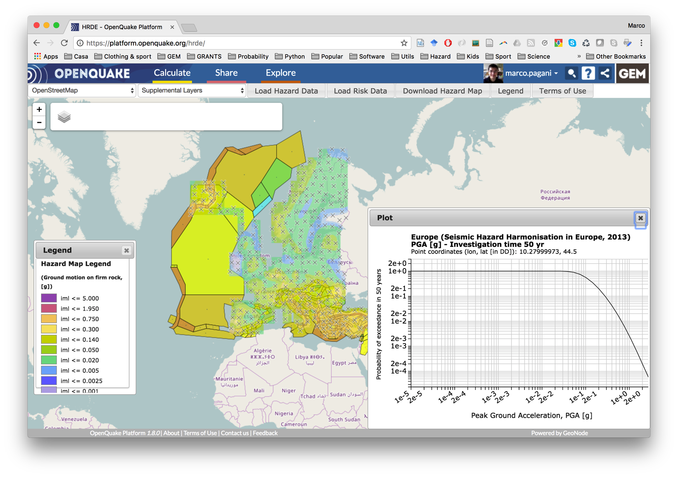
GEM Global Database of Hazard Models
http://platform.openquake.org
http://hazardwiki.openquake.org

